Slide 1
School Certifying Official
(SCO) Workshop
Veterans Benefits Administration
Education Service
AVAA
Brittany Tennant
October 2023

Slide 2
Agenda
01
Digital GI Bill (DGIB) Overview
02
Enrollment Manager (EM) Outcomes
This presentation provides an overview of Enrollment Manager updates and helpful resources for School Certifying Officials (SCOs).
03
New EM Features and Enhancements
04
Navigating EM: Tips and FAQs
05
Additional Resources
06
Questions?

Slide 3


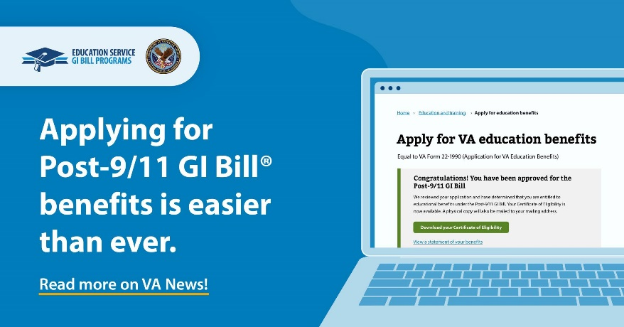
Digital GI Bill (DGIB) Overview
The U.S. Department of Veterans Affairs (VA) is on a mission to modernize GI Bill® systems and processes. The future of the GI Bill is driven by human-centered design.
Transform
DGIB is a major modernization effort to transform GI Bill operations into a digital platform.
Improve
We are on a mission to improve education benefits and customer service delivery.
Support
This will impact nearly one million GI Bill students served each year, and thousands more who support them, like you.
“I honestly didn't even realize the [GI Bill application] process had changed, it was so smooth and instantaneous!
I've already told a few of my friends who are out/getting out soon how easy the process was to apply for the Post-9/11 GI Bill and get the go ahead to apply for classes.”
- Post-9/11 GI Bill Veteran

Slide 4
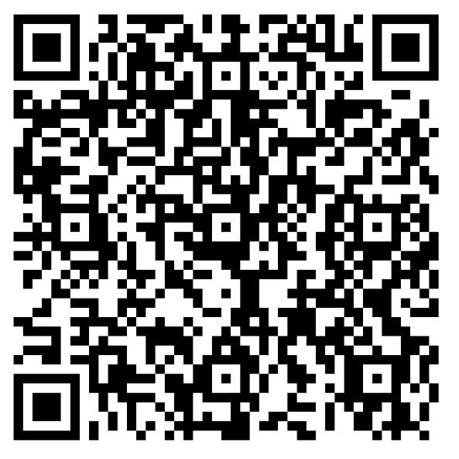
Enrollment Manager Outcomes
Feedback Form

Slide 5

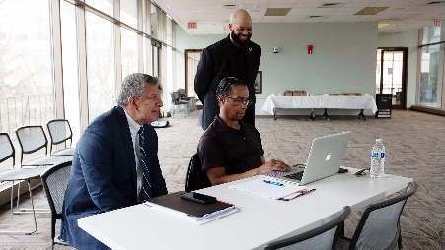
Enrollment Manager Successes
What we’ve heard from you:
“So user friendly.”
“I could put in certs all day.”
Outcomes to date:
2,955,000+ enrollment certifications submitted since EM launched
Average of 5 minutes for Chapter 33 claims to reach processing during business hours
Supplemental claims processing faster than any year prior
17,000+ distinct users from over 13,800+ institutions have submitted enrollments
Displays Chapter 33 percentages for the first time ever
Enhanced student data protection
“It’s always nice to see something updated, and the right way.”
“For us to have that [Benefits Remaining] now in Enrollment Manager is fantastic. It’s life changing.”
“This is exciting.”
Data as of 10/11/23
“Way better than VA-ONCE. The flow just makes sense.”

Slide 6
New Enrollment Manager
Features and Enhancements
Feedback Form

Slide 7


Enrollment Manager | October Updates
Deployed 178 updates on October 8, 2023. The following features and enhancements are now available in Enrollment Manager as we continue to improve the SCO experience.
Ability to export filtered student lists into a CSV file when on the Students Tab
Update to the warning message displayed when adding VET TEC enrollments
Correction to make sorting not case sensitive
Increased character limit on the Notes field
Enhancements to the View Details tab, including the ability to see the Objective, Program, Benefit Type and Enrollment ID on the View Details page without going to the Print page​
Enhancements to the Enrollment Tab, including:
  The ability to see Benefit Type under which enrollments and amendments were submitted
  The ability to see the Objective type, Program name and Benefit Type when adding an enrollment

Slide 8
Enrollment Manager | Future Updates
The following features and enhancements are planned for future system updates.
System Updates:​
  Enrollment term dates will appear in chronological order on 1999 printed PDFs
  The “Add student to school" link was incorrectly showing on newly created student pages and will no longer be displayed. Newly created students already have an active academic record aligned to the school of the SCO creating the new student
  The bio and contact information of existing students will be read-only fields. Users can add this information if they do not exist on file.
  The VR&E email address section on Benefits Tab will be enables when the benefit type is changed to Chapter 31.

Slide 9





Refinement of Custom Remarks
Custom Remarks for Chapter 33 enrollments at Institutions of Higher Learning (IHL) and Non-College Degree (NCD) facilities are no longer available in most cases.
Guidance: When adding or amending an enrollment, please select from one of the new or existing VBA Remarks as needed. Enrollments for all non-33 (Chapters 31, 30, 1606, 35), On-the-Job Training/Apprenticeships (OJT/APP) and Flight schools will still be able to use Custom Remarks.
To aid in this transition, if one of the below new VBA Remarks is selected, SCOs will be required to provide additional information.
Dual Degree Program
Incarcerated Students
Tuition & Fees in a foreign currency
Compliance Survey
Correcting previously terminated enrollment

Slide 10
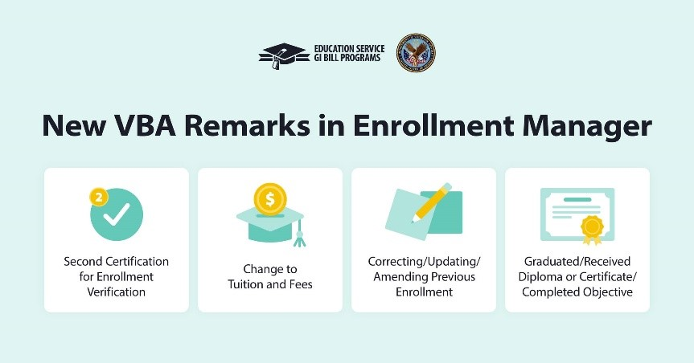
Enrollment Manager | VBA Remarks
An additional four VBA remarks were made available in August.
Pro Tip 1: For non-CH33, OJT/APP and Flight: Refrain from using Custom Remarks whenever possible and use VBA remarks instead.
Pro Tip 2: Refrain from using unnecessary remarks, as they are routinely not needed. Check the SCO Handbook to know when a remark may be required.

Slide 11

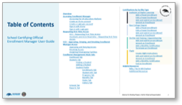
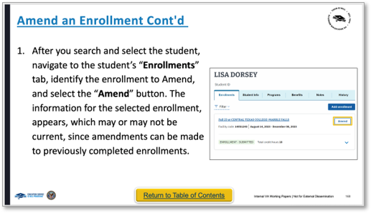
Updated Enrollment Manager User Guide
The updated EM User Guide includes improved navigation, readability and EM’s latest functionality.
Bookmark the User Guide!
1
Every slide header includes hyperlinks to the beginning of that section.
Each slide has a Return to Table of Contents yellow button to return to Table of Contents.
For sections associated with a specific facility type, an associated color coated band displays on the far left.
2
1
3
3
  Institution of Higher Learning
  Non-College Degree
  On-The-Job Training/Apprenticeship
  Flight
2

Slide 12
Navigating Enrollment Manager:
Tips and FAQs
Feedback Form

Slide 13
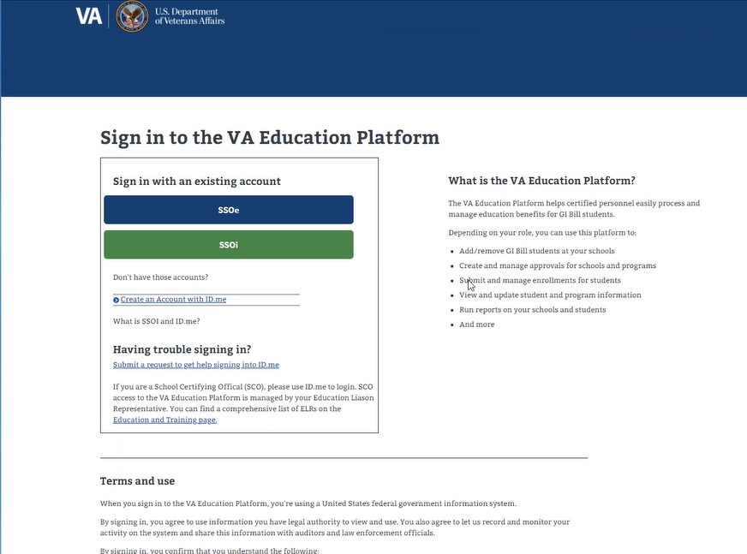
Log In Through VA Education Platform Portal
To log in to Enrollment Manager:
  Navigate to the VA Education Platform sign in page: https://iam.education.va.gov/
  Select SSOe (Note: SSOe is the external login).
  Log in using your VA.gov account verified ID.me or Login.gov.

Slide 14
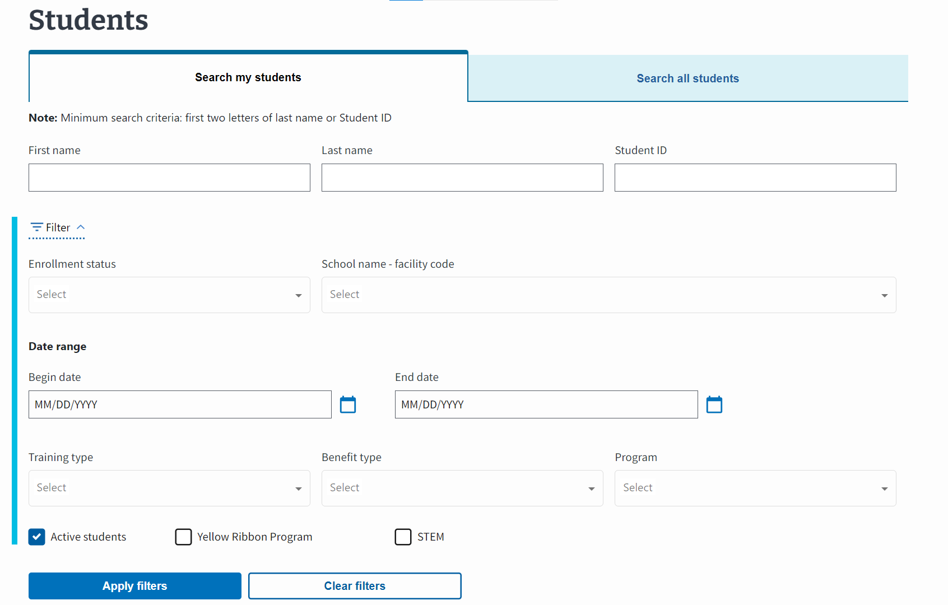
Searching for a Student
To search for a student, select the Students tab on the Dashboard Menu.
There are two ways to search for a student:
Search my students | Search all students
Searches through all students associated with your facility code(s). Search for a student by first name, last name or student ID. | Searches through all students in the VA database. Search for a student by first name, middle name, last name, email, phone number or date of birth.
Note: When searching all students, the first two letters of the last name or date of birth is required.
Tip: Try searching for a student under a previously known name (if they recently got married, divorced, changed their name, etc.)

Slide 15
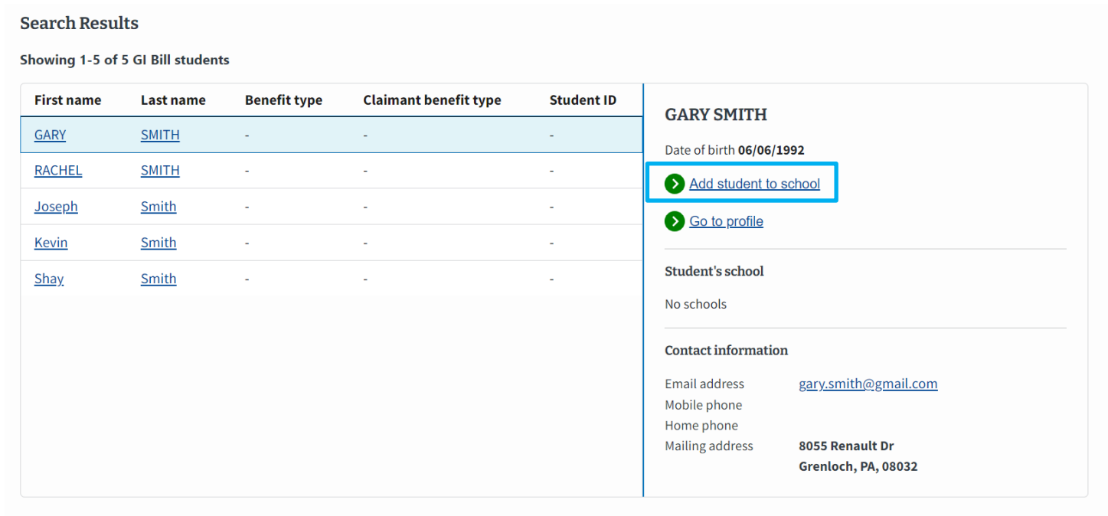
Adding a Student to a School
If a student has not been added to a school, you will see the link to “Add student to school”.
Search for the appropriate student.
Select the “Add student to school” button.
Disclaimer: All staged data shown is false and intended for training purposes.

Slide 16
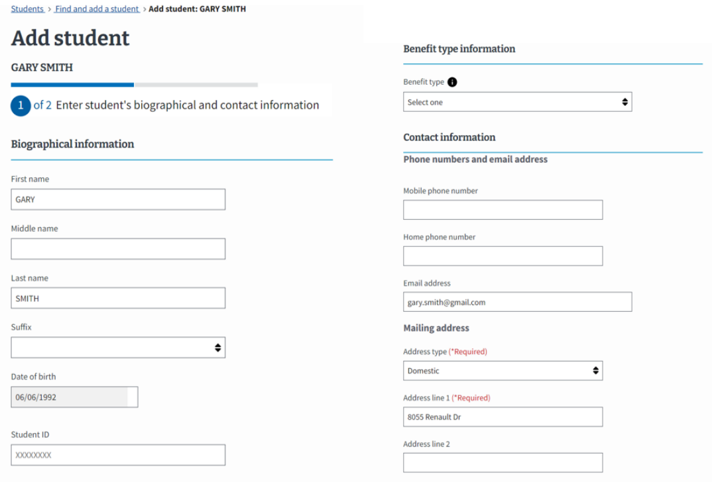
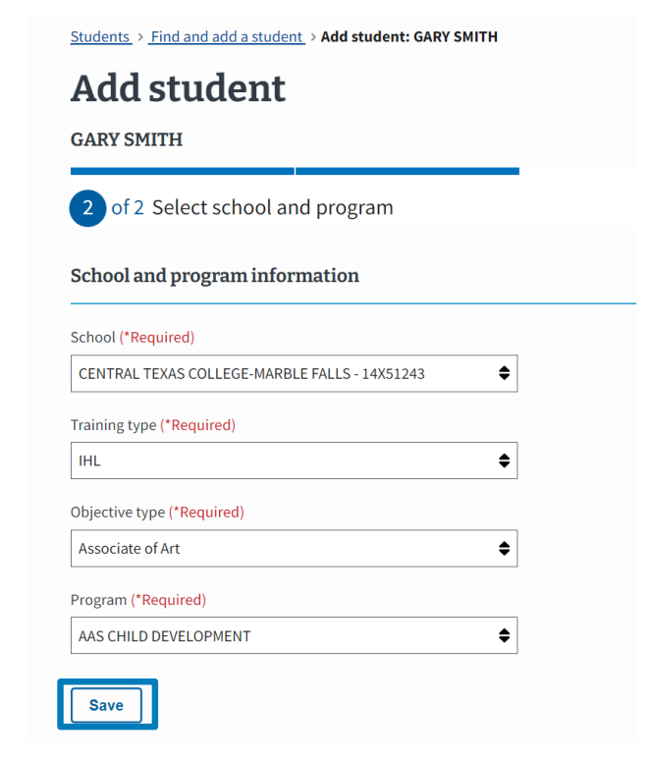
Adding a New Student
Enter the corresponding school and program information.
Disclaimer: All staged data shown is false and intended for training purposes.

Slide 17
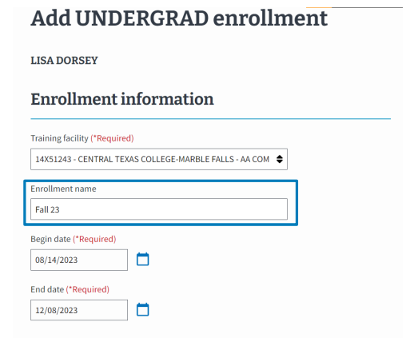
Add and Submit an Enrollment
Search for the appropriate student.
Highlight the student and select “Go to profile” or double click.
Choose the “Add enrollment” button.
Enter the student enrollment and tuition information. Input vacation periods, if applicable.
Select “Submit enrollment.”
  Add a Note to share key information with other SCOs.

Slide 18
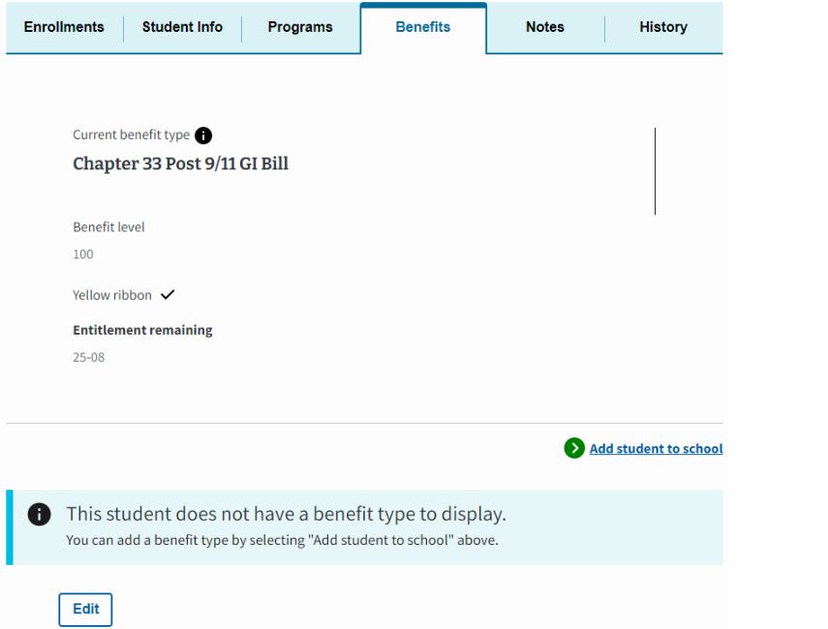
Add an Inactive Students Guidance
If the “Add enrollment” button is grayed out or disabled in the Enrollments Tab, it may be due to one of the following:
The student existed at your school but was inactive in VA-ONCE
The student was inactive at a different school
The program card is inactive
To add an inactive student to a school:
Navigate to the Benefits tab to update the benefit type.
Select the Add student to school link in the bottom right-hand corner.
Enter and submit all the required information as if you are adding a brand-new student and associate the school.
Then, the Add enrollment button under the Enrollments tab is enabled.

Slide 19
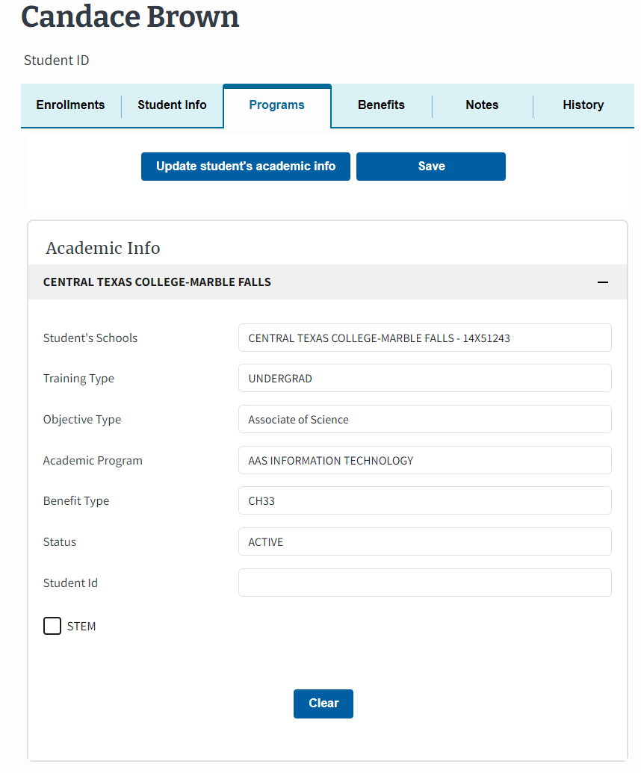
How to Change a Student’s Program or School
To make changes to a student’s program or school:
Select the Update student’s academic info button and then select Add another school button.
In the Additional school and program section, select the appropriate dropdown option for the School, Training type, Objective type and Program fields.
Once you have made your selection, then select Save this school.
Click Submit.
Disclaimer: All staged data shown is false and intended for training purposes.

Slide 20
Enrollment Manager | Frequently Asked Questions
How do I remove my personal email from displaying in EM?​
To change the email that appears on the enrollment certification printout, please contact the SCO Hotline at 1-888-442-4551 and provide the representative with your facility code, incorrect email address and correct email address.
Why does EM time out after 15 minutes of inactivity? ​
To keep Personal Identifying Information (PII) secure, EM times out in 15 minutes of inactivity to align with VA’s security requirements.
Why is a Program/Objective code required for a Guest Student?
When a SCO clicks the Guest Student checkbox, the Program will auto populate as Guest Student. The Objective is required to ensure the right fields are shown and that auto-processing is done correctly.
Can SCOs add programs manually?
There is not a way for SCOs to add programs in EM. The Web Enabled Approval Management System (WEAMS) feeds all programs to EM and once a program is added to WEAMS it should be available in EM the next day.
If you have a program that is not listed in WEAMS that has received approval in the past, contact the Education Liaison Representative (ELR) of jurisdiction. If you have a new program that needs to be approved, contact the State Approving Agency (SAA) of jurisdiction.

Slide 21
Enrollment Statuses: VA-ONCE To EM
Previously in VA-ONCE | Enrollment Status | Definition
1 - Student Added | N/A | There is no status for students who have not been created in Enrollment Manager.
2 - Cert in Progress (Draft) 3 - Cert Completed | In Progress | Enrollment/Amendment/Certification is in draft state.
2P - Cert Pending Approval (Draft) | Pending SCO Review | Draft must be verified and submitted by a SCO.
3x - Ch 31 Cert Submitted 4x - Ch 33 Cert Submitted 4 - Ch 30, 1606, 1607, 32, 35, 901, 903, OJT/APP & FLIGHT (all chapters) | Submitted | Enrollment/Amendment/Certification was sent for processing.
5M - (Ch 33, 1606,...) Cert Reviewed for Manual Processing | Under Review | Enrollment/Amendment/Certification was off-ramped for manual review. **Flight/OJT/APP, and many non-33 remain In Under Review status indefinitely.
5A (Ch 33) Cert Award Processed by ECAP 5D (CH33) Cert Award Processed Automatically 5E - (Ch 33) Cert Reviewed for Manual Processing 5X (Ch 31 Cert) Accepted by VR&E | Processed | Enrollment/Amendment/Certification has been processed.
5r (Ch 31) Rejected by VR&E System | N/A | There is no automated processing in Chapter 31.
Notes:
Another question we get is how do I know what the status of the enrollment is in EM?

Slide 22
Enrollment Manager | Frequently Asked Questions
Is there a way to amend a monthly certification for OJT/APP if a mistake is made?
EM cannot replace a monthly certification. If an error is found, the SCO should add the correct information as a Custom Remark on a subsequent monthly certification.
For example: It was discovered while certifying the hours for August that 12 hours were certified for June. 120 should have been certified for June. On the August monthly cert, add a remark such as "June hours reported as 12. Correct June hours is 120".
Why do OJT/APP enrollment certifications show Pending review after submitting an enrollment? This leaves SCOs not knowing if the enrollment has processed.
OJT/APP enrollment certifications are manually processed, and the system doesn’t currently return processed enrollment information to EM.
Even when certifications are Processed, the enrollment continues displaying Under Review. There are future enhancements to Enrollment Manager that will correctly display enrollment statuses when processed.

Slide 23






Enrollment Manager Tips and Reminders
Guidance for submitting enrollments
When submitting enrollments for students at separate facilities for the same dates, please submit the enrollments at extension campuses using manually entered dates.
Entering a double major?
Select one major and use the VBA standard remark “Dual Degree Program” to note the second major.
Wait 10 minutes before amending original enrollments
When submitting original enrollments at multiple facility codes for the same student, wait 10 minutes before amending any of these enrollments.
Correcting a previously terminated enrollment
Currently, there is no way to edit a terminated enrollment in Enrollment Manager. Use this VBA remark “Correcting Previously Terminated Enrollment” when necessary for a terminated enrollment that needs to be updated.
No more paper, PDF or hardcopy enrollments
Exceptions may apply for programs or training types not supported by EM, including Correspondence Training, Chapter 32, restricted foreign school locations, students without a social security number and facilities permitted to teach-out of existing students.
Review updated EM 100, 101 and 102 trainings
With the new school year in progress, review EM capabilities and complete any trainings if you haven’t already.

Slide 24
SCOs Should:
SCOs Should Refrain From:
Double check the Program tab to make sure it displays the correct Training Type, Objective Type, Academic Program, and Benefit Type
Pay close attention to confirm Chapter 31 enrollments are being submitted as Chapter 31.
Inputting false numbers in the Social Security Number (SSN) field for students who do not have an SSN
Using Custom Remarks when a VBA remark applies for non-CH33, OJT/APP and Flight

Slide 25
Additional Resources and Annual Training Reminders
Feedback Form

Slide 26
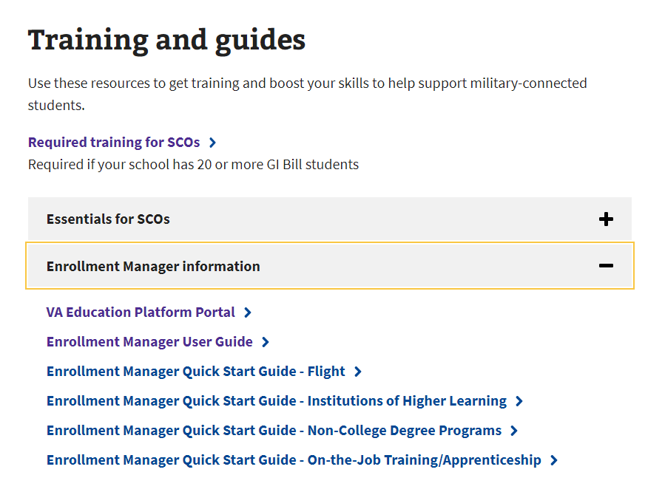
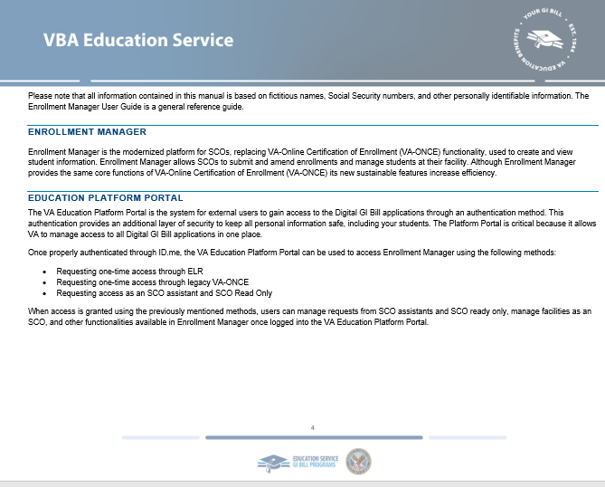
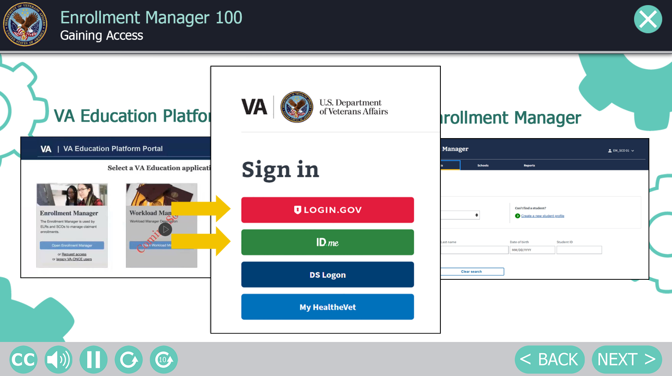
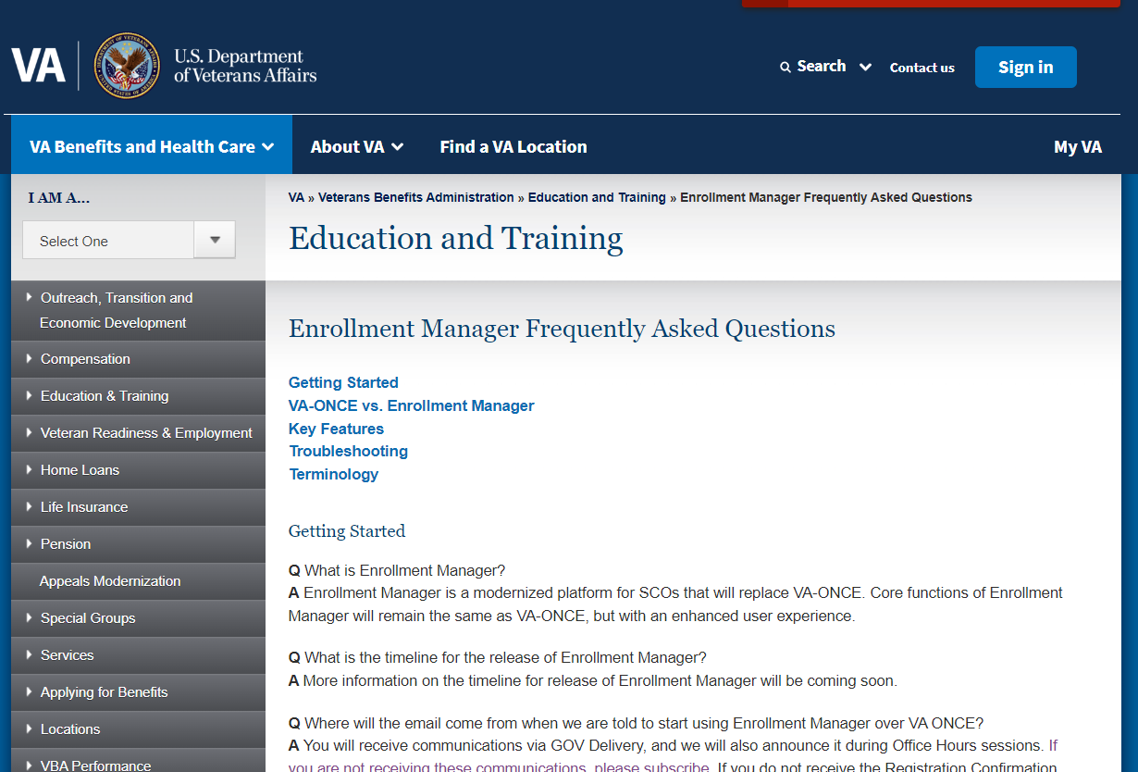
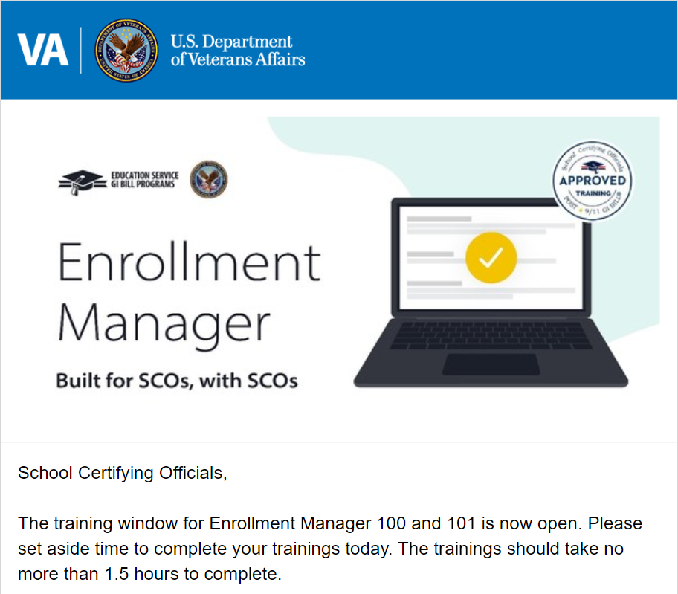
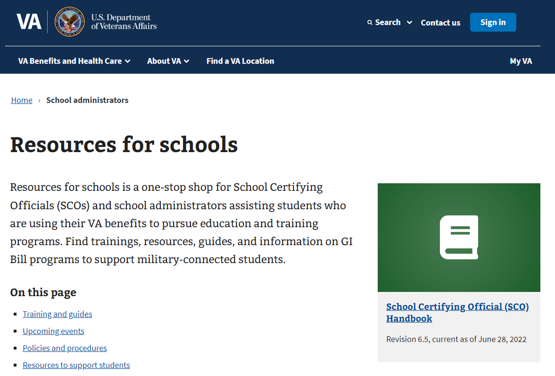
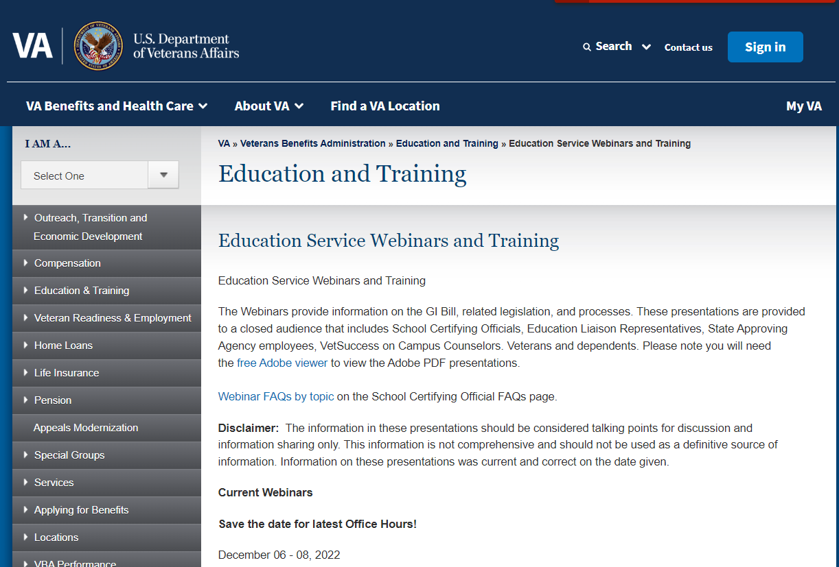

Enrollment Manager | Resources Overview
The following materials can be referenced for further information:
00
IHL Quick Start Guide
SCO EM User Guide
SCO Training Portal
FAQs and System Updates
Chatbot Video and Social Posts
Office Hours
GovDelivery Emails
Web Updates

Slide 27
Annual Training Requirements Roadmap (FY2024)
October 1, 2023
1
Annual Training window opens. Updated training requirements are effective.
2
June 1, 2024
90-Day Training Alert: Reminders for the August 31st Existing SCO training deadline sent via GovDelivery and posted on GI Bill website.
4
August 1, 2024
July 1, 2024
3
30-Day Training Alert: Reminders for the August 31st Existing SCO training deadline sent via GovDelivery and posted on GI Bill website.
60-Day Training Alert: Reminders for the
August 31st Existing
SCO training deadline
sent via GovDelivery and posted on GI Bill website.
August 15, 2024
5
15-Day Training Alert: Reminders for the August 31st Existing
SCO training deadline sent via GovDelivery and posted on GI Bill website.
6
August 31, 2024
Annual Training window closes. Training requirements for Existing SCOs must be complete.
September 1-30, 2024
7
Existing SCOs: No training in progress.
New SCOs: Continuous training throughout year.

Slide 28
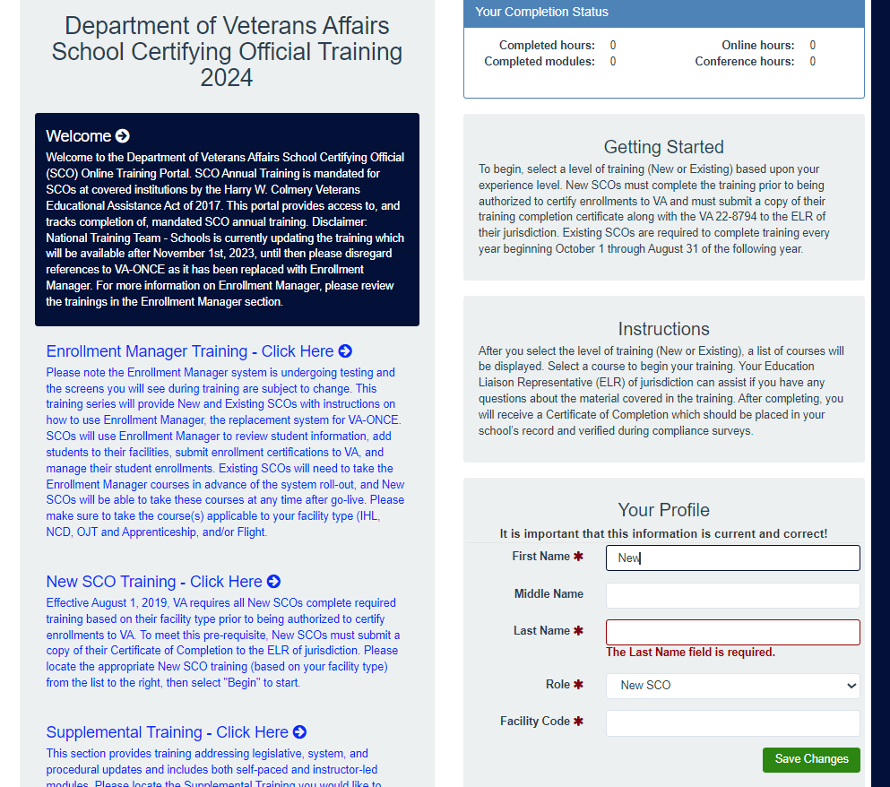
SCO Annual Training Portal (FY 2024)
Non-College Degree Facilities
For Portal access, click here: Live Assessments (vbatraining.org)

Slide 29
Training Self-Certification Steps
Step 6
Enter the Date of Training, then click “Submit”.
Step 4
Verify you have selected the correct training session, then click “Continue”.
Step 2
Select one:
Office Hours
Conference Sessions
Supplemental Training
Step 7
Download your results and keep the certificate for your records. page.
Non-College Degree Facilities
Step 5
Click “Yes” to certify you have completed 100% of the training. Click “Submit”.
Step 3
Locate the applicable session and click “Begin”
Step 1
Login to the SCO Annual Training Portal.
Live Assessments

Slide 30
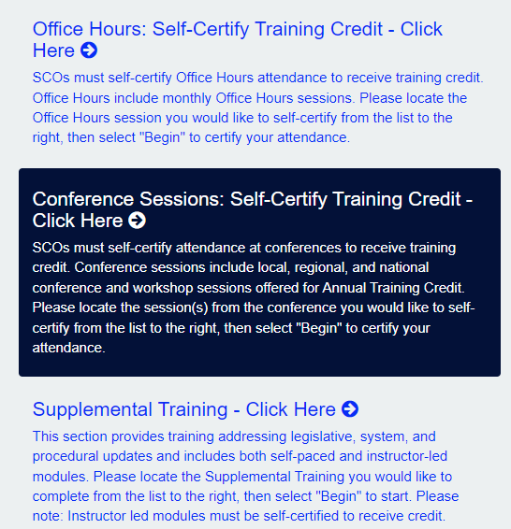
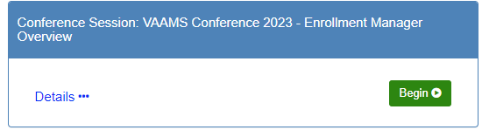
Conference Session Self-Certification
Example:
Non-College Degree Facilities

Slide 31
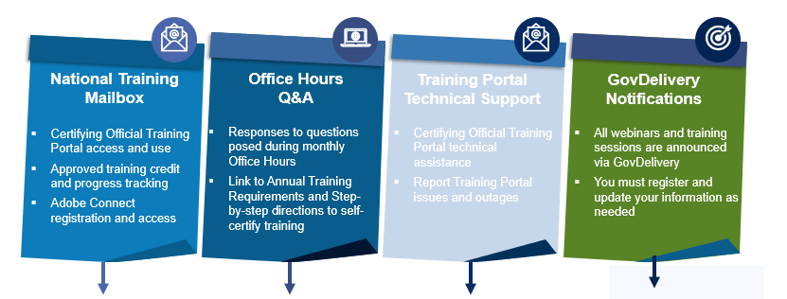
Annual Training Resources
Non-College Degree Facilities
edutraining.vbaco@va.gov
Office Hours Q&A Webpage
support@VBATraining.org
  GovDelivery
GovDelivery Support

Slide 32
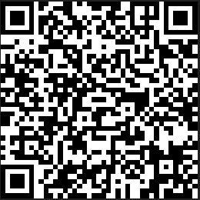
Feedback Form
Presentation Feedback
Education Call Center:
1-888-442-4551
SCO Hotline representatives available 8 a.m.-5 p.m. ET
Questions?

