Slide 1
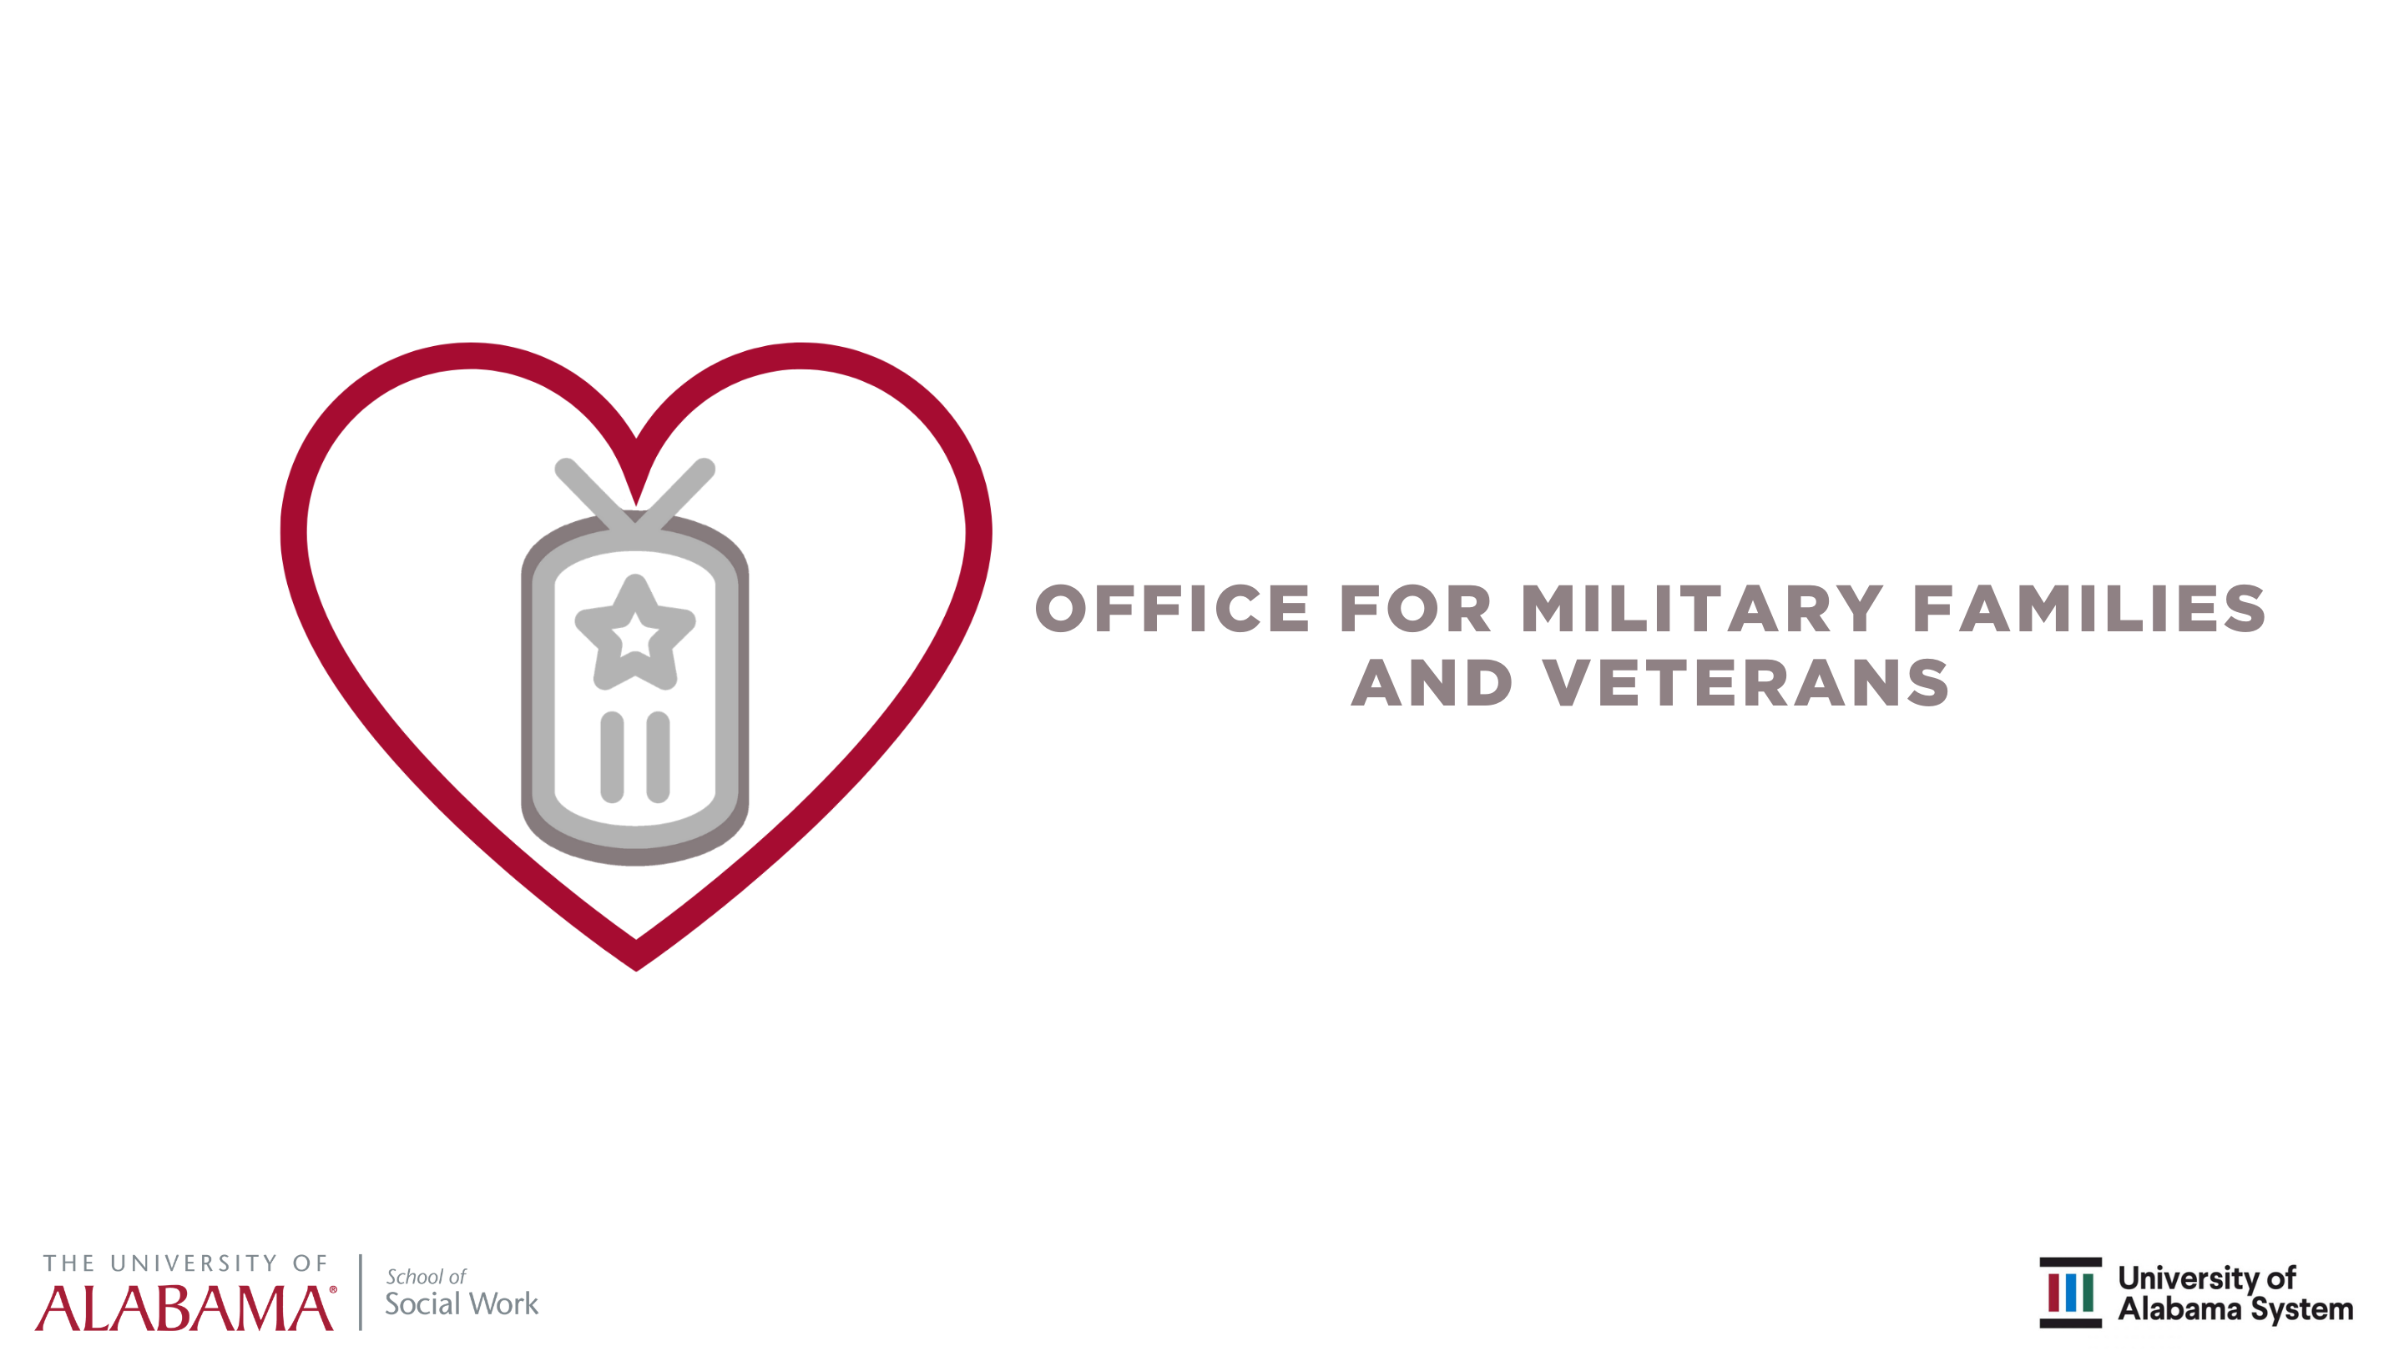
The State of Alabama
GI Bill School Certifying Officials Challenges and Concerns
Report
AAVA Conference
October 15-17, 2019
Dr. David Albright, Dr. Josephine Pryce, and Krystal Dozier

Slide 2

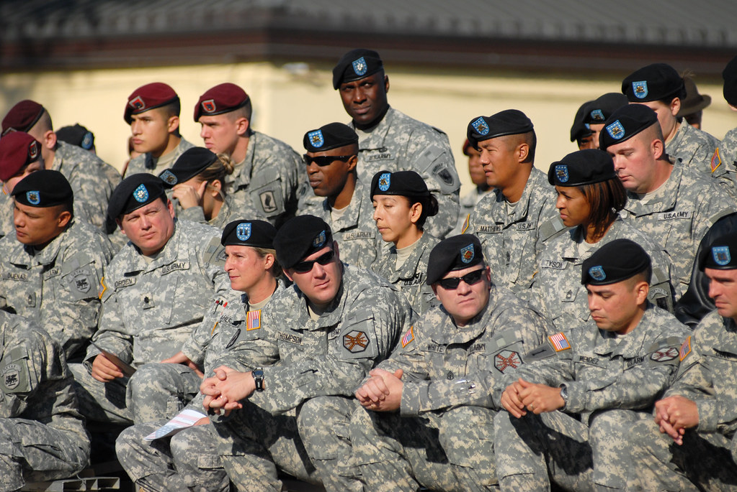

Office for Military Families and Veterans
School of Social Work
The University of Alabama
October 16, 2020
The survey was conducted to support the work of the
Alabama State School Certifying Officials (SCO’s).
The survey addressed the challenges and concerns related
to their work with GI Bill recipient students.

Slide 3
Finding 1: Increase Institutional Support
SCO’s need better institutional support.
Administrators of higher education do not understand the complexities of certifying each student using the GI Bill and its various chapters.
SCO’s may have multiple university duties that compromise their ability to dedicate the necessary time to GI Bill students’ certification and their academic support needs.

Slide 4
SCO’s Responses
“As an SCO that has an office in the registrar’s office my duties expand beyond SCO duties. It is a task just trying to explain my SCO duties come first to supervisors. My title is VA Coordinator/Records Specialists.”
“Misconception by administrators that certifying students is quick and easy so they pile additional duties on top of those duties.”
“For smaller schools with no dedicated VA support office this function is tacked on as “…and other duties as assigned”. There is no institutional support or resources (comes out of office budget which is to support other functions).”

Slide 5
SCO’s Responses
“Expected to do everything VA related on top of other duties …without adequate compensation.”
“The administrators do not understand what I have to do to get students certified on time.”
“Not enough help and no one at the school understands that certification is not a one-time event.”

Slide 6
Finding 2: Student Lack of Knowledge
GI Bill students who do not understand their education benefits challenge SCO’s work.
Some students do not understand the requirements for certification, the documents needed, and the limitations of funding for tuition and expenses.
These students’ expectations are incongruent with what the GI Bill allows.

Slide 7
SCO’s Responses
“Students arrive at institution with a lack of misinformation (no information)
about benefits for which they are eligible. Results in disappointment and ill
will.”
“They don’t understand their benefits and how much they will owe that the GI Bill doesn’t cover.”
“They don’t know what benefits they receive or how it pays. They are not
knowledgeable about how the program works and that it is an education program.”

Slide 8
Finding 3: Student Transition Assistance
SCO’s encounter students who do not understand the academic culture and its educational requirements towards completing a degree.
Military culture does not translate to being able to navigate an academic culture.
GI Bill students would benefit from specialized academic advising and career guidance at their schools.

Slide 9
SCO’s Responses
“Knowing what program of study to pursue (younger vets and dependents); Too many program changes; wasting benefits.”
“There is no education by the military to educate those getting out about how to apply and use their benefits.”
“Probably not having a space for VA students to be with and study with and gather with other vets.”

Slide 10
Finding 4: First-Generation Students
SCO’s were largely unfamiliar with students being “first-generation” college students, which some GI Bill students are.
Literature increasingly points out that these students face challenges navigating the academic environment and many drop out due to a lack of knowledge regarding academic demands and expectations.
First-generation students need to be identified and provided ongoing support and guidance to degree completion.

Slide 11
SCO’s Responses
“Unknown”
“?”
“A Majority”
“25% to 90%

Slide 12
Finding 5: In-state Tuition
SCO’s favor in-state tuition for GI Bill recipients.
It would lessen the stress of transition for military service members, veterans, and their dependents deceasing the need for supplemental income.
It would also decrease yellow-ribbon administration and increase SCO productivity elsewhere.

Slide 13
SCO’s Responses
“Absolutely, after service members serve our country each state should give back to that soldier and their dependents.”
“Yes, these students often live were assigned or stationed. Also, military service members and vets deserve the least amount of stress, as well as the greatest chance to be -successful in order to re-acclimate to civilian life. Charging in-state will help with these issues.”

Slide 14
Finding 6: Recruitment
SCO’s point out that in-state tuition would make the state of Alabama competitive with other states who offer in-state tuition.
It would be advantageous for recruiting GI Bill students to the state.
In-state tuition would affirm Alabama’s commitment to veterans.

Slide 15
SCO’s Responses
“Yes, it would make Alabama more competitive.”
“Yes, less yellow ribbon to certify…This may make others want to come to our school.”
“Yes, I think it would benefit the students and make more want to come to Alabama for school.”

Slide 16
Office for Military Families and Veterans
School of Social Work
The University of Alabama
Contact David Albright at dlalbright@sw.ua.edu
for additional input or questions
Many thanks to the State Certifying Officials who filled out the survey.

