Slide 1

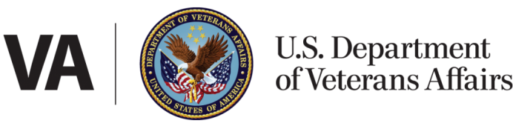
Education Service
School Certifying Official Training
LESSONS LEARNED
VA Debt Management Center
(DMC)

Slide 2

Learning Objectives
Upon completion of this module, you should be able to:
1.
Provide an overview of DMC
Assess why/how debts are established
2.
3.
Define collection processes
4.
List options to resolve a debt
5.
Define risks of non-payment
6.
Formulate responses to debt questions

Slide 3
DMC Overview
DMC Mission:
Provide distinctive, high quality accounts receivable services through a compassionate and value-added approach, empowering our stakeholders to focus on core missions.
1
DMC is a franchise fund aligned with VA’s Office of Finance (OF) within the Office of Management (OM)
2
DMC’s staff of approximately 300 employees works to service VA benefit debts, counsel Veterans on options and outcomes, and offer resolutions for each unique situation.
3
DMC provides accounts receivable services to VBA, VHA, NCA
4
The DMC collection services collects approximately $1.6 billion annually

Slide 4
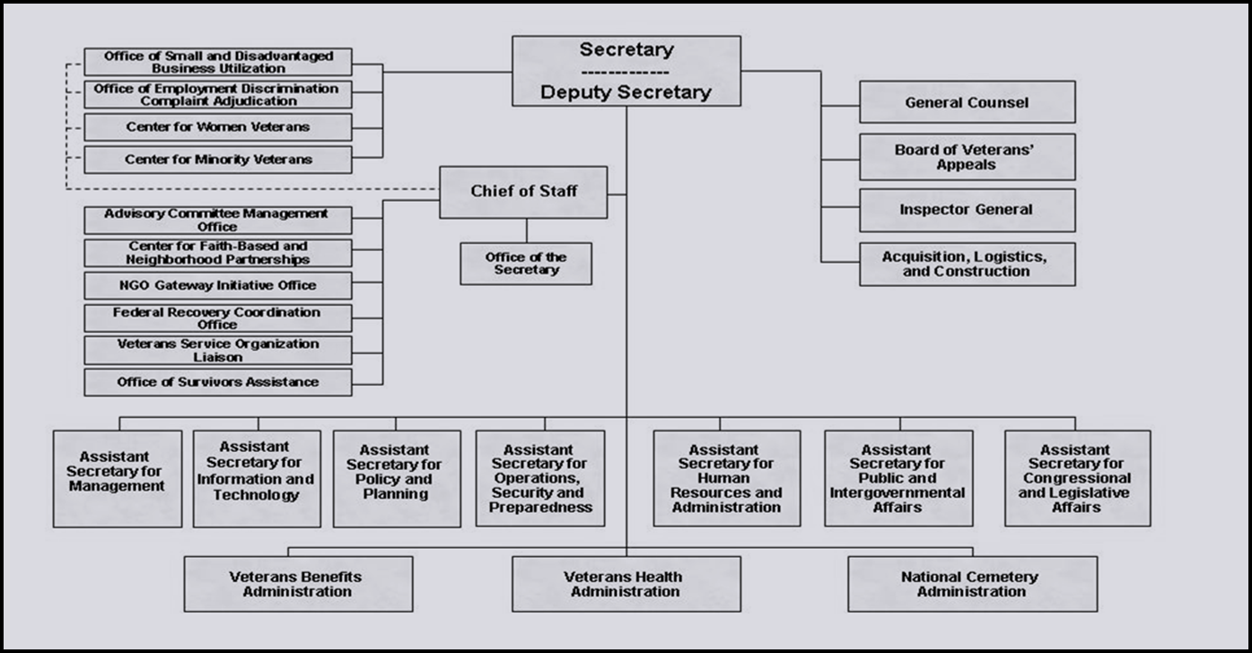
Organization Chart

Slide 5
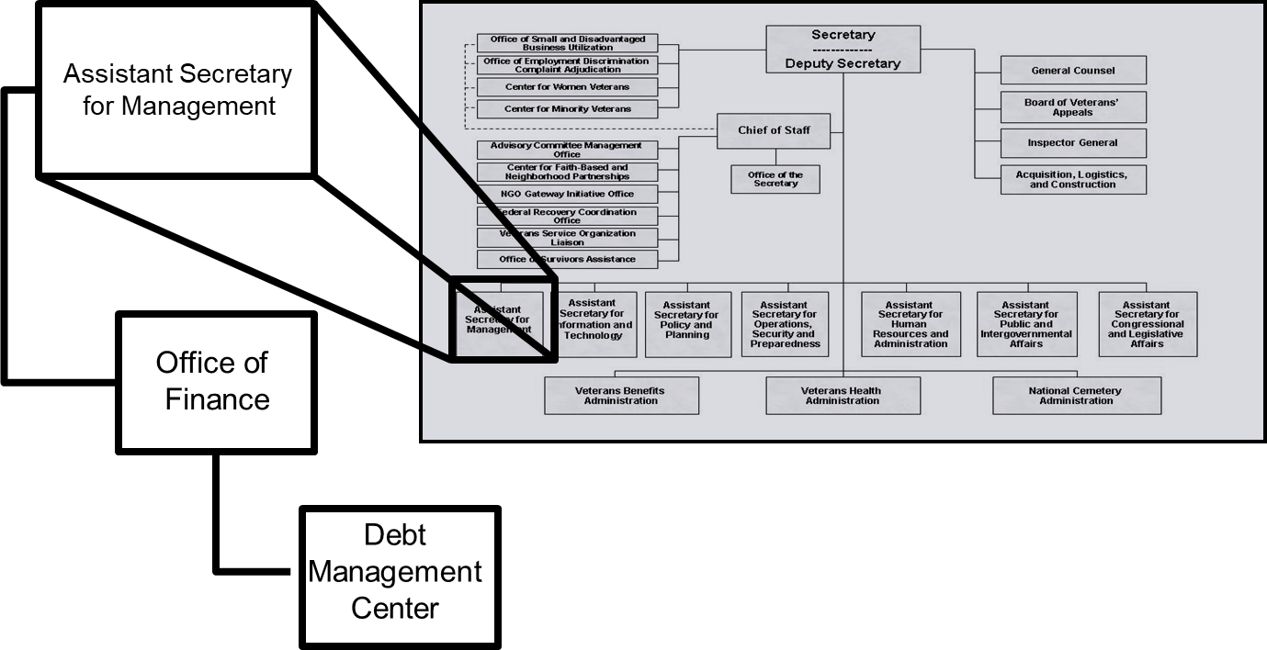
Organization Chart

Slide 6
DMC provides accounts receivable services to
VBA
VHA
NCA
All the above
KNOWLEDGE
CHECK
6
6

Slide 7
DMC provides accounts receivable services to
VBA
VHA
NCA
All the above
KNOWLEDGE
CHECK
7
7

Slide 8
Debt Establishment
SCO Certifies Student
RPO Processes Certifications
DMC Collects Debts
Sends collection letters for debts
Sends a letter when payments are issued or debt created
Processes collection actions
Evaluates entitlement
Issues payments and establishes debts
Communicates with student about certification process

Slide 9
Debt Establishment
School debts
Student never attended
Duplicate payment issued
Amended certification with reduced tuition charges
Student completely withdrew on or before first day
Student passed away
Payment issued for wrong amount
School receives payment for wrong student
Sources:
38 CFR 21.9695(b)(2)
SCO Handbook

Slide 10
Debt Establishment
Student debts
Housing stipend
Tuition
Change in Active Duty Status
Reductions
Terminations
Books and Supplies

Slide 11
Examples (1 of 2)
School certifies student for 12 credits. School reports student completely withdrew on the second day of the term.
Student debt
School certifies student for 12 credits. School reports student reduced training to 9 credits during the add drop period.
Student debt

Slide 12
Examples (2 of 2)
School certifies student for 12 credits/$1000 tuition and fees. School reports a reduced tuition and fees amount of $200, there is no change to the amount or type of training.
School debt of $800

Slide 13
Who will incur a tuition debt if a student withdraws on or before the first day of the term?
School
Student
School and Student
None of the above
KNOWLEDGE
CHECK
13
13

Slide 14
Who will incur a tuition debt if a student withdraws on or before the first day of the term?
a. School
b. Student
c. School and Student
d. None of the above
KNOWLEDGE
CHECK
14
14

Slide 15
If a student never attends the course for which he or she was certified, it can result in a school debt
True
False
KNOWLEDGE
CHECK
15
15

Slide 16
If a student never attends the course for which he or she was certified, it can result in a school debt
a. True
b. False
KNOWLEDGE
CHECK
16
16

Slide 17
If a school certifies a student for 12 credits and the student reduce to 9 credits during the drop add period, this would result in a ______.
School tuition debt
Student tuition debt
School and student tuition debt
None of the above
KNOWLEDGE
CHECK
17
17

Slide 18
If a school certifies a student for 12 credits and the student reduce to 9 credits during the drop add period, this would result in a ______.
School tuition debt
b. Student tuition debt
School and student tuition debt
None of the above
KNOWLEDGE
CHECK
18
18

Slide 19
Federal Debt Collection Laws
The Debt Collection Act of 1982
  Authority for collection by administrative offset
The Debt Collection Improvement Act (DCIA) of 1996
  Agencies required to refer delinquent non-tax debts to the Department of Treasury at 180 days
Digital Accountability and Transparency Act (DATA) of 2014
  Changed referral requirement for delinquent non-tax debts from 180 days to 120 days

Slide 20
What act provides the authority to collect debt by administrative offset?
The Digital Accountability and Transparency Act of 2014
The Debt Collection Improvement Act of 1996
The Debt Collection Act of 1982
The Harry W. Colmery Education Assistance Act of 2017
KNOWLEDGE
CHECK
20
20

Slide 21
What act provides the authority to collect debt by administrative offset?
The Digital Accountability and Transparency Act of 2014
The Debt Collection Improvement Act of 1996
c. The Debt Collection Act of 1982
The Harry W. Colmery Education Assistance Act of 2017
KNOWLEDGE
CHECK
21
21

Slide 22
COVID-19 Relief
Collection action on new Veteran and beneficiary debts delayed. Institutions (schools) continue to receive the normal series of debt letters.
No referral to Credit Reporting Agencies or Credit Alert Interactive Voice Response System (CAIVRS). CAIVRS alerts lenders of VA debt and impacts federal home loan underwriting
All collection action on VA debts under the jurisdiction of the U.S. Department of the Treasury is suspended until after January 1, 2021

Slide 23
COVID-19 Relief
Options for Veterans with pre-existing debts who are financially unable to pay their debt due to COVID-19:
Delay benefit offset or payments due until January 1st, 2021
Extend repayment plan terms

Slide 24
Outreach and Updates
November letter to Veterans
VSO, SCO and Veteran emails
VA texts and social media
Borne the Battle Podcast
DMC website: https://www.va.gov/debtman/
Debt Portal on va.gov (Live January 2021)

Slide 25
Collection Process
DMC sends Notice of Indebtedness letters, monitors accounts, and advises debtor of any delinquency, including the requirement to refer their account to Treasury
DMC Sends 1st Letter
30 days
DMC Sends 2nd Letter
30 days
DMC Sends 3rd Letter
60 days
Debt is Referred to Treasury (120 days)
If DMC receives payment, next collection letter is deferred

Slide 26
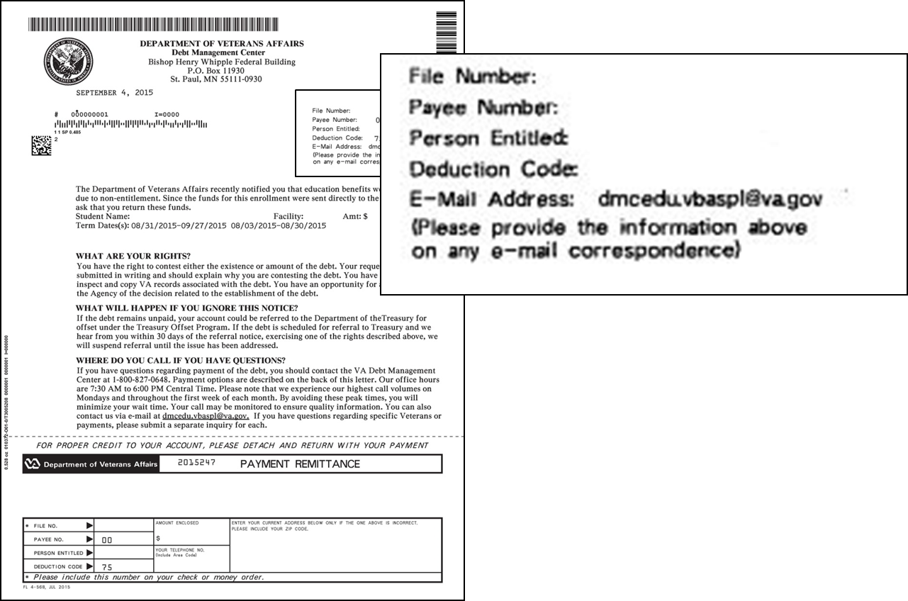
Notification Letters

Slide 27
When does DMC refer a debt to the Department of Treasury?
30 days after the third letter is sent
60 days after the third letter is sent
90 days after the third letter is sent
120 days after the third letter is sent
KNOWLEDGE
CHECK
27
27
Notes:
sent

Slide 28
When does DMC refer a debt to the Department of Treasury?
30 days after the third letter is sent
b. 60 days after the third letter is sent
90 days after the third letter is sent
120 days after the third letter is sent
KNOWLEDGE
CHECK
28
28

Slide 29
School Options
School Options
Pay in Full
Dispute
Compromise
Payment Plan

Slide 30
Tips for School Inquiries
When emailing disputes and inquiries, please include:
One email per student
  First initial, middle initial, last name
  Last four of SSN
School name and facility code
Debt amount
Supporting details (front and back of cashed check, when was updated certification sent, etc.)

Slide 31
Which of the following is not an option for schools regarding a debt?
Pay in full
Compromise
Request a waiver of the debt
Dispute the debt
KNOWLEDGE
CHECK
31
31

Slide 32
Which of the following is not an option for schools regarding a debt?
Pay in full
Compromise
c. Request a waiver of the debt
Dispute the debt
KNOWLEDGE
CHECK
32
32

Slide 33
When the debt is not paid in full, how many students per email should the school send to DMC?
1 student per email
5 students per email
10 students per email
20 students per email
KNOWLEDGE
CHECK
33
33

Slide 34
When the debt is not paid in full, how many students per email should the school send to DMC?
a. 1 student per email
b. 5 students per email
c. 10 students per email
d. 20 students per email
KNOWLEDGE
CHECK
34
34

Slide 35
Student Options
Student Options
Pay in Full
Reduced Benefit Offset
Dispute
Waiver
Compromise
Payment Plan

Slide 36
Common Student Concerns
“I think my school certified me incorrectly or VA did not process my benefits correctly.”
“My school is going to pay the debt for me.”
“My school says they sent the check to you.”

Slide 37
What actions can a student take if he or she incurs a debt
Pay in full
Request a waiver of the debt
Compromise
Set up a payment plan
All of the above
KNOWLEDGE
CHECK
37
37

Slide 38
What actions can a student take if he or she incurs a debt
Pay in full
Request a waiver of the debt
Compromise
Set up a payment plan
e. All the above
KNOWLEDGE
CHECK
38
38

Slide 39

How to Pay a Debt
Pay by check: mail the check, payment coupon(s) and/or letter to:
    VA Debt Management Center
    Bishop Henry Whipple Federal Building
    P.O. Box 11930
    St. Paul, MN 55111-0930
Pay online: www.pay.va.gov
Check SCO handbook for other options
Payments from schools for student debts must include either:
  The remittance stub for the student debt (preferred)
  A letter specifically stating the school wants to pay the student debt

Slide 40


Toolbox
Reduced repayment plans
Expedite hardship refunds
Temporarily suspend offset
Prioritize waiver requests

Slide 41
Treasury Overview Debt Collection Tools
Treasury has two main programs for student and school debt collection
Treasury Offset Program (TOP)
Cross-Servicing (CS)
Federal grants
Social Security
Civilian pay
Military retirement
Private Collections Agencies (PCA)
Telephone collections
Administrative Wage Garnishment (AWG)

Slide 42
How to Contact TOP
Schools may contact TOP by calling the TOP Call Center:
1-800-304-3107
In order to provide you with information about an offset, Treasury will need to know:
The caller’s name, department and job title. The job title will need to indicate a need-to-know position.
At least one of the following:
  date of the payment
  amount of the original payment
  amount of the offset

Slide 43
What are the two main programs used by the Department of Treasury to collect school and student debts?
TOP and CRA
CAIVRS and DMC
TOP and CS
None of the above
KNOWLEDGE
CHECK
43
43

Slide 44
What are the two main programs used by the Department of Treasury to collect school and student debts?
TOP and CRA
CAIVRS and DMC
c. TOP and CS
d. None of the above
KNOWLEDGE
CHECK
44
44

Slide 45

Become a Debt Superstar (Contact DMC)
www.va.gov/debtman
800-827-0648
https://iris.custhelp.va.gov/app/ask/
dmcedu.vbaspl@va.gov
(Schools only)

Slide 46

Issue Not Getting Resolved?
Julie Lawrence – Chief Education and External Relations
Julie.Lawrence@va.gov
Nicole Haselberger – Assistant Chief Education and External Relations
Nicole.Haselberger@va.gov
Tami Dorle – Supervisory Financial Administrative Specialist
Tamara.Dorle@va.gov
Gary Greenwood – Management Analyst
Gary.Greenwood2@va.gov

Slide 47

Summary
You should now be able to:
1.
Provide an overview of DMC
Assess why/how debts are established
2.
3.
Define the collection processes
4.
List options to resolve a debt
5.
Define risks of non-payment
6.
Formulate responses to debt questions

Slide 48

Additional Resources
GI Bill Webpage – Colmery Act
School Administrators Resources
ELR of Jurisdiction
School Certifying Official’s (SCO) Handbook
School Certifying Official (SCO) Training 2019
Education Service Webinars
Education Call Center: (888) 442-4551
Thank You
For Supporting Our Nation’s Veterans

