Slide 1
Military Transcripts, Degree Evaluation & Prior Credit

Slide 2
In This Presentation We Will Cover:
VA Mandated Requirement for Transcripts.
Who Has a Military Transcript & How Can They Obtain Them?
Best Practices for Military Transcripts.
Auditing Courses for Degree Plan.
Best Practices for Degree Auditing.

Slide 3
Title 38 CFR 21.4253 & 21.4254
All schools must obtain and evaluate records or prior education and training (including military) within a specified period or terminate the enrollment for VA educational benefits of any Veteran if appropriate transcripts cannot be obtained.

Slide 4
Do All Veterans Have a Military Transcript?
YES!!!!

Slide 5
All enlisted, officers and warrant officers from the Army, Coast Guard, Marines, Navy, Air Force and Space Force.
This includes members of the National Guard and Reserves.

Slide 6
How Can a Student Get Their Military Transcript?
Veterans & Reservists of the Army, Navy, Marines & Coast Guard, and Army National Guard will log into https://jst.doded.mil/jst/ and select the option to “Request Official Transcript”.
All students using Chapter 31 – VR&E, Chapter 33 – Post 9/11, Chapter 30 – MGIB, and Chapter 1606 – MGIB-SR will need to submit military transcripts.

Slide 7
If they haven’t requested a transcript previously, they will need to create an account by registering for one. A CAC card/reader is not a requirement to request the transcript.

Slide 8
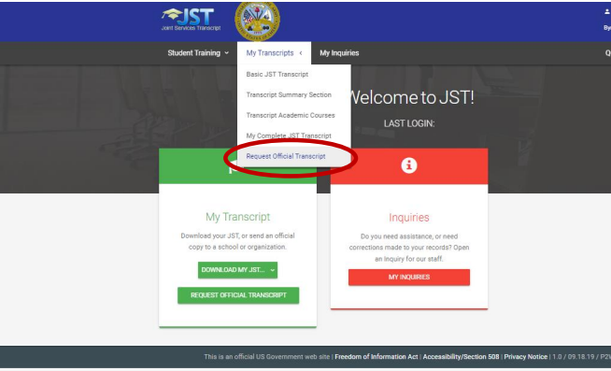
Once the student creates their profile and has accessed the system, they will click, “My Transcripts” and choose the option to “Request Official Transcript”.

Slide 9
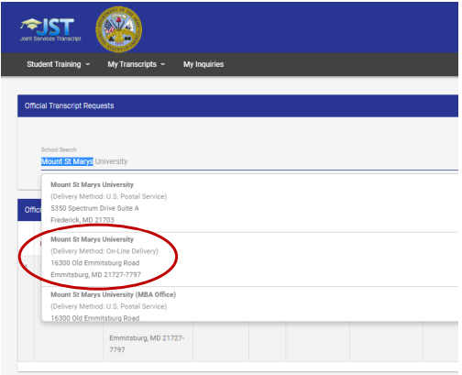
The student will then search for their institution in the “School Search” section, select that institution and then select the option to “Send Official Transcript”.

Slide 10
How Can a Student Get Their Military Transcript?
Veterans & Reservists of the Air Force and Space Force, as well as members of the Air National Guard will log into https://www.airuniversity.af.edu/Barnes/CCAF and select the option to “Order from Parchment” if your institution uses that service. Otherwise, transcripts must be mailed.

Slide 11
Once the student opens the CCAF site, they will select the option for “Transcripts”. They will be taken to a page detailing how to request. Please suggest Parchment if your institution participates.

Slide 12
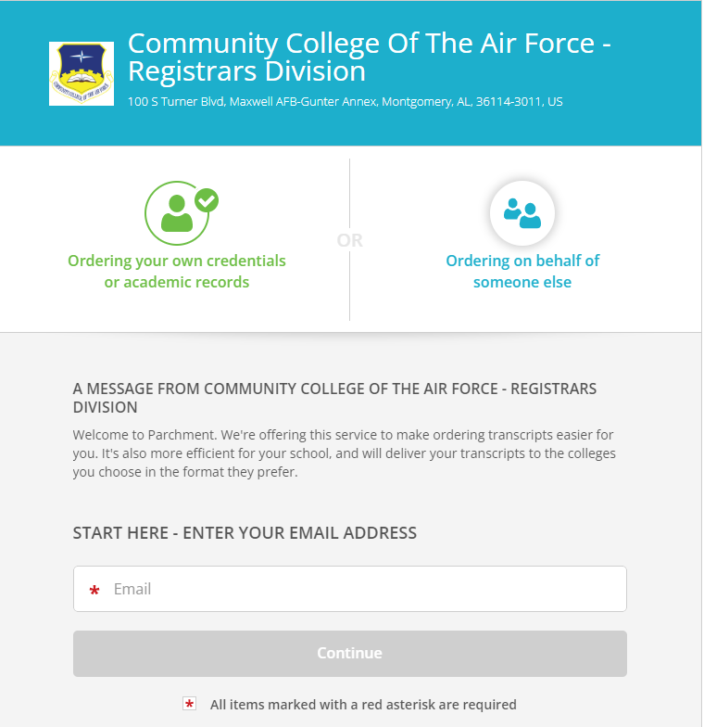
When the student clicks on the link to “Order from Parchment”, they will be directed to the Parchment website to complete their order.

Slide 13
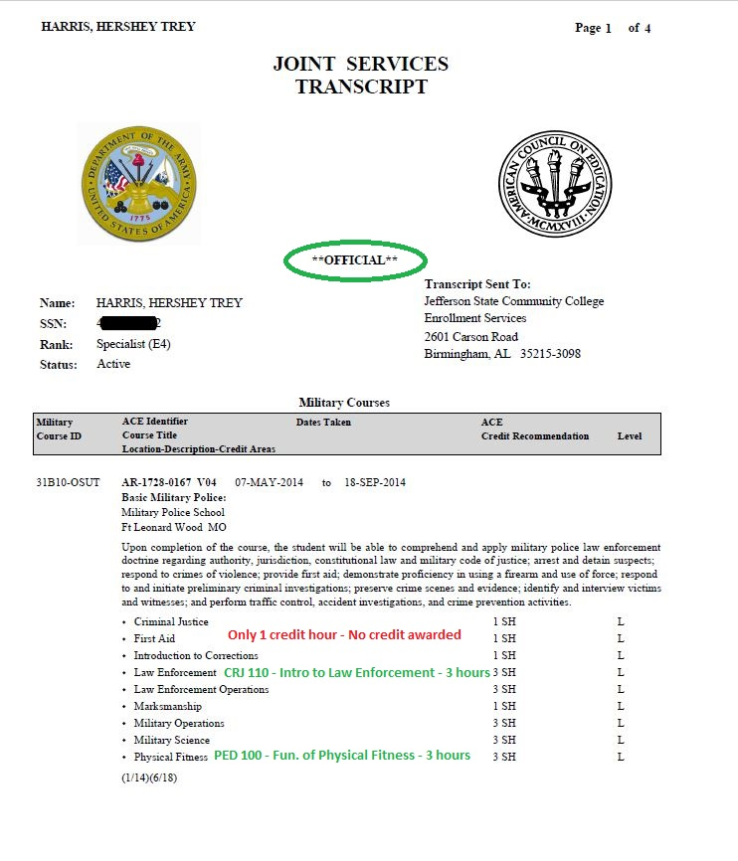
All transcripts must be official. Unofficial transcripts cannot be accepted.
Credit is awarded depending on the number of hours the military awards the “class”.
Department chairs are very helpful in reviewing, especially for AAS trade programs.

Slide 14
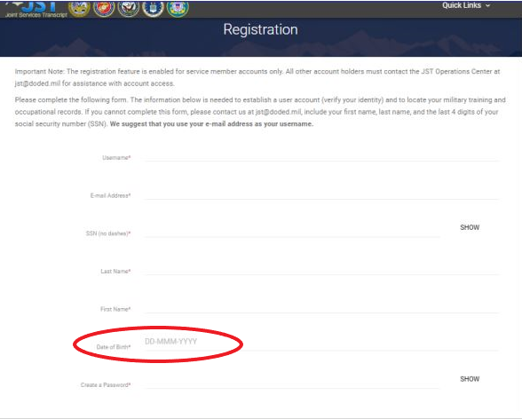
Trouble Shooting
“I don’t have a military transcript.”
Explain to the student that all enlisted military personnel who completed basic training will have a military transcript.
“I can’t create my account. It says my birthday is wrong.”
The JST site registration page asks for the DOB to be listed in the format of DD-MMM-YYYY, so 31-OCT-1951.

Slide 15
Trouble Shooting
“It says my record isn’t found.”
The student will need to contact JST customer support. They will need to email jst@doded.mil.
“My advisor didn’t tell me I had to have it.”
Explain that this is a VA requirement that their advisor may not have been aware of, but it is required for VA benefits.
“I served for years. Why did only a few credits transfer?”
Explain that the military may not weigh credit hours the same as a college. Refer to Records or a Dean/Department chair for a clearer explanation.
“Do I have to pay anything to get my military transcript?”
The JST is free! It also is typically delivered the next business day. CCAF transcripts do incur a fee of $3.10 to order via Parchment.

Slide 16
Degree Auditing & Prior Credit
In addition to military transcripts, it’s very important to ensure a student submits all transcripts from colleges, universities, trade schools and other training for review to ensure all prior credit has been accounted for. While records is responsible for reviewing transcripts, SCOs are responsible to ensure students are not repeating courses or being processed for classes not in their major/program of study.

Slide 17
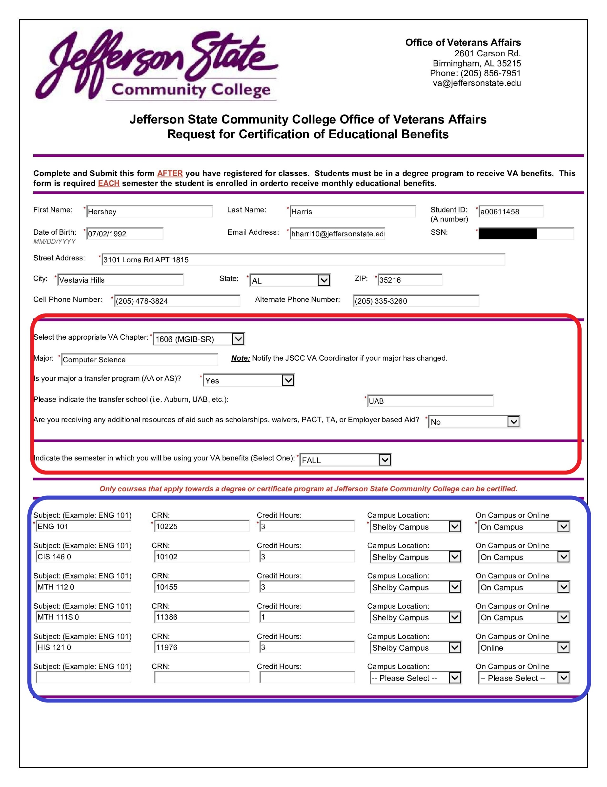
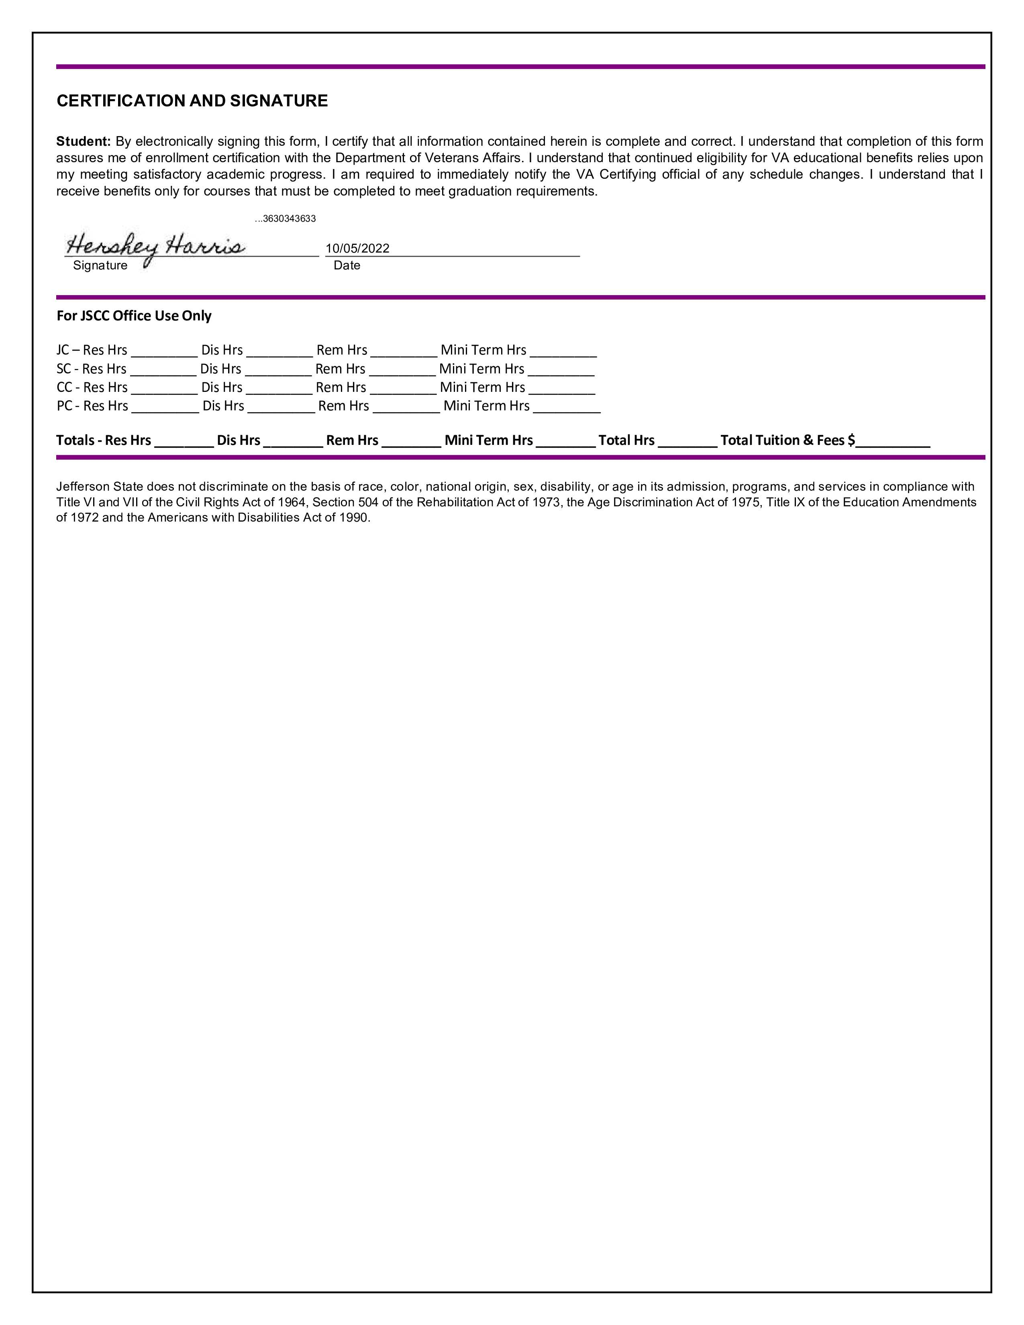
At JSCC, we use Dynamic Forms to streamline the certification process. This allows students to list their transfer institution as well as where and how they are taking classes. If applicable for your institution, your form could include a link to upload a Degree Plan to double check their classes.

Slide 18
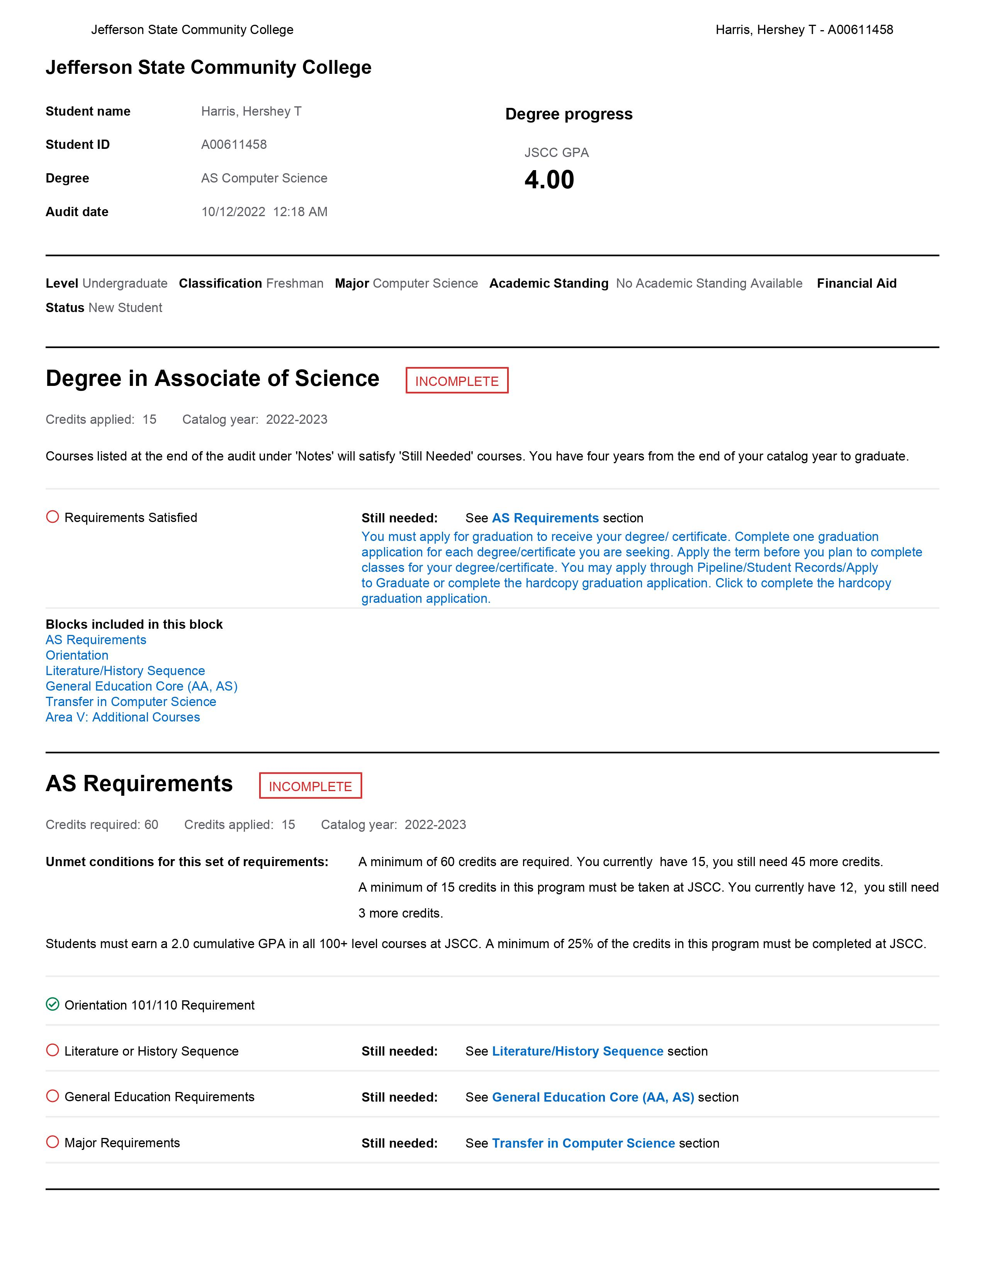
There are various ways to double check credit.
ACCS schools can check Degree Works and have holds placed on student accounts once they are registered and/or certified.
The STARS Guide is also an excellent tool in checking courses required for transfer (AA & AS) majors

Slide 19
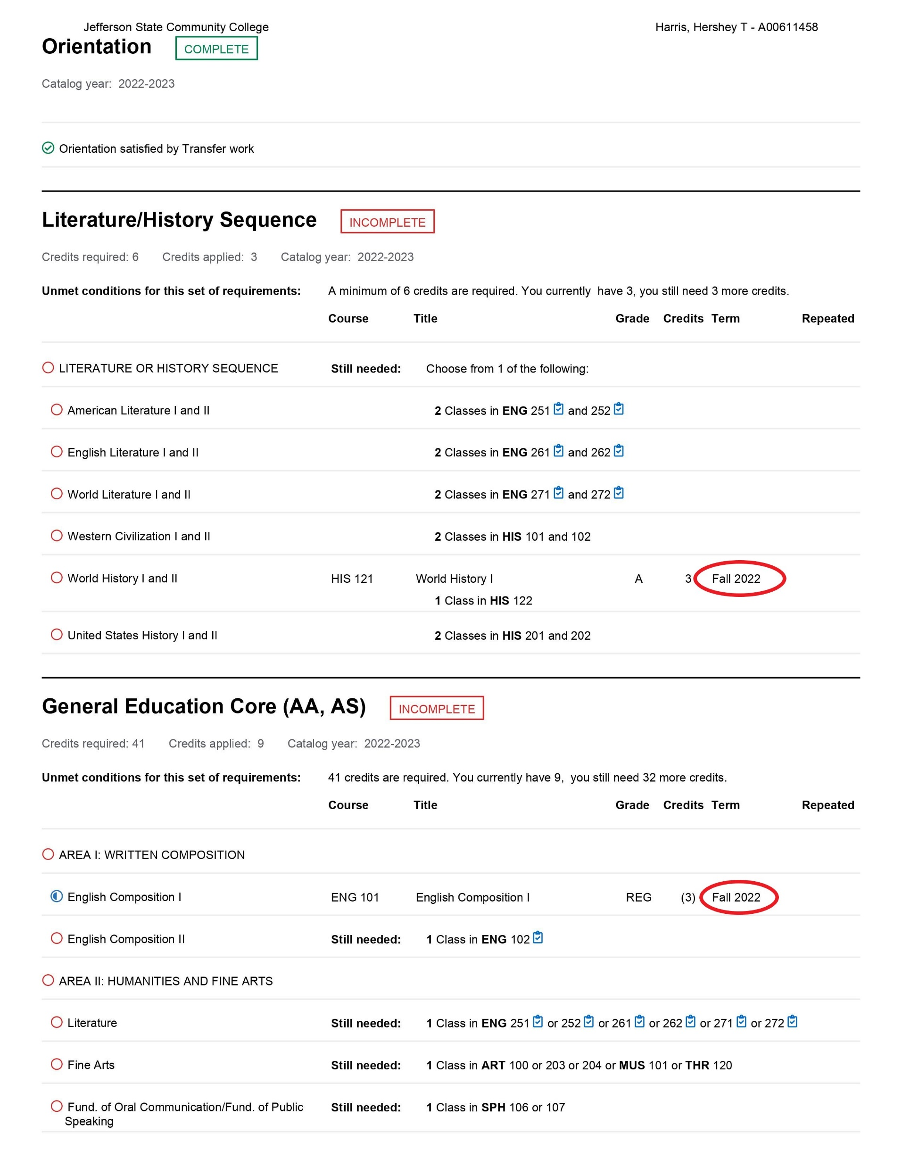
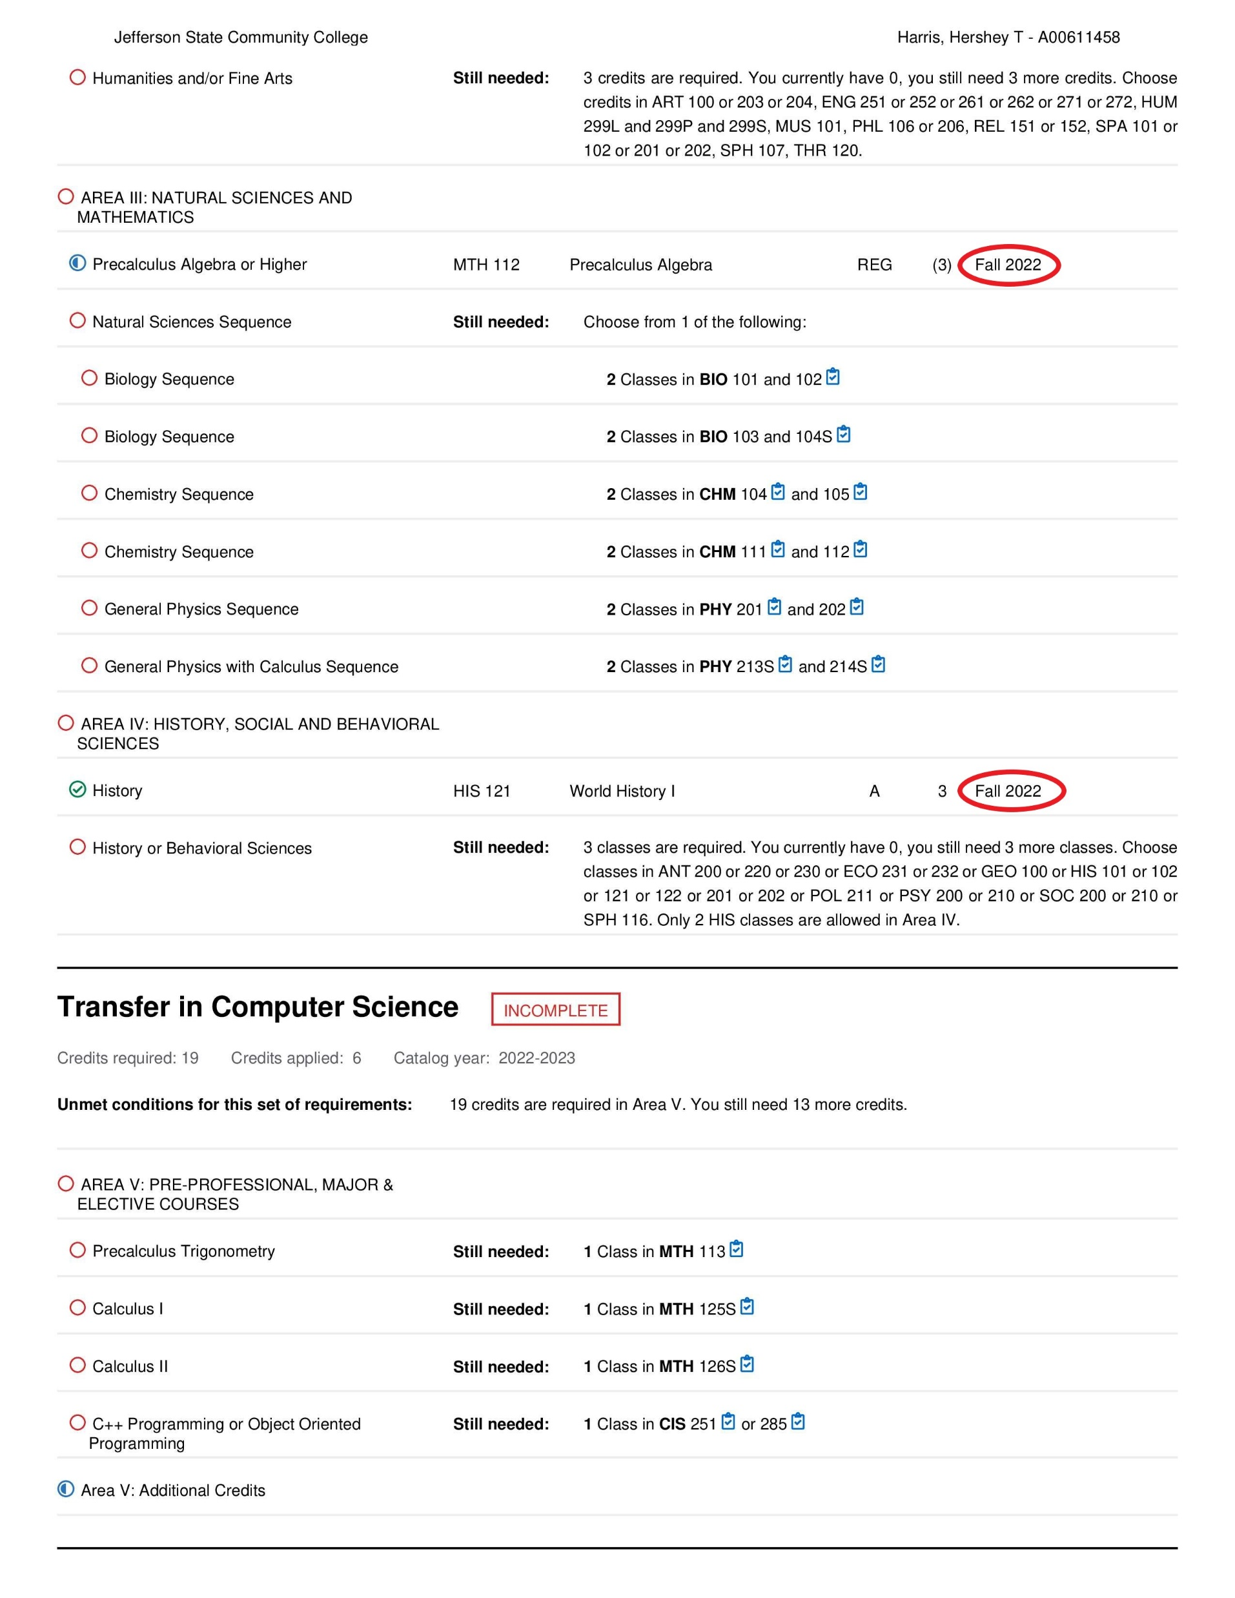

Slide 20
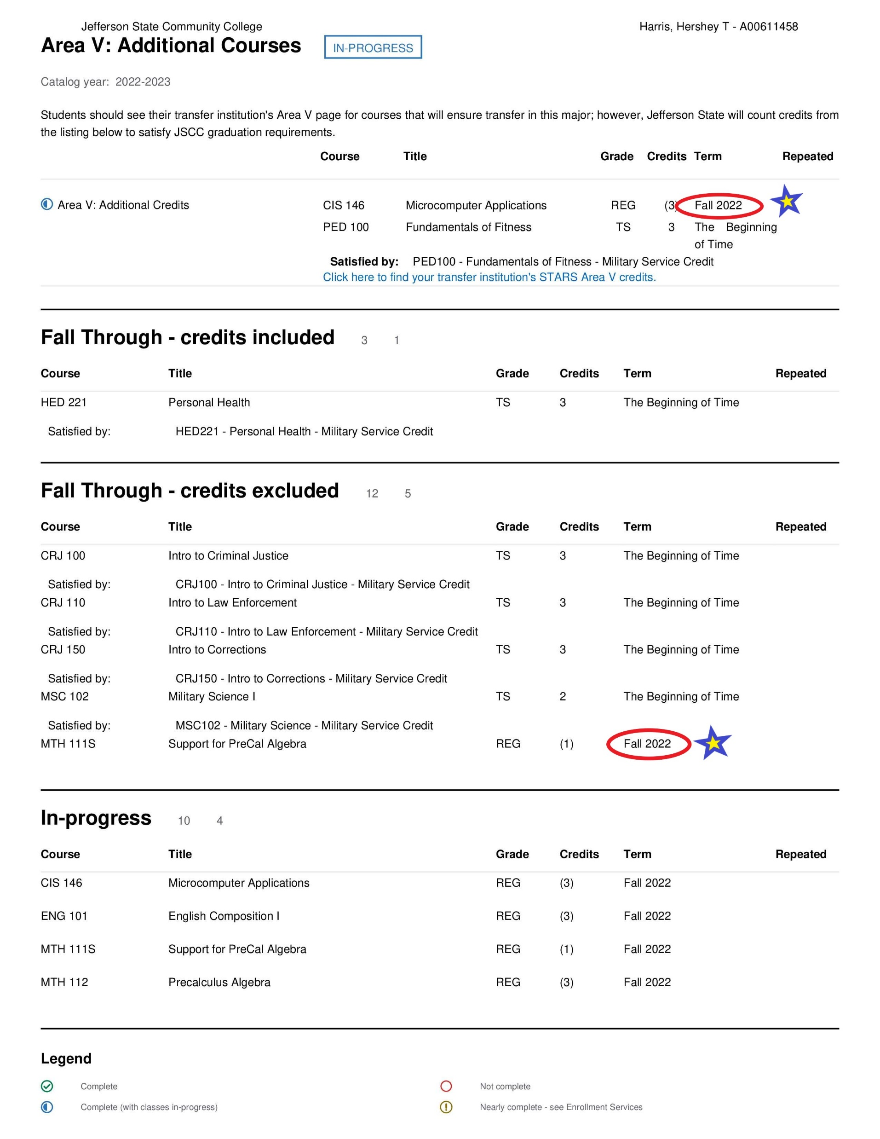
Your degree planning software should show you where the classes fall on a student’s degree plan, as well as show you the credits that your institution was able to accept.
This is important to ensure that your student is not repeating courses already passed or taking a class that is not needed for their major.

Slide 21
If you personally do not have access to your degree planning software, have the student submit a copy of their degree planned that has been signed off by an academic advisor. If the major is a transfer program (AA & AS) you can then use the Alabama Transfers guide for a quick check to ensure classes are required for the major.
https://alabamatransfers.com/counselors
Many universities also have Transfer Credit Equivalency Guides to help double check classes you’re not sure of for the Area V section. Ask your Registrar for the links to these guides for four-year institutions.
If you are a four-year degree seeking institution, you can use the degree planning tools available at your school to confirm a student’s courses are in their major.

Slide 22
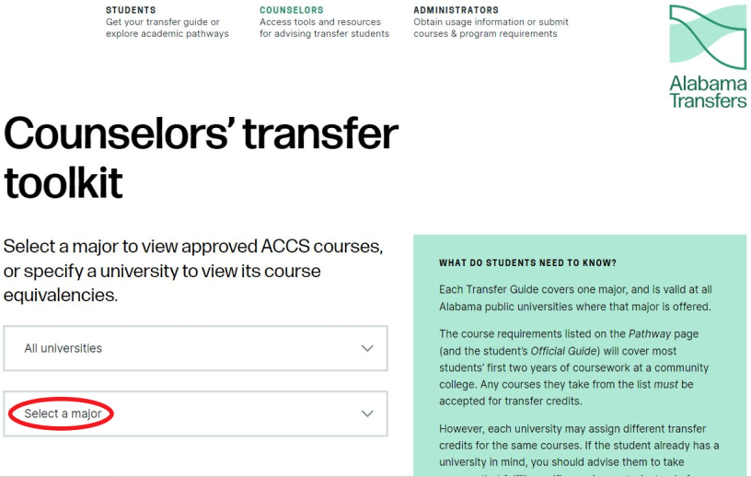
If you are a two-year college, once you access the Alabama Transfers guide, click “Select a Major”.

Slide 23
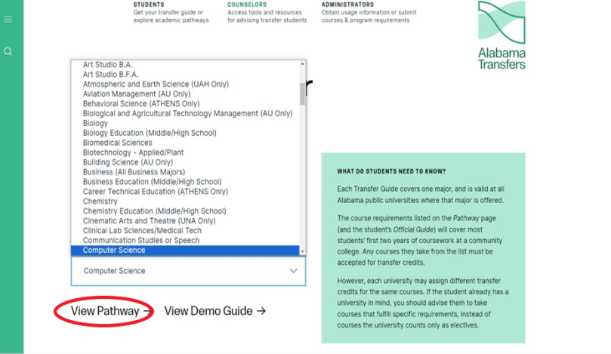
Once you have selected the major, choose “View Pathway” and the site will take you to the courses required for the degree.

Slide 24
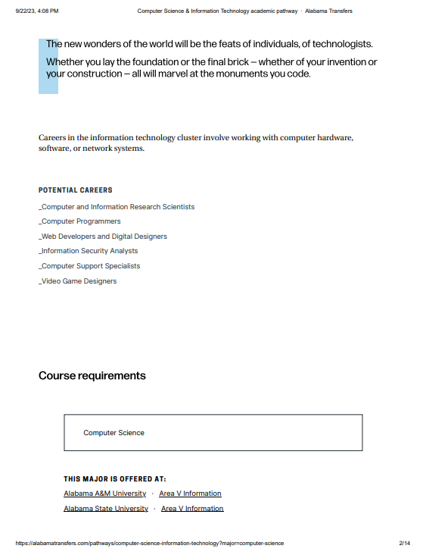

Slide 25
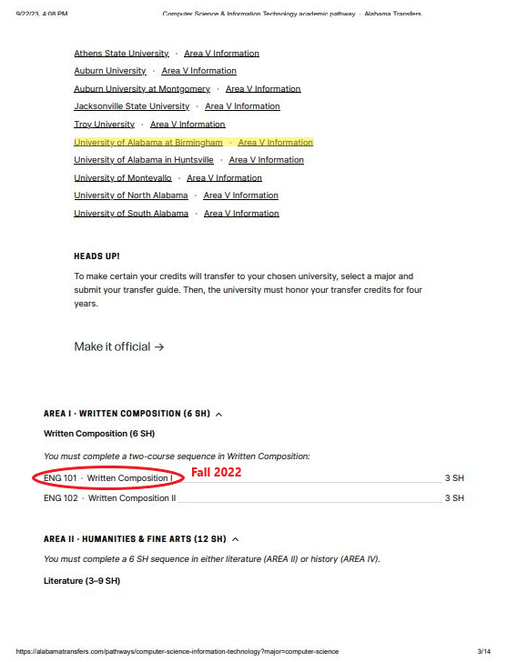
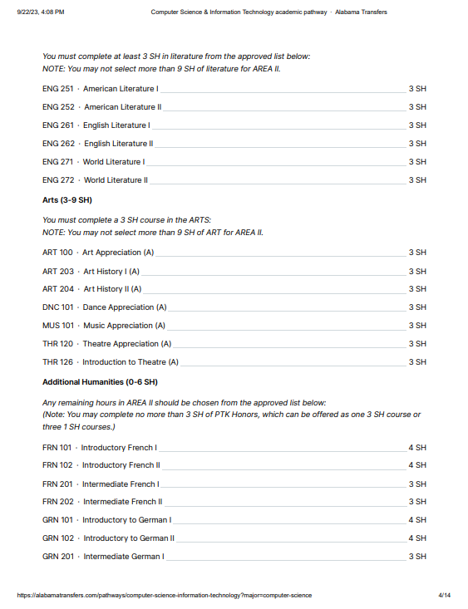

Slide 26
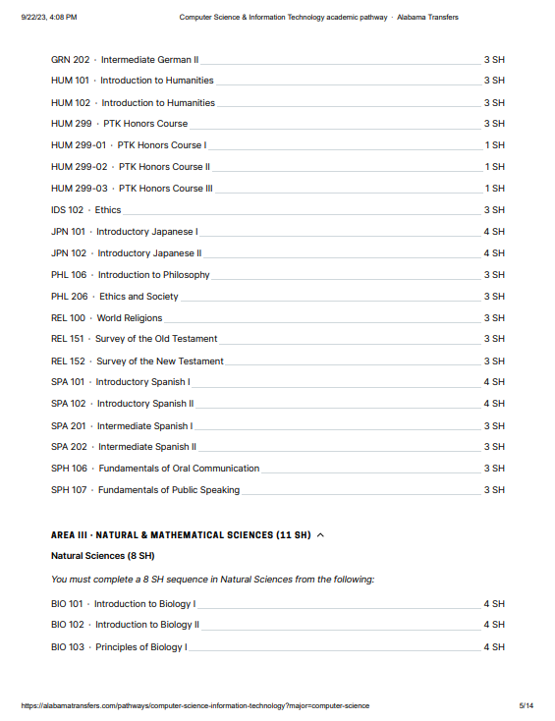
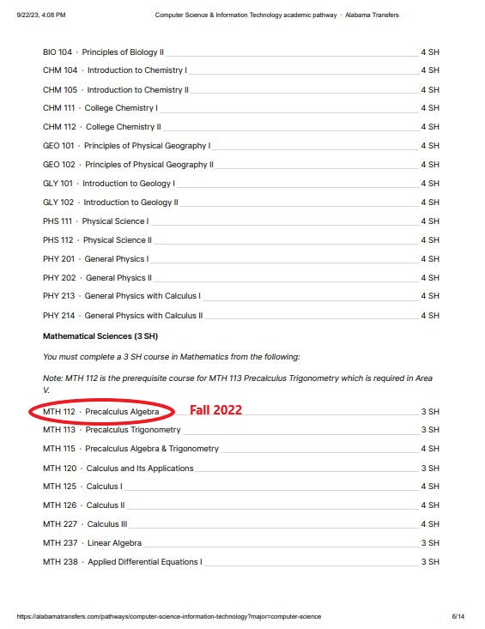

Slide 27
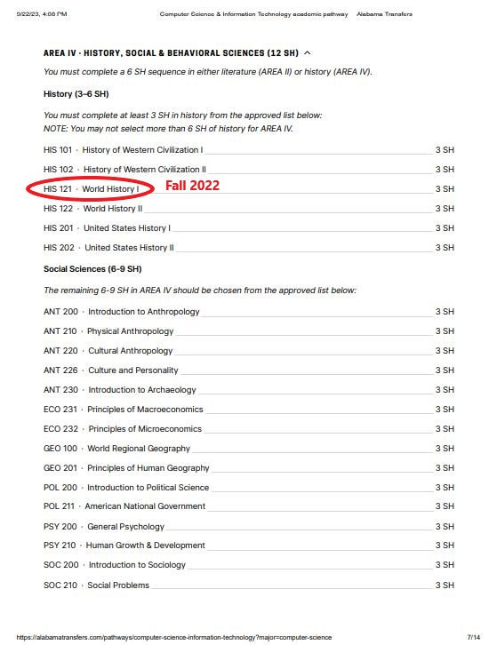
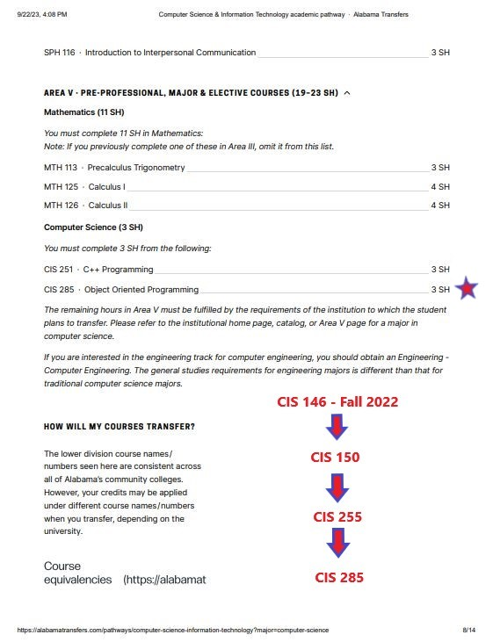

Slide 28
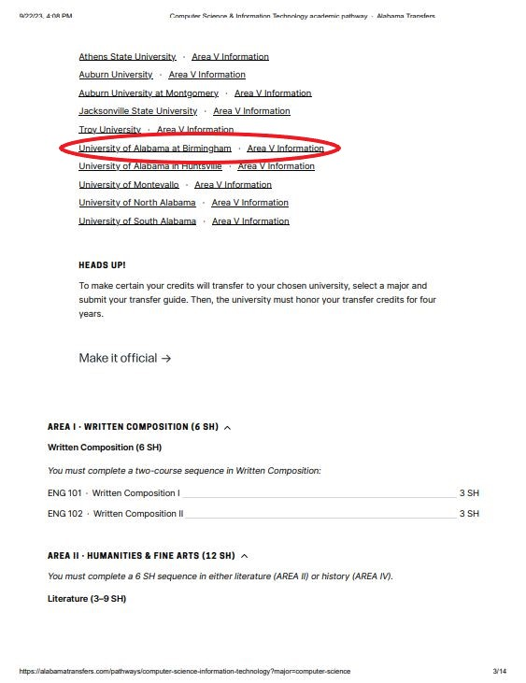
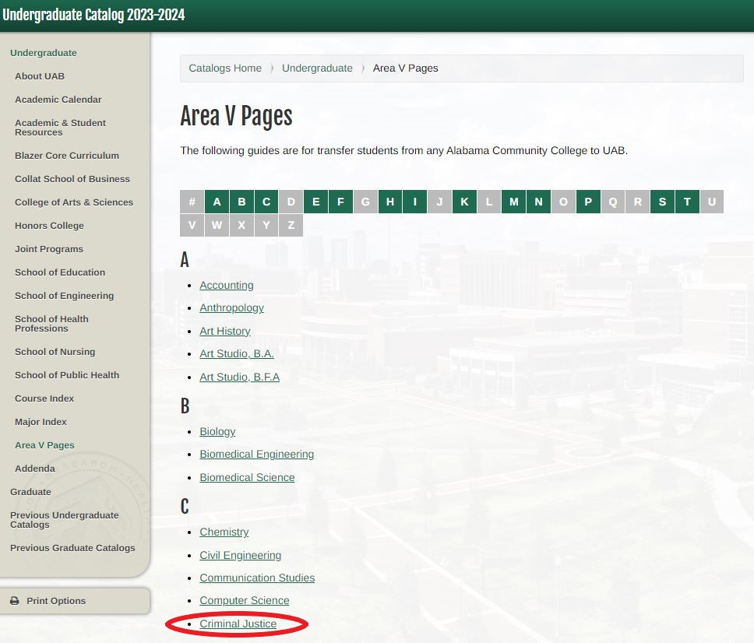

Slide 29
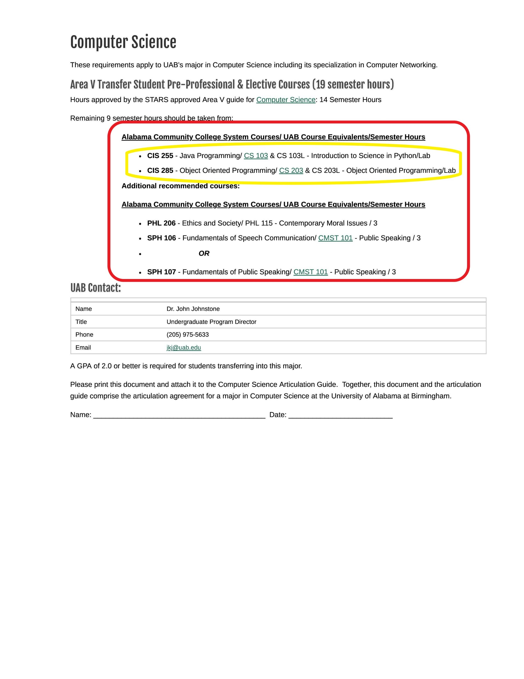
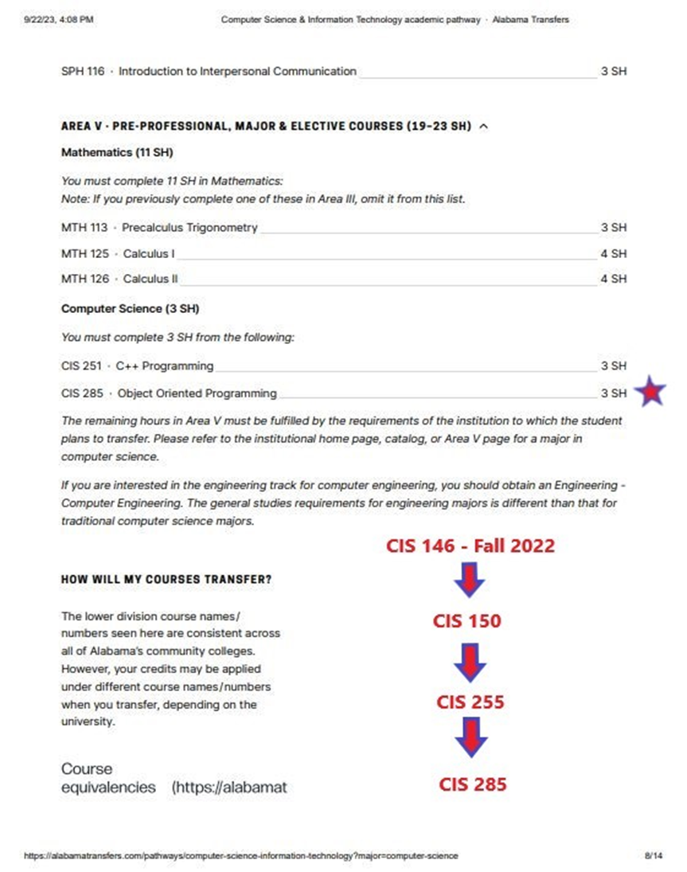
According to the guide, UAB prefers CIS 285 to CIS 251. Therefore, when we review a student’s courses if we know they wish to transfer to UAB, we can make sure they are in the preferred classes. This will help extend their GI Bill by them not having to retake courses they’ll need at the four-year institution.

Slide 30
Best Practices for Degree Auditing
Each institution is different in the way degree auditing, advising and certifications are handled. However, when it’s time for a VA audit, you as an SCO are responsible for what is submitted into the system. If there’s a finding, you are responsible.
Don’t Stress!!

Slide 31
Best Practices for Degree Auditing
Know Your Support Staff By Name.
Devise a Game Plan with Your Supervisor for Checks & Balances
Reach Out to Other Institutions for Advice.
Ask for Resources.
Use Technology to Your Benefit

Slide 32
Alabama State Approving Agency
James A. Thompson, SAA Director
james.thompson@accs.edu 334-293-470
Laura Taylor, SAA Program Analyst
laura.taylor@accs.edu 334-293-4464
Kim Minniefield, SAA Program Coordinator
Kimberly.Minniefield@accs.edu 334-293-4503

