Slide 1
FOR CERTIFYING OFFICIALS
1

Slide 2
AC&L Staff
The VA-ONCE Quick Reference User Guide was created especially for you, the school certifying official. Whether you are a novice taking over the duties as certifying official or a seasoned “Veteran” of VA-ONCE, we hope that this quick reference guide will make a great desktop reference for you.
NOTE: All information contained within this manual is based on fictitious names, social security numbers, and other personal identifiable information.
The VA-ONCE Quick Reference User Guide is a general reference guide. Always contact your VA Education Liaison Representative (ELR) if clarification is needed.
2

Slide 3
References
GI Bill Web Site:
http://www.benefits.va.gov/gibill/index.asp
National Education Call Center:
1-888-442-4551
SCO Hotline (for certifying official use only):
1-855-225-1159
VA ONCE - Users Guide; Users Tips; Updates:
http://www.benefits.va.gov/gibill/school_training_resources.asp
Education Liaison Representative (for certifying official use only)
http://www.benefits.va.gov/gibill/resources/education_resources/school_certifying_officials/elr.asp
3

Slide 4
CONTENTS
Section
Initial VA -ONCE start and log on Password
Overview
User Preferences User Accounts Entering Term Dates
Entering Programs and Objective/Course Codes User Defined Fields
Select Student
School Details
Students
Certify Enrollments
Single Term
Multi-Term Enrollments
Page
6 - 7
8 - 11
12 - 17
18 - 22
23 - 25
26 - 29
30 - 42
43 - 46
47
48 - 51
52 - 58
59
60 - 68
69 - 73
4

Slide 5
CONTENTS
Section
Adding Remarks Modifying Enrollments
Adjust Enrollments
Amend Enrollments
Terminate Enrollments
Certification Deletion
Reports
VA Data Tab Log Tab History Tab Sorting Data
Inactive/Deleted Students
Page
74 - 76
77 - 78
79 - 86
87 - 90
91 - 95
96 - 98
99 - 105
106 - 107
108 - 111
112 - 113
114 - 115
116 - 120
5

Slide 6
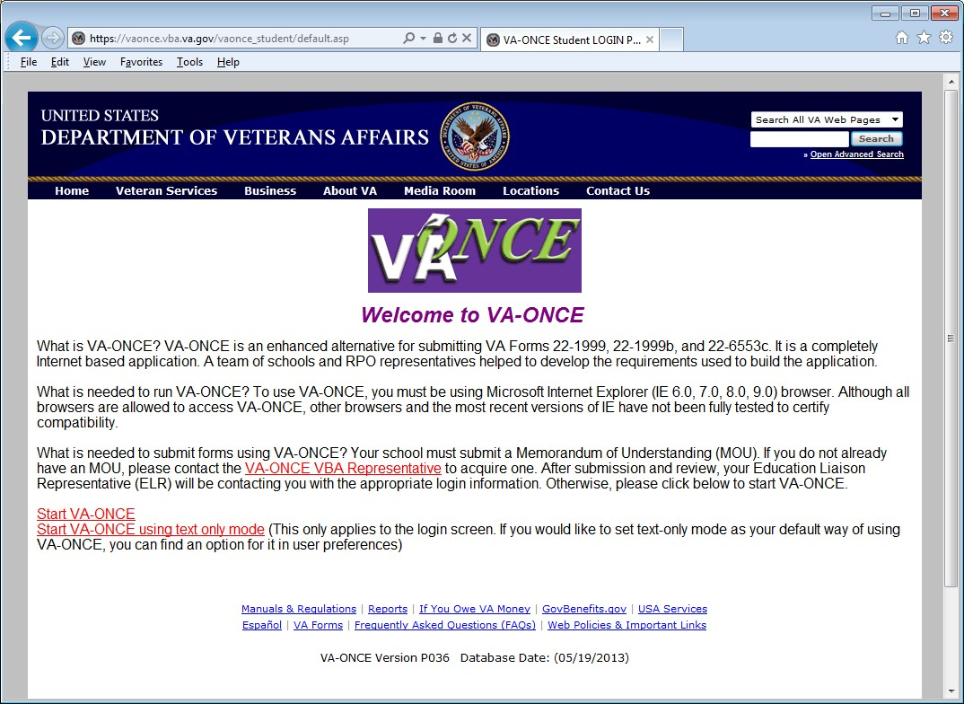
NOTE: Your browser must be Internet Explorer (IE) in order to access VA-ONCE. Other browsers can be used to access VAONCE, but VA does not test to certify compliance with browsers other than Internet Explorer. See your IT department for available browsers at your school.
STEP 1: INITIAL SET UP – Type in the web address as follows:
https://vaonce.vba.va.gov/vaonce_student/default.asp
Click on START VA-ONCE
6

Slide 7
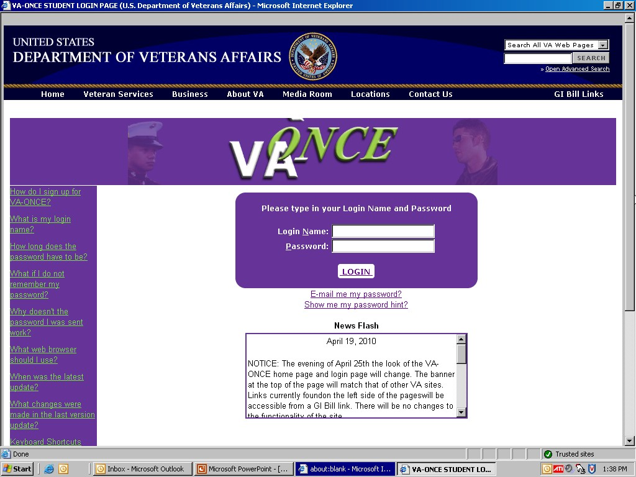
STEP 2: INITIAL SET UP – Log On
Log On using your VA provided user ID and temporary Password
Note: Your browser must allow “Pop-Ups” to view this page.
7

Slide 8
STEP 3: INITIAL SET UP – Changing your Password
Each certifying official will be assigned a temporary password. Click on the ADMIN BUTTON to change the password
8

Slide 9
STEP 4: INITIAL SET UP – Changing your Password
Click on USER and then click on USER PREFERENCES (drop down menu)
9

Slide 10
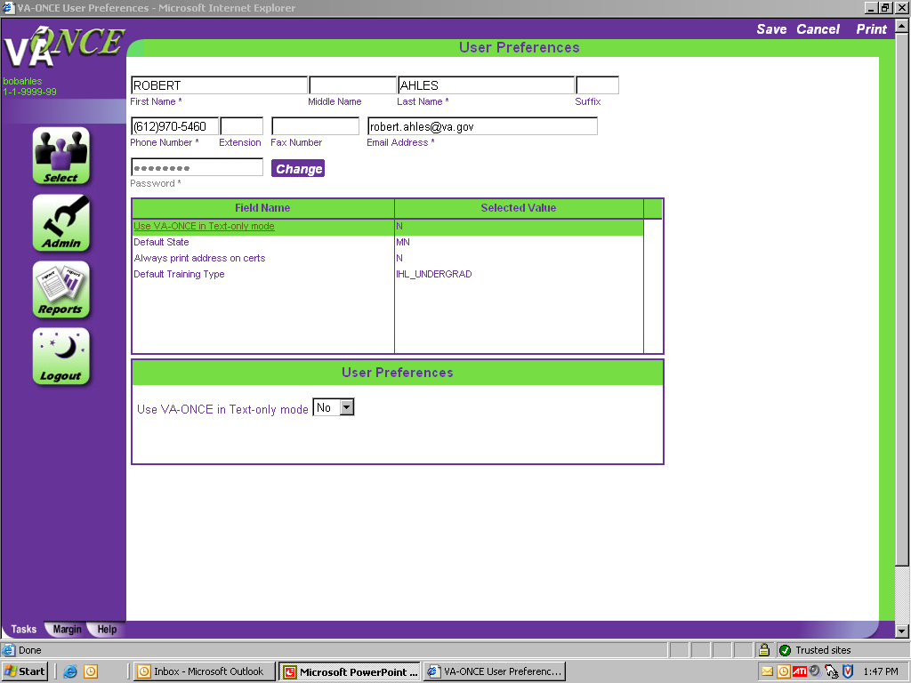
STEP 5: INITIAL SET UP – Changing your password
Click on CHANGE.
10

Slide 11
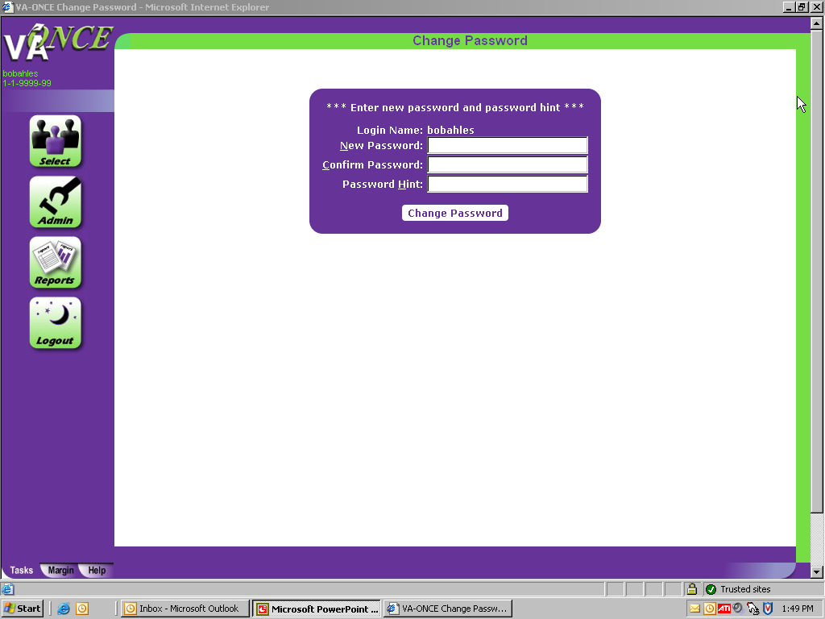
STEP 6: INITIAL SET UP – Changing your password
Complete New Password Information, Confirm Password, and Password Hint. Click CHANGE PASSWORD.
Password must consist of 3 of the 4 following categories: Uppercase; Lowercase; Numeric; Special Characters.
NOTE: You will be prompted to change your password every 90 days. If you do not log in, your account will be deleted after 120 days of inactivity.
11

Slide 12
12

Slide 13
ACTIONS
Across the top of every screen are the actions that can be performed on that page.
The 3 mini tabs located at the bottom of every VA ONCE screen are the TASKS, MARGIN, and HELP tabs.
The TASKS tab is the default. When it is selected you will see the Main Task Buttons: Select; Admin; Reports; and Logout.
MAIN TASK BUTTONS
MINI TABS
13

Slide 14
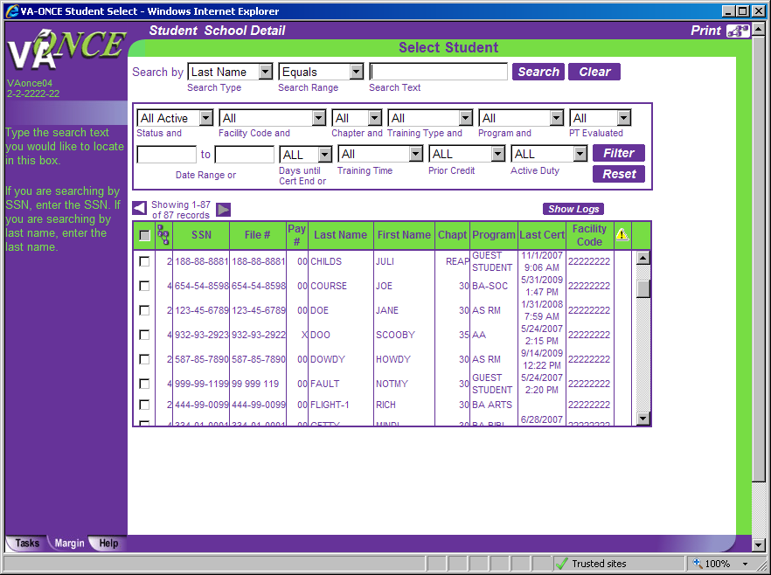
When the Margin Tab is selected, the left margin will change as you enter each individual field on the page and give you information specific to that field.
In this example the cursor is in the “Search Text” box and the Margin text instructs the user on what to enter.
14

Slide 15
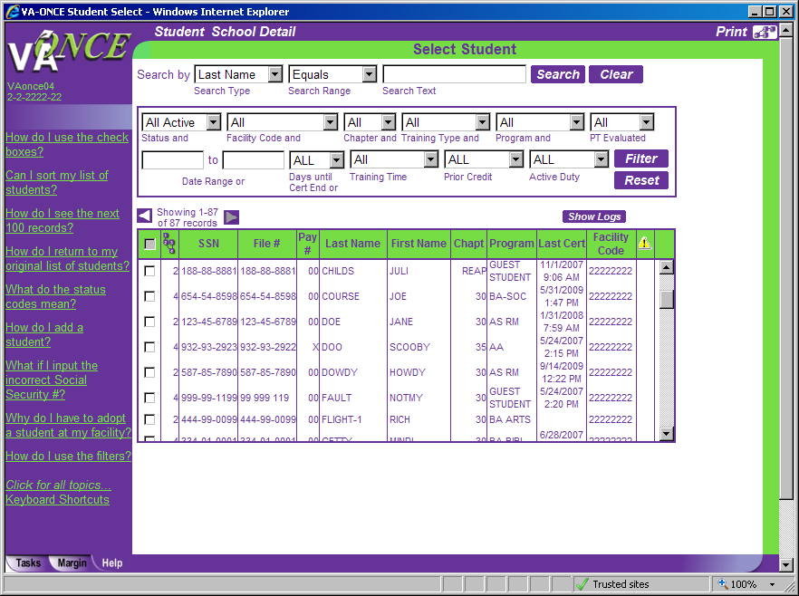
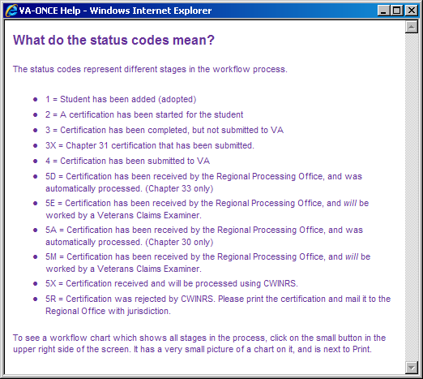
When the Help Tab is selected, the left margin will display Help questions related to the page you are viewing.
If you click on the question, the answer will appear in a separate pop-up.
In this example the user clicked “What do the status codes mean?” and the pop-up provides the answer.
15

Slide 16
Remember that you have 3 mini tabs that will help you move through VA-ONCE.
The TASKS tab located at the bottom left corner of every VA ONCE screen will bring you back to Main Task Buttons.
The MARGIN tab located next to the Tasks tab provides you with help text specific to each field on the page. If the cursor is not in a field, the Margin text will be specific to the page.
The HELP tab located next to the Margin tab provides you with Frequently asked questions regarding the page. Clicking on the question will bring up a pop-up box with the answer. At the bottom of the screen when the Help Tab is selected is also a link for Keyboard shortcuts if you prefer using the keyboard to the mouse.
16

Slide 17
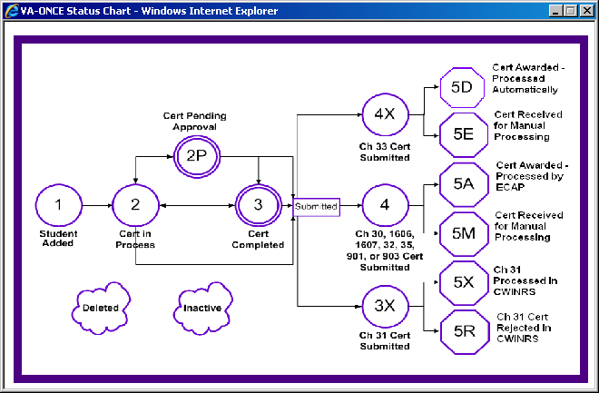
Processing Status Flow chart and Definitions
For each major action taken in VA-ONCE there is an associated status code. This is shown in the top right corner of the screen. The status chart can be viewed at any time by clicking on the icon with the status number.
The status code of the last action taken will also be listed next to your student on the Select Student page.
17

Slide 18
18

Slide 19
STEP 1: INITIAL SET UP – User Preferences
User Preferences allows you to edit basic functions such as name, phone number, email, password, along with setting defaults.
Click on ADMIN BUTTON.
Click on USER.
Click on USER PREFERENCES
19

Slide 20
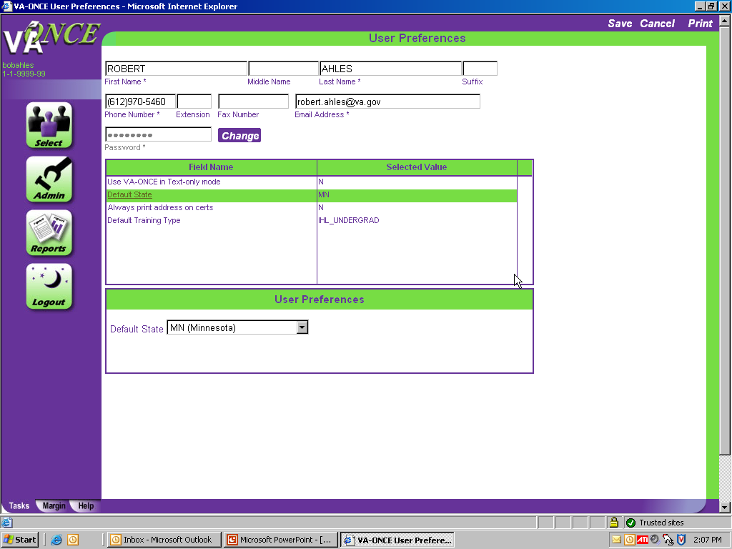
STEP 2: INITIAL SET UP – User Preferences
Click on DEFAULT STATE.
Click down and find your state
20

Slide 21
STEP 3: INITIAL SET UP – User Preferences
Click on Always Print Address on certs.
Set the default to No, if you do not want the address on the printed Certification. Select Yes, if you would always like the address printed.
NOTE: The address is only sent to VA the first time a certification is sent for the student, or if there has been a change since the submission of the last enrollment.
21

Slide 22
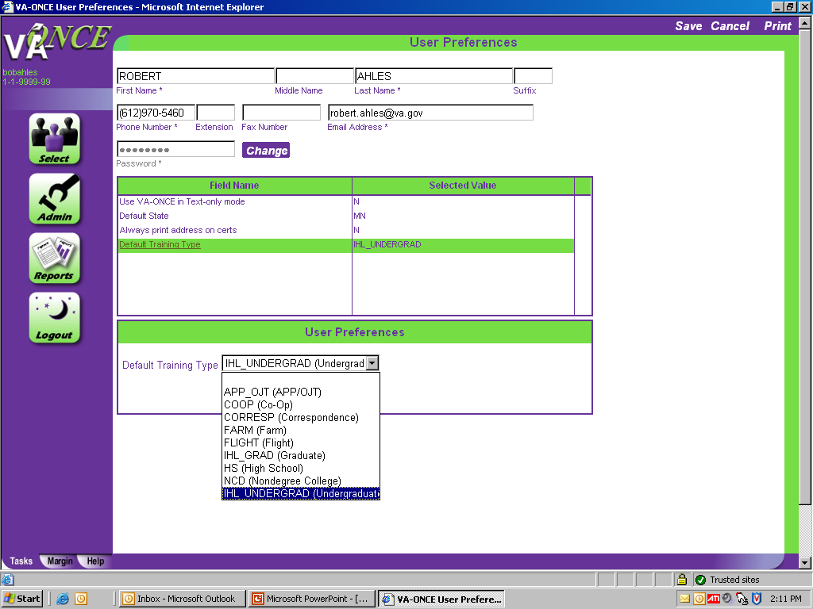
STEP 4: INITIAL SET UP –
User Preferences
(1)Highlight DEFAULT
TRAINING TYPE.
Click on the Drop Down and find the most appropriate training type for your school. Set your default for the most predominate type.
Click on SAVE
22

Slide 24
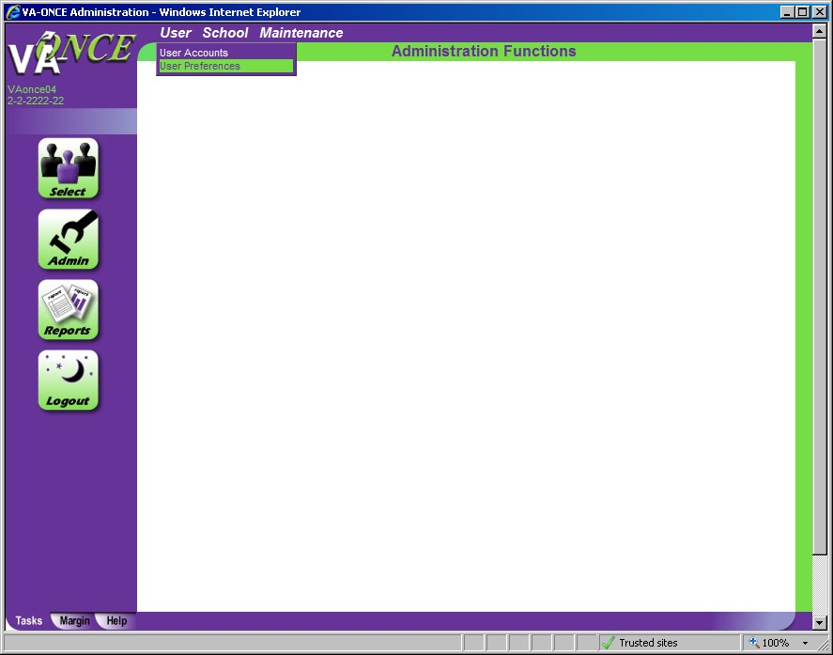
STEP 1: INITIAL SET UP – User Accounts.
User Accounts allows the School Certifying Official the ability to add / delete additional users and give those users specific edit, delete, or read only access.
Click on ADMIN BUTTON.
Click on USER.
Click on USER ACCOUNTS

Slide 25
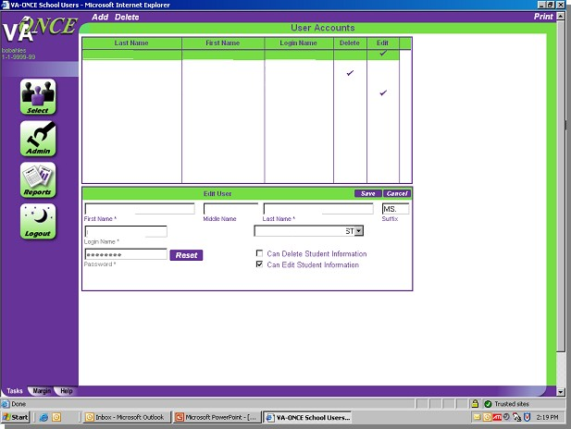
STEP 2: INITIAL SET UP – User Accounts.
(1)Click ADD. (2)Complete information. (3)Click on SAVE when completed.
By checking Delete, the individual will be able to view, edit, and delete. By checking Edit, the individual will be able to view and edit only. If you check Neither, the individual will have “read only” access.
25

Slide 26
26

Slide 27
STEP 1: INITIAL SET UP – Entering Term Dates.
Adding term dates allows for quick access later as you will not need to re-type the term each time. A drop-down for the terms you entered will be displayed when you certify your enrollments.
(1)Click on ADMIN Button. (2)Click on MAINTENANCE. (3)Click on STANDARD TERMS.
27

Slide 28
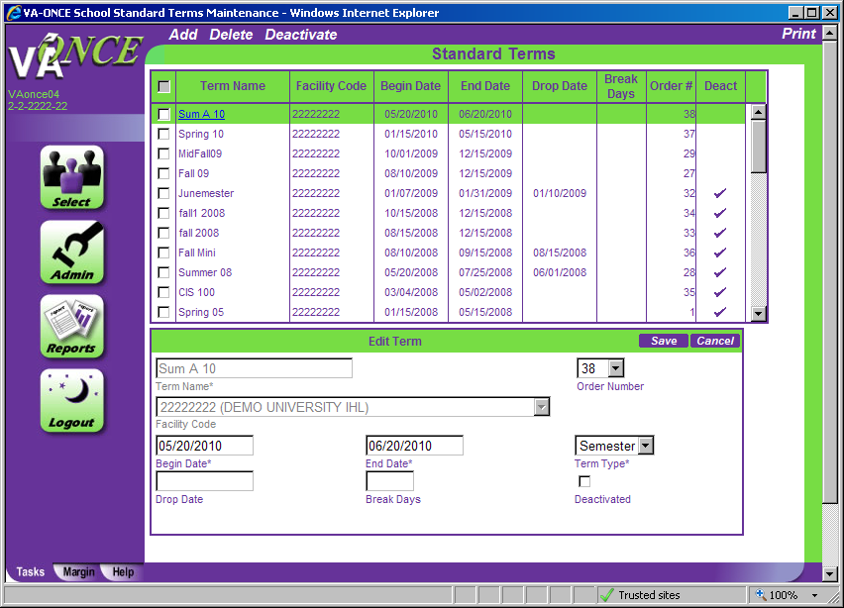
STEP 2: INITIAL SET UP – Entering Term Dates. (1)Click on ADD.
(2)Complete the term information. (3)Click on SAVE
(See additional information on following page to help you understand how to complete this section)
28

Slide 29
Additional Information to complete New Terms
Term Name – (e.g. FALL 2010, SUM 10) Enter an abbreviation for the term. This abbreviation cannot be duplicated for another term. This is not a required field, but may make it easier for you.
Order Number – Changes the order of how the terms are displayed. You can designate which terms appear at the top of the drop down by the order number. Order number 1 would place that term on top of your list of terms.
Beginning Date, End Date – Enter the dates published in the school catalog.
Term Type – Select Semester, Quarter, or Clock as appropriate.
Drop Date – Enter the date as published in the school catalog. It will enable edits in VA- ONCE that will not allow you to enter the reason during drop period, if it is after this date.
Break Days – number of days of the break during the term; must be 7 days or more. Add a remark on the enrollment certification letting the VA know the dates of the break (e.g. Holiday Break: 12/21/2010 – 01/05/2011)
Deactivated – Check the box if you do not want this term to appear in your drop down list, but wish to keep the term in your archive for future use. Click on the box and then click on DEACTIVATE located on the top of the screen. You can also re-activate the term by clicking on the term name and then clicking on the “checked” Deactivate Box to uncheck it.
To delete a term from the list of terms, you can check the box associated with the term you wish to delete and then click on DELETE located on the top of the screen.

Slide 31
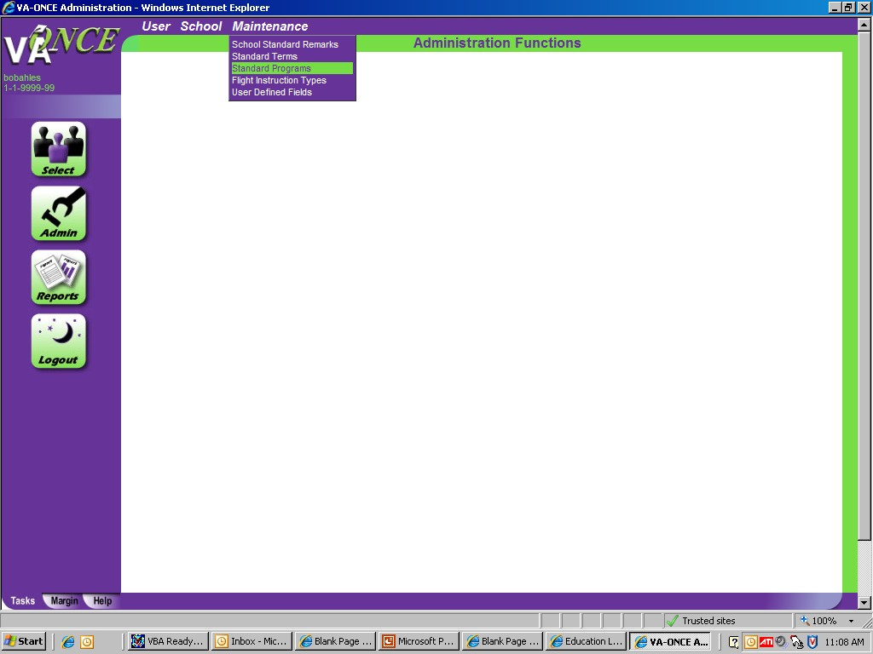
STEP 1: INITIAL SET UP – Entering Programs.
It is very important that you enter all approved programs (shown in the WEAMS document provided by your ELR) prior to entering your students as the programs you enter will appear in the Student Bio page drop-down menu.
Click on ADMIN.
Click on MAINTENANCE.
Click on STANDARD PROGRAMS.
31

Slide 32
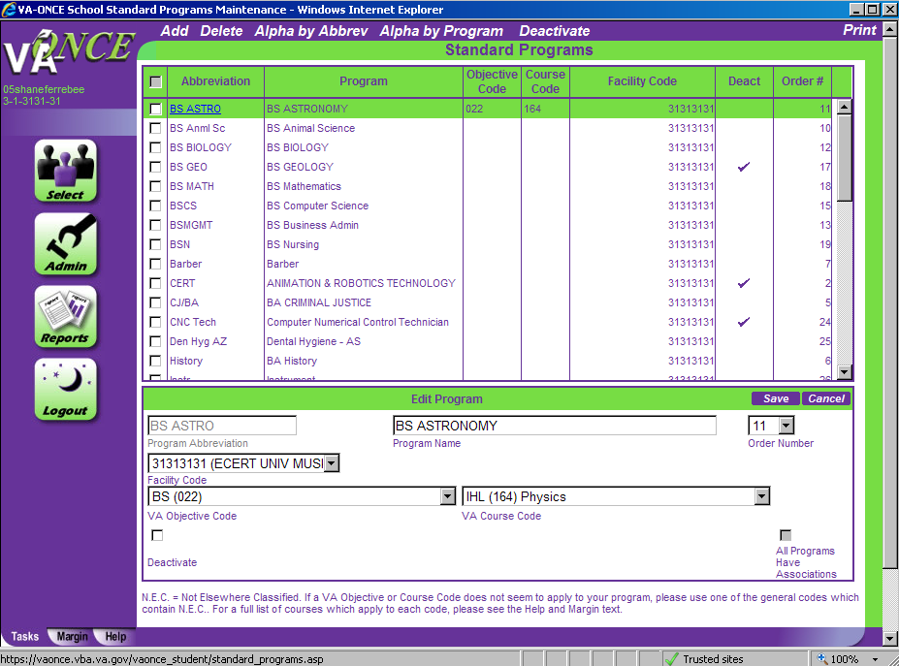
STEP 2: INITIAL SET UP – Entering Programs.
(1) Click on ADD. (2) Fill in the Program Abbreviation, Program Name, VA Objective Code and VA Course Code accordingly. (3) Click SAVE. Repeat steps to add more programs.
(See additional information on following page to help you understand how to complete this section.)
32

Slide 33
Additional Information to complete Entering Programs
Program Abbreviation – Enter an abbreviation for the approved program. This abbreviation cannot be duplicated for another program. For example, if you enter “SOC” for BS-Sociology, you cannot use “SOC” for BA-Sociology.
Program Name - Enter the program name. You may type of degree followed by the program of study (e.g. BS-Sociology), or the program of study followed by the degree (e.g. Sociology-BS). If there is more than one type of degree for the program, list each type separately (e.g. BA-Sociology; BS-Sociology; MS-Sociology).
OBJECTIVE CODES AND COURSE CODES ARE LISTED ON PAGES 36-41
Adding VA Objective Codes and Course Codes for IHL programs
If you are adding Objective/Course code(s) to program(s) that were input before the code requirement, select the program name by highlighting it. This will enable the Edit Program area. You can now input the Objective/Course code from the corresponding drop down list. Select Save when complete.
If you are adding new program(s), you will have to enter all of the required data, to include the Objective and Course codes. Select Save when complete.

Slide 34
VA Objective/Course Codes cont.
Adding VA Objective Codes and Course Codes for NCD programs
Follow the directions above. However, you do not need to select the VA Objective Code. Select the appropriate VA Course Code from the drop down list. The VA Objective Code will automatically populate with the same code. The VA Objective code field will be disabled.

Slide 35
VA Objective/Course Codes cont.
On the drop down list, all Course codes are preceded by the type of training. IHL – for programs at an Institution of Higher Learning;
NCD – for programs at Non-College Degree schools;
NAI – for Non-college degree programs at Institutions of Higher Learning; and FLI – for Flight programs
IHL programs are listed first, but you can jump to different portions of the list by typing in “N” (NCD) or “F” (Flight).
N.E.C. stands for Not Elsewhere Classified. If a VA Objective or Course Code does not seem to apply to your program, please use one of the general codes which contain “N.E.C.”.

Slide 36
Additional Information to Complete Entering Programs
Order Number – You can designate in which order programs are listed by giving the program an order number. Order number 1 would place the program first in the list of programs shown.
Note – You can also alphabetize the programs in your list by either the Program Name or Program Abbreviation. These options are at the top of the page and will re-order the programs accordingly.
Deactivated – Check the box if you want this term not to appear in your list, but wish to keep the term in your archive for future use. Click on the box and then click on DEACTIVATE located on the top of the screen. You can also un-deactivate by clicking on the name of the program and then clicking on the “checked” Deactivate Box.
To delete a term from the list of terms, you can check the box associated with the term you wish to delete and then click on DELETE located on the top of the screen.
Additional Information on Changing Programs
Special characters that are not allowed are removed when you are first entering programs, but if you are changing the name of a program, they are not. Please DO NOT use slashes (forward “/” or backward “\”) when changing the name of the program, as it can cause errors with the Standard Programs page.

Slide 37
VA Objective and Course Code Listings
VA Objective Codes:
Non-Mat (000) = Non-matriculated AA (011) = Associate of Art
AS (012) = Associate of Science
AD (013) = Associate Degree Not Elsewhere Classified BA (021) = Bachelor of Art
BS (022) = Bachelor of Science
BD (023) = Bachelor Degree Not Elsewhere Classified MA (031) = Master of Art
MS (032) = Master of Science
M (033) = Masters Degree Not Elsewhere Classified Dr of Philosophy (041) = Doctor of Philosophy
Doctors Degree (042) = Doctors Degree Not Elsewhere Classified Postdoctoral (051) = Postdoctoral Degree Not Elsewhere Classified

Slide 38
VA Course Codes – Institutes of Higher Learning (IHL):
Nonmatriculate (000)
Undecided Major (001) Business and Commerce (060)
Mathematics and Statistics (150) Astronomy (161)
Chemistry (162)
Environmental Sciences (163)
Physic (164)
Physical Sciences, N.E.C. (165) Economics (171)
History (172)
Industrial Relations (173)
Political Science (174)
Psychology (175)
Public Administration (176) Social and Welfare Work (177) Sociology (178)
Other Social Sciences (179)
Computer Science and Systems Analysis (191) Home Economics (192)
Library Science (193)
Other Academic Fields, N.E.C. (194) Agricultural and related courses (911) Marine engineering and navigation (912)
Engineering (070)
Preparation for Teaching (080) Applied Arts (091)
English and Literature (092) Fine Arts (093)
Foreign Languages (094) Liberal Arts, N.E.C. (095) Performing Arts (096)
Philosophy (097)
Theology (098)
Law (except prelaw) (100) Agricultural Sciences (110)
Biological Sciences (120) Medicine and Surgery (131)
Dentistry (D.D.S. and D.D.M. only-Not predental) (132) Nursing (133)
Osteopathy (134)
Pharmacy (135)
Veterinary Medicine (D.V.M. only-Not Preveterinary) (136) Mortuary science (913)
Optometry (137)
Chiropody or Podiatry (138) Physical Therapy (139)
Dental Hygiene (141)
Occupational Therapy (142)
Stationary engineer (914)
Other institutional courses, N.E.C. (915)
38
Other Medical or Related Courses (exclude Technicians) (143)

Slide 39
VA Course Codes – Non-College Degree (NCD):
Accounting (421)
Acting (331)
Advertising (422)
Air Conditioning and Refrigeration (510) Aircraft Mechanics (576)
Airline Service (437)
All Other Crafts and Trades, N.E.C. (632) Applied Arts N.E.C. (320)
Automobile or Motor Vehicle Mechanics (571) Baking, Canning, and Preserving (561)
Ballet Dancing (332)
Barbering (431)
Blacksmithing (581)
Bookbinding (621)
Bookkeeping (423)
Bricklaying (521)
Cabinetmaking (522)
Carpentry (523)
Ceramics and Design (Not Engineering) (328) Chemical and Related Products (622)
Clerical (425)
Commercial Art (321)
Computer Technology (424)
Custodial Service (432)
Dairying (562)
Decorating and Window Display (322) Design (325)
Diesel and Heavy Equipment Mechanics (572)
Drafting (323)
Dressmaking and Tailoring (530) Electrical Trades (540)
Electronic & Communication Mechanic (553) Electronic Technician (311)
Electronics Assembly and Installation (551) Electronics Operation (552)
Elementary Courses (451)
Engineering Technician (312) Engraving, Hand and Machine (582) Glass Products (623)
Grain Processing and Packing (563) Heavy Equipment Operation (629) Hospital or Medical Services (435) Hotel and Motel Training (433) Jewelry and Watchmaking (583) Laundry & Dry Cleaning (434) Leather and Leather Products (624)
Legal Technician, Including Law Clerk (315) Lumber and Lumber Products (625) Machinists (584)
Meat Processing (564) Mechanical Courses, N.E.C (577)
Medical & Related Technologies (313) Metalwork Courses, N.E.C. (586) Musicians (333)
Optical Mechanics (575) Other Services, N.E.C. (438)

Slide 40
VA Course Codes – Non-College Degree (NCD): Other Business and Commerce, N.E.C. (429) Other Construction and Related Courses (526) Other Electrical Trades, N.E.C. (554)
Other Food Trades (565)
Other Technical Courses, N.E.C. (314) Painting (524)
Paper and Paper Goods (626) Performing Arts, N.E.C. (335) Photography (324)
Plumbing (525)
Printing (590)
Protective Services (436)
Radio and TV Broadcasting (334) Railroad Mechanics and Repairmen (573) Real Estate and Insurance (427) Salesmanship (428)
Secondary Courses (High School & College) (452) Secretarial (426)
Sheetmetal Working (585) Shoe Making and Repair (610) Surveying (329)
Textile Manufacturing (627)
Tobacco Manufacturing (628)
Upholstering (631)
Agricultural and related courses (911)* Marine engineering and navigation (912)* Mortuary science (913)*
Stationary engineer (914)*
Other institutional courses, N.E.C. (915)*
* These 5 codes are listed under IHL. However, they can by used for NCD and at IHL, if applicable

Slide 41
VA Course Codes – Non-College Degree (NCD): Applied, Fine and Graphic Arts Technology (201) Automotive Technology (214)
Bible Study or Religious Work (Technology) (202) Building and Construction Technology (203) Business and Commerce Technology (204)
Data Processing Technology (205) Electrical Technology (206)
Mechanical Technology (207) Medical or Related Technology (208)
Police, Criminology, or Fire Protection (Technology) (209) Miscellaneous Engineering-Related Technology (211) Miscellaneous Science-Related Technology (212)
Other Technologists, N.E.C. (213) Agricultural and related courses (911)* Marine engineering and navigation (912)* Mortuary science (913)*
Stationary engineer (914)*
Other institutional courses, N.E.C. (915)*
* These 5 codes are listed under IHL, however they can be used for NCD and NCD at IHL, if applicable.

Slide 42
VA Course Codes – Flight:
Advanced Flight or Commercial Pilot (341) Airline Transport pilot Training (342)
Flight Instructor Course (344) Glider Training (343) Instrument rating Course (345)
Multiengine Class Rating Course (346) Other Flight Training, N.E.C. (347)
VA Course Codes – Other:
Special Program (999)

Slide 44
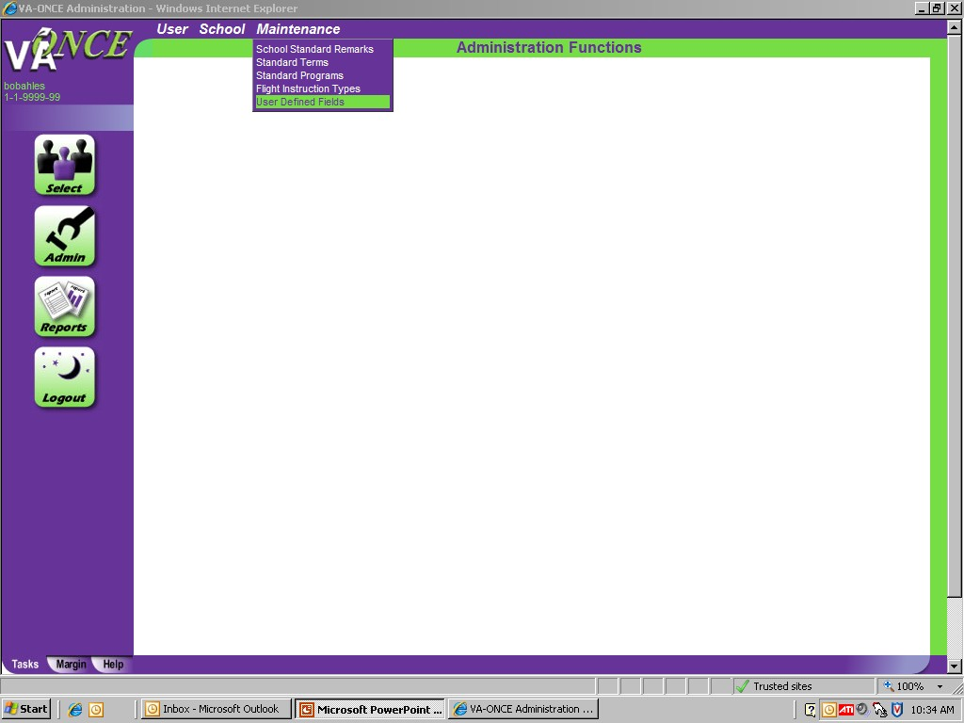
STEP 1: INITIAL SET UP – User Defined Fields.
The user defined fields are 3 text boxes and a check box on the Student Bio page. They are there for your use only, and are not transmitted to VA. You can use these fields to track anything you would like. Some schools use these to keep track of things such as the student's counselor, branch of service, tuition deferments, Chapter 33 percentage rates, Fry Scholarships, tuition assistance, or other information important to your school.
(1)Click on ADMIN BUTTON. (2)Click on MAINTENANCE.
(3)Click on USER DEFINED FIELDS.
44

Slide 45
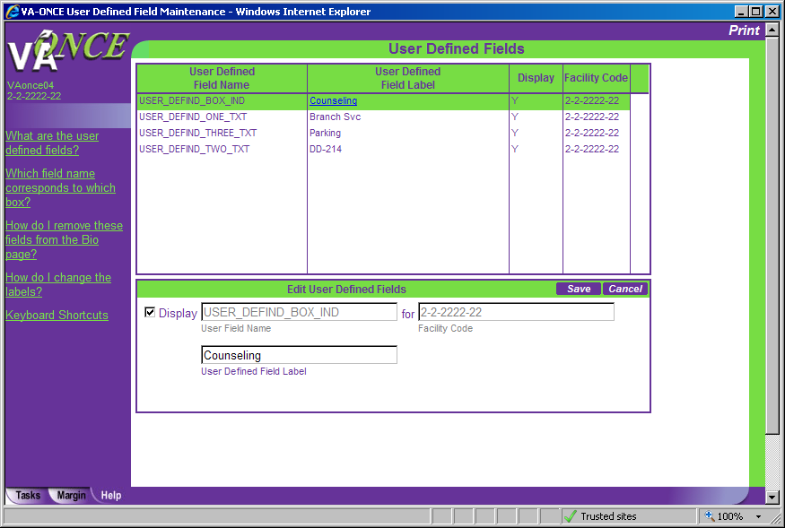
STEP 2: INITIAL SET UP – User Defined Fields. (1)Click on the User Defined Field Name to highlight it.
(2)Type in the name to be displayed in the User Defined Field Label field. (3)Click on SAVE.
The Bio screen will show the new user defined field label. You can display up to 3 user defined text boxes and one defined check box.
45

Slide 46
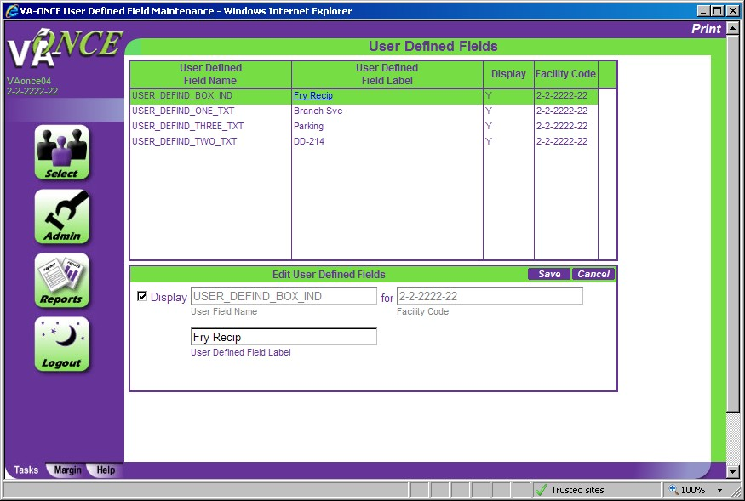
STEP 2: INITIAL SET UP – User Defined Fields.
To remove the user defined fields, if you do not want them displayed.
Highlight the user defined field name
Click on the DISPLAY box to uncheck it. (3)Click SAVE.
46

Slide 48
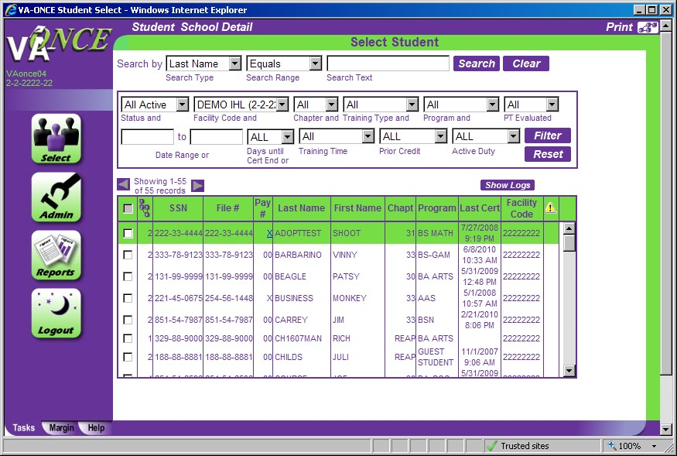
STEP 1: INITIAL SET UP – Select Student – School Details.
The Select Student screen has two actions shown above: STUDENT and SCHOOL DETAIL.
We will cover SCHOOL DETAIL first. (1)Click on SCHOOL DETAIL. The Select School screen appears.

Slide 49
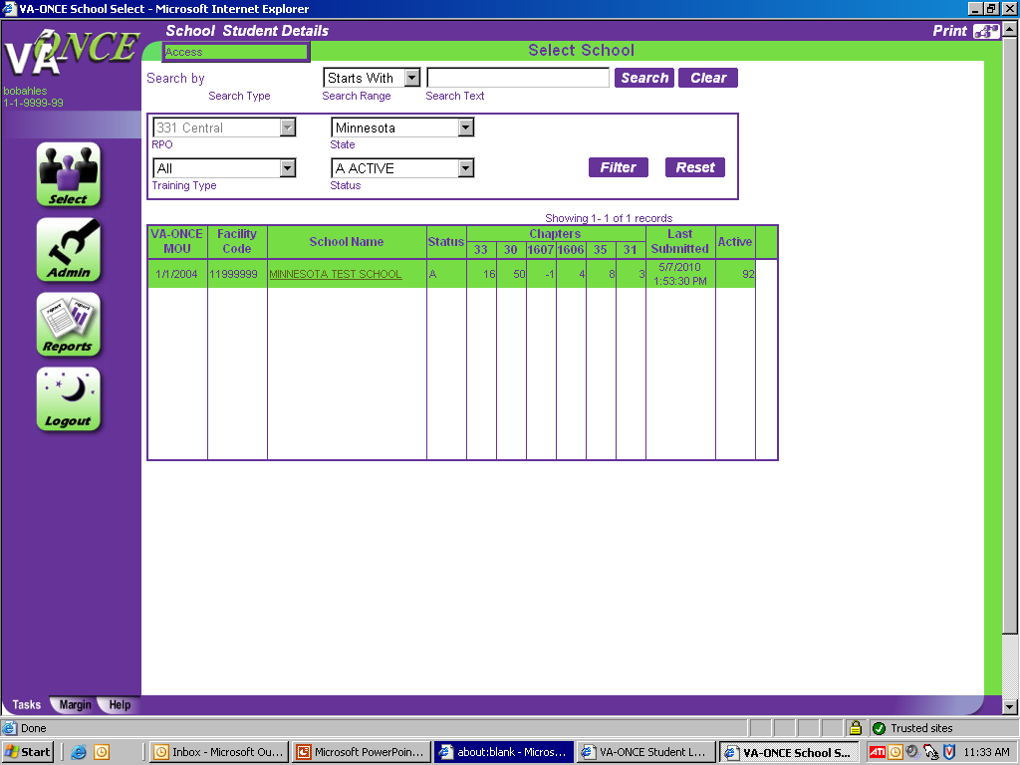
STEP 2: INITIAL SET UP – School Details.
The SCHOOL DETAIL action allows your Education Liaison Representative (ELR) to input information about you and your school. You will have read only access to most data on the screen. If any is incorrect, contact your ELR. To access, double click on the school name or
(1)Click on SCHOOL. (2)Click on ACCESS. The School Data screen will appear.
49

Slide 50
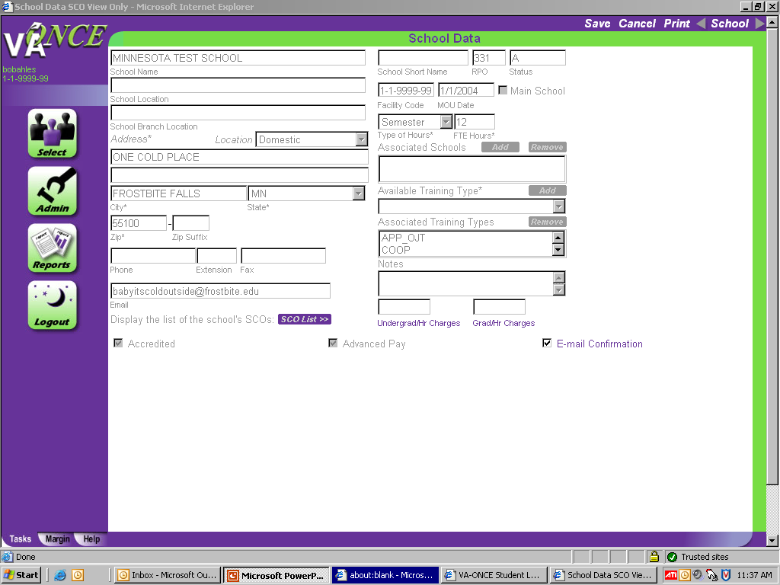
STEP 3: INITIAL SET UP – School Data.
To establish an automated email to the student each time a certification is submitted
Place a check in the “E-mail Confirmation” box by clicking the box.
Click on SAVE after checking or unchecking the box.
An email will be sent to the student email address (or addresses) on the Student Bio page.
50

Slide 51
STEP 4: INITIAL SET UP – School Data.
You also have the option of entering rates in the Undergraduate per hour charges field and the Graduate per hour charges field. By entering the per hour charge, the tuition and fees will be automatically calculated based upon the number of hours you enter on a certification.
For example, if you enter $100 per hour here and enter 12 hours on the enrollment certification, the Tuition and Fees field will be populated with $1200.00. You will still be able to change this, if needed.
51

Slide 52
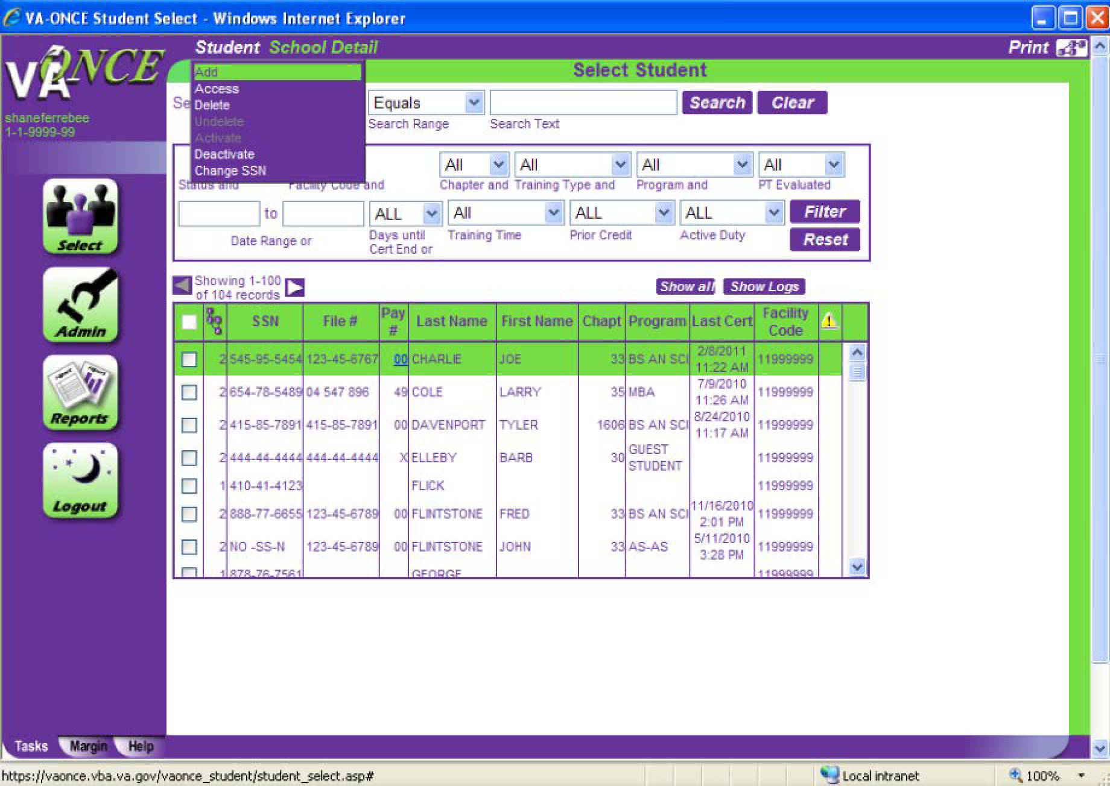
STEP 1: INITIAL SET UP – Adding students – STUDENTS.
(1)Click on STUDENT on top of the screen. (2)Click on ADD. An Add a Student Box appears.
52

Slide 53
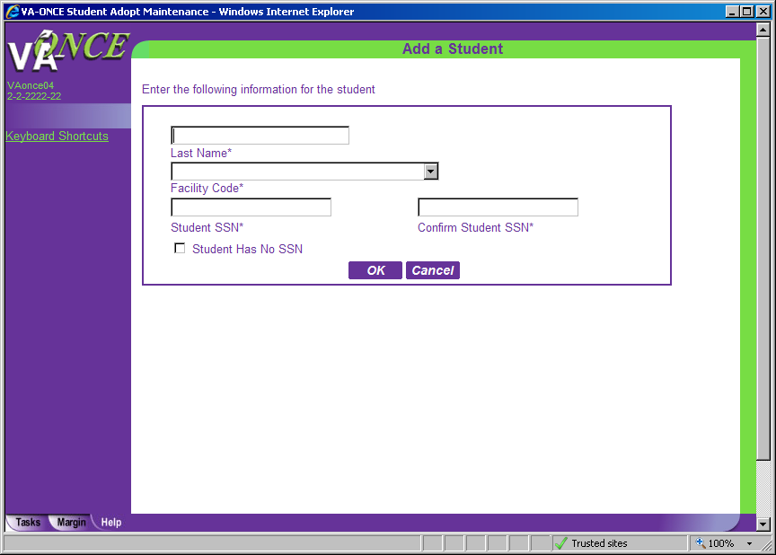
STEP 2: INITIAL SET UP – Adding students – STUDENTS.
Enter the Last Name, select the appropriate facility code from the drop down, enter the Student SSN and enter the Student SSN again in the Confirm Student SSN field. Be very careful to enter the correct SSN for the student.
Click on OK when finished.
If the student exists at another school, a message appears (see page 53).
If the student already exists at your school, a different message appears (see page 54).
If the student is being added to VA-ONCE for the first time, you will be taken to the Bio page.
53

Slide 54
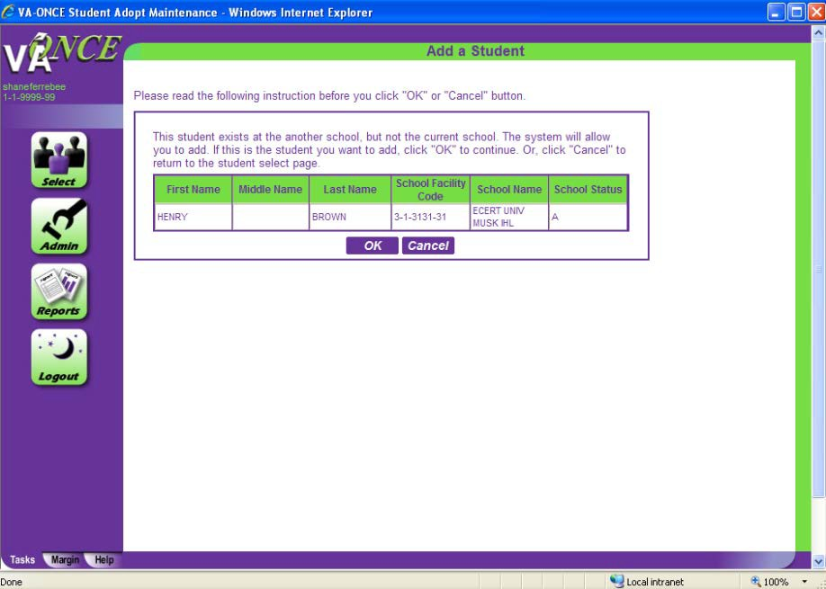
STEP 3: INITIAL SET UP –Add a Student (message screen).
If you receive this message, the student has been certified in the past by another school. When you add the student, you will be able to see, but not modify, those past certifications.
Click OK to continue, or Cancel if this is not the correct student.

Slide 55
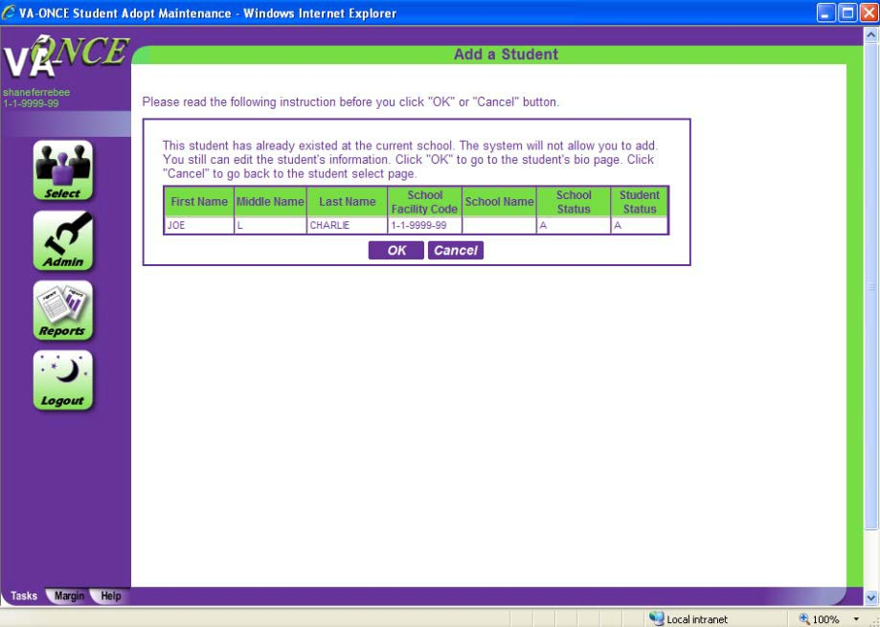
STEP 3: INITIAL SET UP –Add a Student (message screen).
If you receive this message, the student is at your school. The Student Status column will have an A (Active), D (Deleted), or I (Inactive). Click cancel to go back to select student page. Then, on the select student page, use the Status filter for Deleted or Inactive. This will bring up a list of students in that status and you can undelete or reactivate the student. (See Page 116 for instructions.)

Slide 56
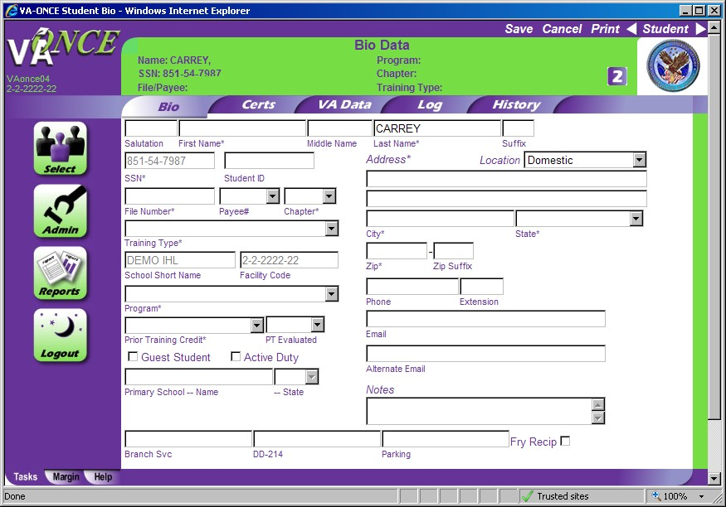
STEP 4: INITIAL SET UP – Adding Students.
Enter the required information for the student on the Bio Data page. Required fields are designated by an asterisks. Once you have entered the information, click on SAVE
(See additional information on the following page to help you understand how to complete this section.)
56

Slide 57
Additional Information to complete the BIO DATA page
The File Number is usually the students’ SSN with the exception of Dependent's Educational Assistance, chapter 35. For chapter 35, this is the dependent’s spouse or parent’s Social Security Number or 8 digit claim number. The dependents VA File number will be on all award documents sent to the claimant. Don’t confuse Ch 35 (dependents) with Ch 33 Transferee dependents. VA uses the Ch 33 transferee (the student) SSN as the file number. For chapter 31 students, the file number may be 8 digits. Be sure you input the correct VA File number for chapter 31 students or the certification will not be received by the VR&E counselor.
Fry Scholarship recipients: Select Ch 33 as the chapter for this type of beneficiary (not eligible for yellow ribbon) Use the student’s SSN as the file number.
The Payee Number for Ch 35 may not be known. If not known, add “XX”.
Make sure that the Training Type you choose from the drop down menu reflects the actual type of program the Student is taking (IHL, NCD).
Use “Guest Student” if your school is not the primary institution. (Make sure you have a parent letter on file if you are the guest school). Enter the name of the parent school and the State in order for it to be routed to the correct Regional Processing Office.
VRAP: This benefit ended on March 31, 2014. The selection was removed from VA- ONCE. If you need to make a change to a certification that was sent as VRAP claim, you will need to change the benefit type on the Bio page to 32.

Slide 58
Additional Information to complete the BIO DATA page cont.
For additional assistance, review the MARGIN and HELP tabs for complete information on how to fill out the BIO DATA page for your students.
After you SAVE the data, you can go back to the Select Page to add another student by clicking on SELECT button.

Slide 60
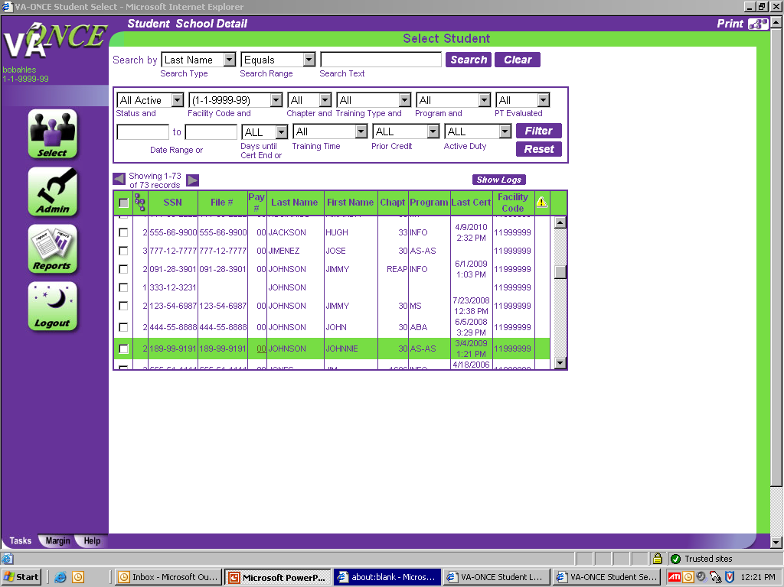
STEP 1: Certify Enrollments – Single Term
Certifying Enrollments correctly is the most important step in the process of ensuring that benefits are paid correctly. Attention to detail is the key ingredient when creating an enrollment certificate.
(1)Double-click on the student you wish to certify. The student’s record will open to the Bio page. Additional tabs will be available.
60

Slide 61
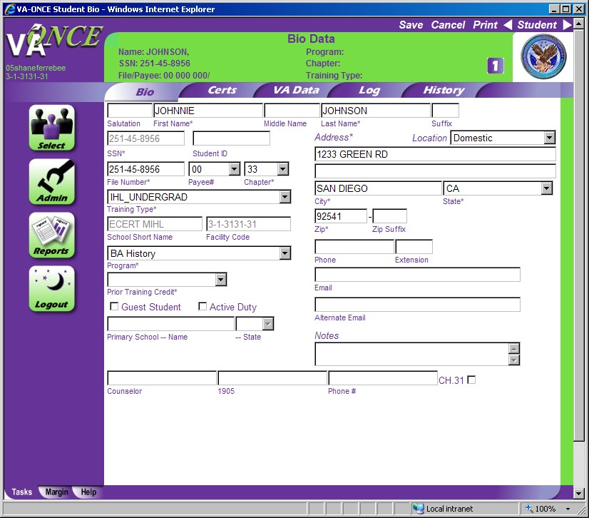
STEP 2: Certify Enrollments – Single Term
(1)Click on CERTS tab. The Certs screen appears.

Slide 62
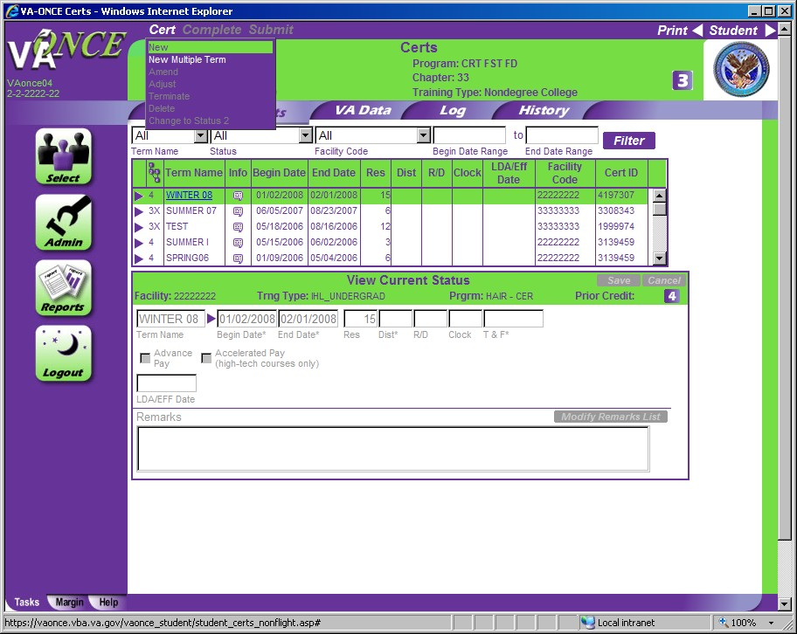
STEP 3: Certify Enrollments – Single Term
Click on CERT located on top of the screen. A drop down menu appears.
Click on NEW. The bottom ½ of the screen will open for editing. The section title will change from “View Current Status” to “Edit Enrollment”.

Slide 63
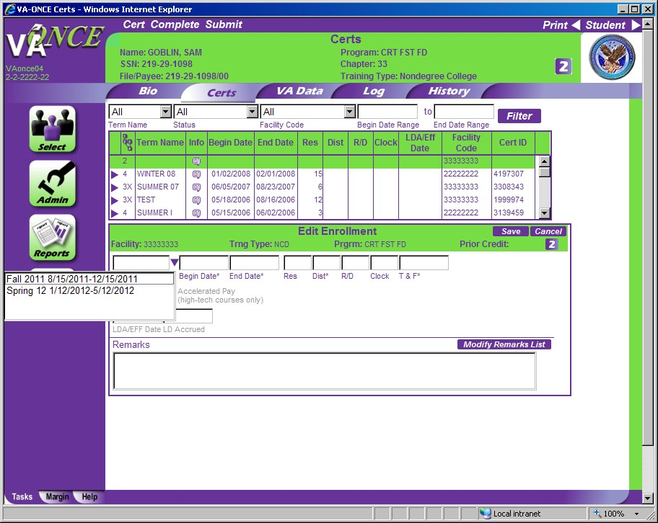
STEP 4: Certify Enrollments – Single Term
(1)You can now complete the fields in the Edit Enrollment section. All fields with asterisks are required.
Note: If you click on the arrow next to Term Date, you will see all of the terms you entered using the Standard Terms feature. This will save you valuable time.
(See page 66-67 for additional information on Chapter 33 Tuition & Fees (T&F).)

Slide 64
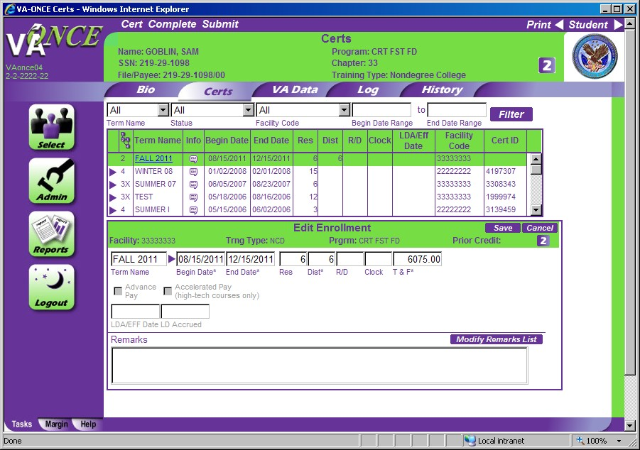
STEP 5: Certify Enrollments – Single Term
Once you have entered the required data, review for accuracy. (1)Click SAVE.
Click COMPLETE. Note – you can skip this step and click directly on Submit. Complete can be used if you are not submitting right away and would like to review later.
Click SUBMIT.

Slide 65
Additional Information to complete the Certs - Edit Enrollment section.
Term Name – A corresponding arrow next to the TERM NAME box will allow to access the drop down list of all the terms you have entered. The name, begin date and end date will be entered.
Res – Number of residential (classroom) credits taken during the term. NOTE: THE RES box must not include any DIST, R/D, or Clock hour credits. ONLY Residential (Classroom) should be entered. The field requires a numerical value. Report “0” if necessary.
Dist – Number of distance (online, non-classroom) credits taken during the term. The field requires a numerical value. Report “0” if necessary
R/D – Number of remedial / deficiency credits taken during the term. NOTE: Online Remedial Courses cannot be certified. Only Residential Remedial courses can be certified.
Clock – Number of clock hours taken per week (typically found in NCD programs, internships, externships).
Tuition & Fees – Tuition and fees charged to the student for that term. (See following page for further information on Tuition & Fees.)
TT/FT= – Graduate programs – for non-chapter 33, select the training time from the drop down list. For chapter 33, insert the number of credits that is considered full time for that program and term based on your school catalog. See the SCO Handbook for further info.
Yellow Ribbon – Only available for benefit type 33Yellow. Insert the amount your institution has agreed to fund above the highest instate rate for that particular term.
Out of State Charges – Charges above and beyond the in-state charges. These charges will be covered by the Yellow Ribbon program. The out-of-state field will appear only on Yellow Ribbon certifications.
65

Slide 66
General rules for reporting tuition
Tuition & Fees: Schools should report the net-charge for tuition and fees.
What should be deducted from the Tuition amount reported to VA?
Any waiver, scholarship, aid, or assistance [other than loans and funds provided under section 401(b) of the Higher Education Act of 1965] provided directly to the institution and specifically designated for the sole purpose of defraying tuition and fees.
Only in-state charges should be reported in the Tuition and Fees field.
Any additional out-of-state net charges should be reported in the Out of State Charges field.
What should NOT be deducted from the Tuition amount reported to VA?
Title IV Funds
Waiver, scholarship, aid, or assistance that is not designated for the sole purpose of reducing a student’s tuition and fee cost.
Please see the SCO Handbook section, “CERTIFYING TUITION AND FEES” for more guidance. http://www.benefits.va.gov/gibill/docs/job_aids/SCO_Handbook_v3.pdf

Slide 67
General Rules for reporting fees
Fees: The mandatory charges (other than tuition, room, and board) applied by the school for pursuit of an approved program of education. Fees include, but are not limited to:
health premiums
freshman fees
graduation fees
lab fees
Tool Kits, Uniforms fees (if listed on the student invoice)
Fees do not include those charged for a study abroad course(s) unless the course(s) is a mandatory requirement for completion of the approved program of education.
NOTE: VA will not pay a mandatory third party charge. Third party charges are charges not originating at your institution. For example, if a student requires a toolbox for an approved program, in order to report the fee, the student must buy the toolbox from your institution. You could not report the fee charged the student if the student bought the toolbox from any source other then your institution.
If you are unsure, check with your Education Liaison Representative.

Slide 68
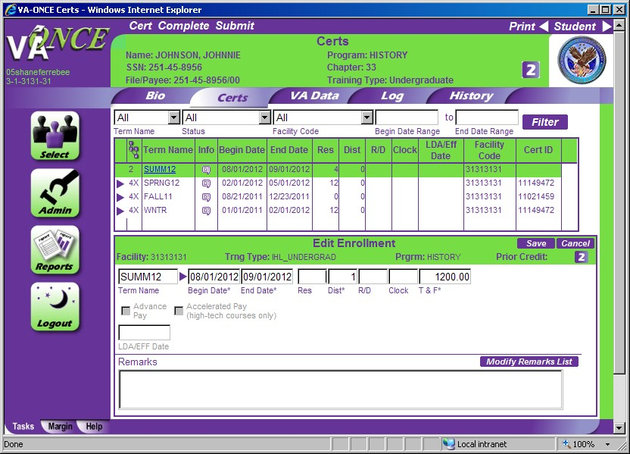
Chapter 33 Enrollment ERROR MESSAGE
When certifying a term, both Res and Dist must have a numeric value. Report “0” hours, if necessary. Leave the R/D and Clock field blank, if no value applies.

Slide 69
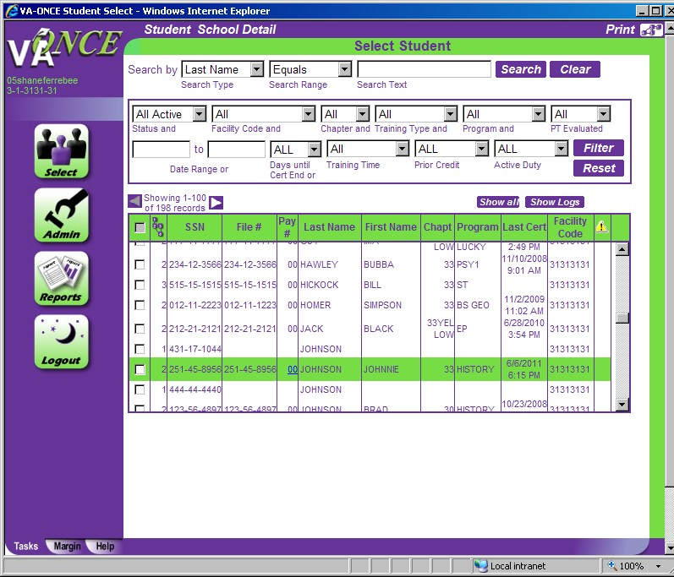
Step 1: Certify Enrollment - Multiple Terms
If you are certifying more than one term at a time, you can use the Multiple Term certification feature. Multiple term enrollments come in handy when you have a variety of term lengths within a semester or quarter, or are certifying past terms.
(1)Double-click on the Student for which you wish to create a multi-term certification.

Slide 70
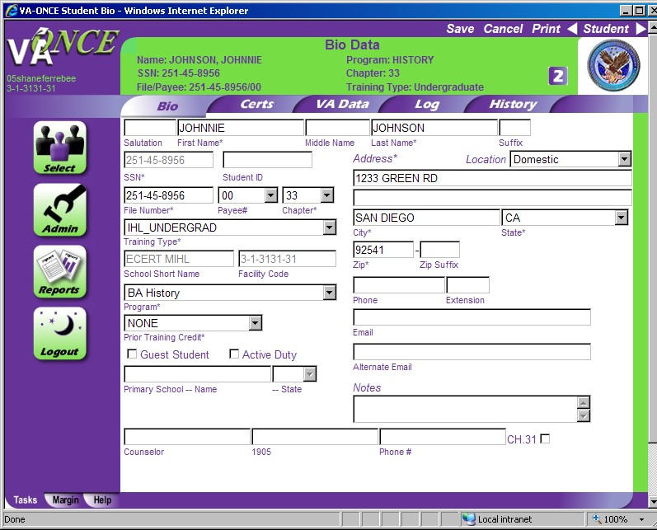
Step 2: Multiple Term Enrollments
(1)Click on CERTS. A Certs screen appears

Slide 71
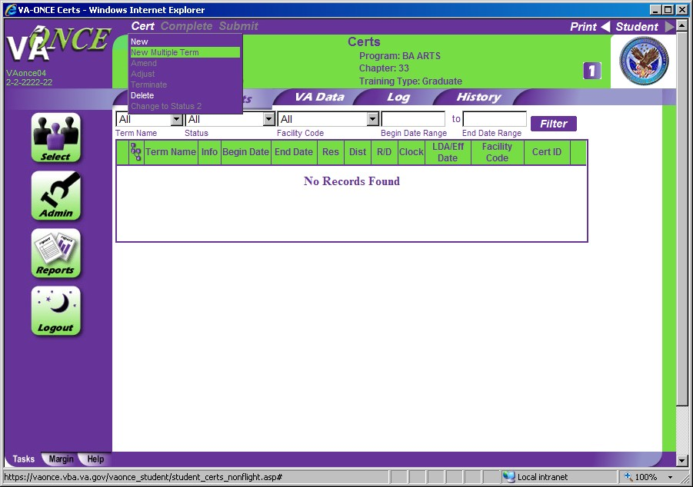
Step 3: Multiple Term Enrollments
Click on CERT located on top of the screen. A drop down menu appears.
Click on New Multiple Term. A Multiple Terms window appears.

Slide 72
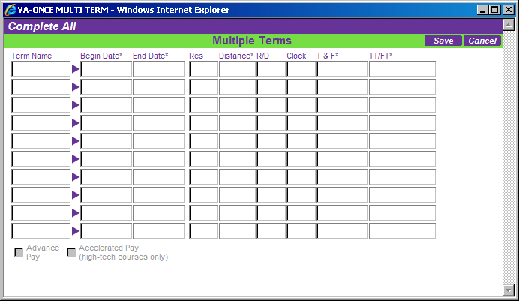
Step 5: Multiple Term Enrollments
Enter the information for each term just as you would for a single term.
When you have entered all of the data, click on SAVE to save the terms in status 2. Click on COMPLETE ALL to save the terms in status 3. You will be returned to the Certs page.

Slide 73
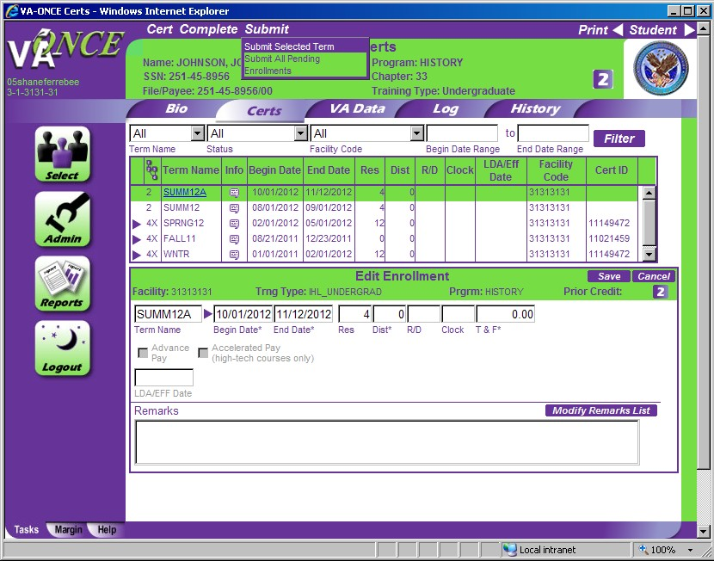
Step 6: Multiple Term Enrollments
On the Certs page, you will see the terms you created (in a status 2, if you selected Save; in a status 3, if you selected Complete All).
To send all terms at once, (1)Click Submit
(2)Click Submit All Pending Enrollments.
73

Slide 74
74

Slide 75
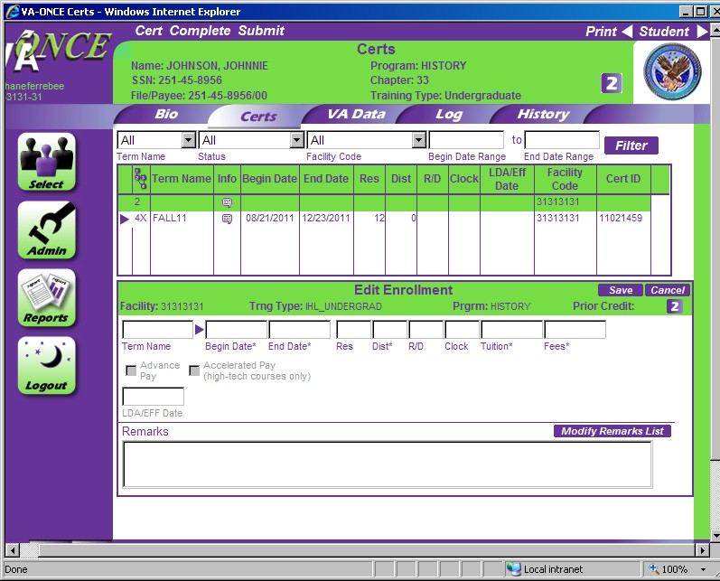
STEP 1: Remarks
Remarks are not usually needed in order to process a claim, and will prevent automation in most cases, but if you need to add them, take the following steps while editing an Enrollment.
(1)Click on MODIFY REMARKS LIST. A Remarks Pop-Up screen appears.
75

Slide 76
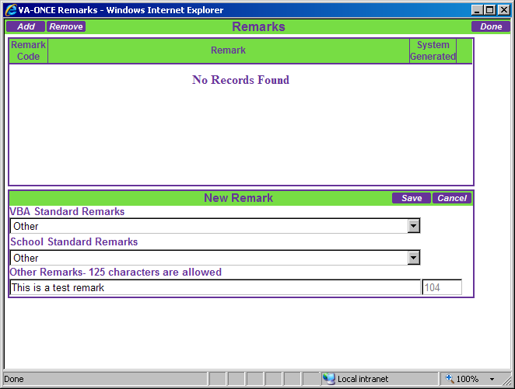
STEP 2: Remarks
Click Add.
Select the VBA Standard Remark from the drop down list. If no VBA Remarks apply, select Other.
Select the School Standard Remark from the drop down list. If none apply, and you need to enter free text, select Other.
Enter your free text remark in the Other Remarks box. You are limited to 125 characters. There is a character count at the end of the field for your information.
Click SAVE. (6)Click DONE.
76

Slide 78
Helpful definitions for modifying enrollments.
Adjustment – Adjusting the enrollment certificate allows you to report a decrease or increase in hours for the term.
Amend – Amending the enrollment certificate allows you to edit the beginning date, ending date, or tuition and fees. For non- chapter 33 cases you can also add an advance pay or accelerated pay request. This feature should be used if you are correcting something, other than hours, on the original enrollment certification.
Terminate – Terminating the enrollment allows you to report when a student is no longer attending the term (dropped to zero credits).

Slide 79
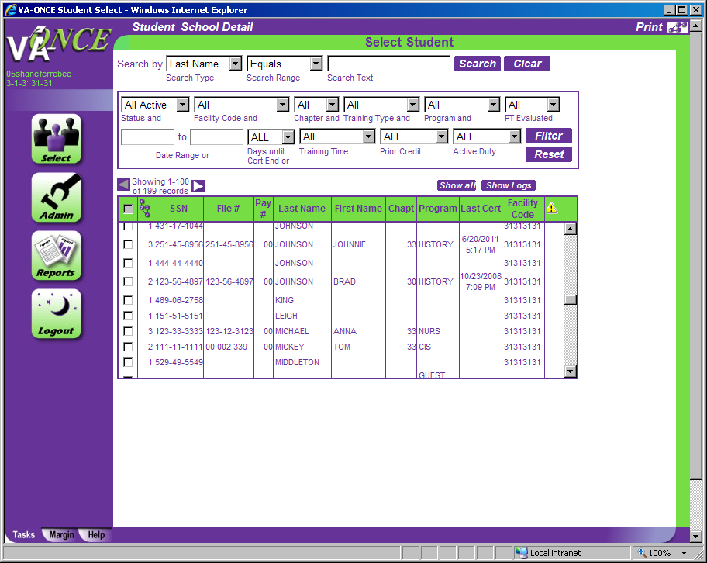
STEP 1: Modifying Enrollment - Adjustments
Adjust the certification if you want to increase or decrease the number of credits. Adjustments are used when the student still has remaining credits.
(1)Double-click on the student, or select Student, then Access from the drop down at the top of the screen. The Bio Data screen appears.

Slide 80
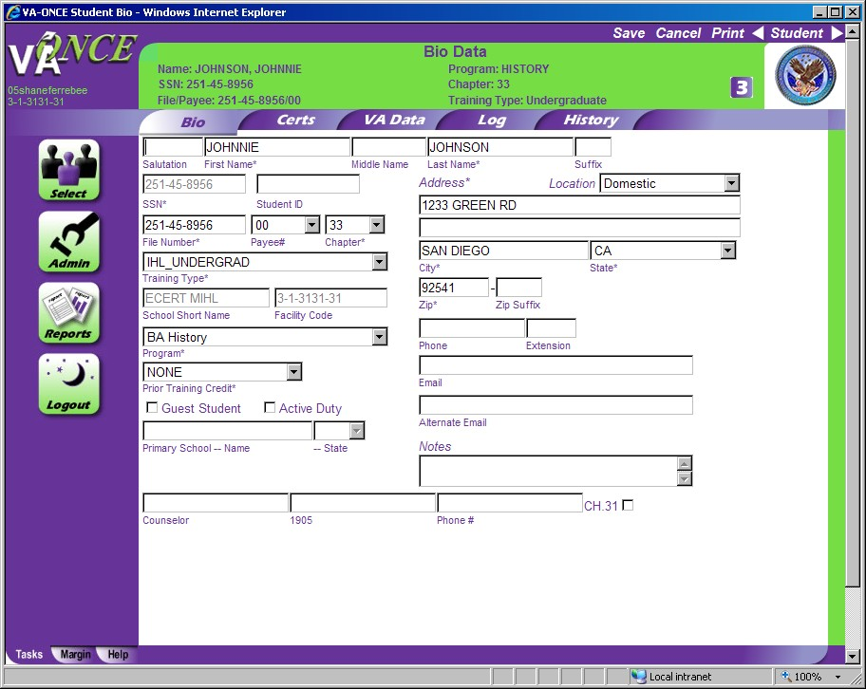
STEP 2: Modifying Enrollment - Adjustments
(1)Click on the CERTS tab. The Certs page appears.

Slide 81
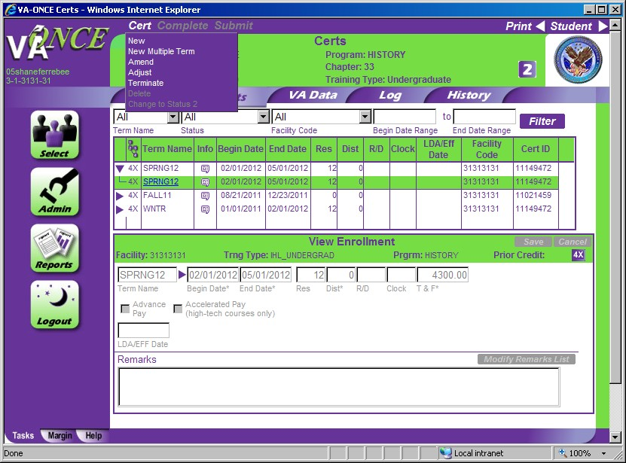
STEP 3: Modifying Enrollment - Adjustments
Select the term to adjust by clicking on the arrow to expand the virtual record, and then highlighting the term.
Click on CERT located on the top of the page The drop down menu appears. (3)Click on ADJUST. The bottom ½ of the screen opens up to Edit Adjustment.

Slide 82
STEP 4: Modifying Enrollment - Adjustments
You can now make adjustments to the following fields: Res, Dist, R/D, Clock, Tuition, Fees, Training Time or Full Time Equivalent (graduate training only), Yellow Ribbon (Ch 33),
Select the Reason for Adjustment from the drop down.
Enter the LDA/EFF Date (Last Date of Attendance/Effective date of the change).
8
2

Slide 83
STEP 4: Modifying Enrollment – Adjustments (continued)
(4)Based upon the Reason for Adjustment, a Mitigating Circumstances field may appear. If the student has provided you with one of the reasons in the list as a reason for adjustment, please select it from the drop down.
If the student has provided mitigating circumstances not on the list, or has not provided a reason for adjustment, leave the Mitigating Circumstance drop down blank.
You may enter a reason not provided in the drop down list a a free text remark.
See page 75-76 for adding Remarks.
83

Slide 84
STEP 5: Modifying Enrollment - Adjustments
The steps to submit an adjustment are the same as for an enrollment, as are the status codes. To submit - Review for accuracy.
Click SAVE.
Click COMPLETE. Note – you can skip this step and click directly on Submit. Complete can be used if you are not submitting right away and would like to review and submit later.
84
(3)Click SUBMIT.

Slide 85
Helpful definitions for completing adjustments
Res – Number of residential (classroom) credits taken during the term after the adjustment. NOTE: THE CREDITS box must not include any DIST, R/D, or Clock hour credits. ONLY CLASSROOM CREDITS ARE PLACED IN THIS COLUMN.
Dist – Number of online credits taken during the term after the adjustment.
R/D – Number of remedial / deficiency credits taken during the term after the adjustment. Online Remedial Courses cannot be certified. Only Residential Remedial courses can be certified.
Clock – Number of clock hours taken per week (typically found in NCD programs, internships, externships) after the adjustment.
Tuition & Fees – Tuition charged to the student as shown on the student’s billing statement for that term based on the adjusted credits, and mandatory fees charged to the student as shown on the student’s billing statement for that term based on the adjusted credits.
TT/FT= – Graduate programs only. For non-chapter 33 select the training time after adjustment from the drop down list. For chapter 33, insert the number of credits that is considered full time for that program and term based on your school catalog.
Yellow Ribbon – Ch 33 Yellow Ribbon Participants. Insert the dollar amount your institution has agreed to fund above the highest instate rate for that particular term based on the adjusted credits.
See additional information on following page for Ch 33 specific issues.
85

Slide 86
Helpful tips for completing the adjustment page for CH 33
You are required to adjust the tuition and fees if adjusting the credits. The adjusted tuition and fees amount will be based on the cost of the new credit load.
If your adjustment includes the Yellow Ribbon amount, you must calculate the new Yellow Ribbon amount based on the adjusted credits.
When filling in RES, DIST, R/D, CLOCK, the following actions must be completed in order to avoid an error message.
RES and DIST must have a number placed in the corresponding box. If no RES or DIST credits remain, place a ‘0’ in that box.
Leave the R/D and CLOCK ‘blank’ if no credits remain.
Example of an adjustment for Ch 33. Notice how a ‘0’ was placed in the DIST field and the R/D and CLOCK fields remain blank.
86

Slide 87
STEP 1: Modifying Enrollment - Amendments
Amend the certification if you have made a mistake in any field other than the hours, or to add the tuition and fees if you previously reported zero. For example, to change the start or end date, tuition, fees, Yellow Ribbon Amount (for 33), or to add an advance pay request (for non-33).
(1)Double-click on the student, or select Student, then Access from the drop down at the top of the screen. The Bio Data screen appears.

Slide 88
STEP 2: Modifying Enrollment - Amendments
(1)Click on the CERTS tab. The Certs page appears.

Slide 89
STEP 3: Modifying Enrollment - Amendments
Select the term to amend by clicking on the arrow to expand the virtual record, and then highlighting the term.
Click on CERT located on the top of the page The drop down menu appears. (3)Click on AMEND. The bottom ½ of the screen opens up to Edit Amendment.
89

Slide 90
STEP 4: Modifying Enrollment - Amendments
You can now edit all fields except the number of hours. A remark indicating that this is an Amended enrollment is automatically inserted. Review for accuracy.
Click SAVE.
Click COMPLETE. Note – you can skip this step and click directly on Submit. Complete can be used if you are not submitting right away and would like to review and submit later.
Click SUBMIT.

Slide 91
STEP 1: Modifying Enrollment - Terminations
Terminate the certification if the student is no longer attending the term (dropped to zero hours).
(1)Double-click on the student, or select Student, then Access from the drop down at the top of the screen. The Bio Data screen appears.

Slide 92
STEP 2: Modifying Enrollment - Terminations
(1)Click on the CERTS tab. The Certs page appears.

Slide 93
STEP 3: Modifying Enrollment – Terminations
Select the term to terminate by clicking on the arrow to expand the virtual record, and then highlighting the term.
Click on CERT located on the top of the page The drop down menu appears. (3)Click on TERMINATE. The bottom ½ of the screen opens up to Edit Termination.

Slide 94
STEP 4: Modifying Enrollment - Terminations
Select the Reason for Termination from the drop down menu. Based upon the Reason for Termination, the hours may automatically drop to 0 and/or a Mitigating Circumstances field may appear. If the student has provided you with one of the reasons in the list as a reason for termination, please select it from the drop down.
If the student has provided mitigating circumstances not on the list, or has not provided a reason for adjustment, leave the Mitigating Circumstance drop down blank.
You may enter a reason not provided in the drop down list as a free text remark. See page 75- 76 for adding remarks.
In some instances the LDA/EFF Date is populated automatically. If not, Enter the LDA/EFF Date. Review for accuracy.
Click SAVE.
Click COMPLETE. Note – you can skip this step and click directly on Submit. Complete can be used if you are not submitting right away and would like to review and submit later.
Click SUBMIT.
94

Slide 95
STEP 4: Modifying Enrollment – Terminations (cont.)
Note – If there are terms certified with begin dates after the termination date, you will be asked if they remain as certified, or if the termination applies to all subsequent terms.
Clicking OK will leave the terms as certified, clicking Cancel will generate terminations for all subsequent terms.
95

Slide 96
96

Slide 97
Certification Deletion – Status 2
Note: Only incomplete certifications created by your school that have not been submitted can be deleted (status 2). Status is found on the left column next to the cert.
Highlight the certification you wish to delete.
Click on CERT located on top of the page. A drop down menu appears (3)Click on DELETE. The term will be deleted from the list of terms shown.
You may also use the Cancel button in the Edit Enrollment area to delete a certification.
97

Slide 98
STEP 2: Certification Deletion – Status 3
Certifications in Status 3 are “complete”. In order to delete them, you must change them to a status 2.
Highlight the certification you wish to delete.
Click on CERT located on top of the page. A drop down menu appears. (3)Click on CHANGE TO STATUS 2. The status will be changed to a ‘2’.
(4)Click back on CERT (top of page) and then click on DELETE to delete the CERT.
98

Slide 99
99

Slide 100
There are 2 separate reports that can be run from the Reports menu, The Weekly Certs Report and the Weekly Detail Certs Report. Each are described in the following pages.
Weekly Certs Report
Step 1: Reports Task button
This feature allows you to print all of the enrollments you submitted or worked upon in any given week. You can print the full certification or the list of students.
(1)Click on the Reports button. A Reports screen appears.
Step 2: Reports Task button
(1)Click on REPORT GROUP 1. A drop down menu appears. (2)Click on WEEKLY CERTS REPORT.
100

Slide 101
Step 3: The Weekly Certs Report
You can filter your certifications by Facility Code, Cert Type, Chapter Type, and CERT Status. Then select the week and the school certifying official.
Once you have selected your desired filters, click on FILTER. A list of students will appear.
101

Slide 102
Step 4: Weekly Certs Report
The list can be sorted by any of the columns by clicking on the heading at the top.
To print the list of certifications, select Reports Page on the Print menu.
To print individual certifications, click the box next to each student you wish to print, or click the box in the heading to select all, and then click Selected Certs on the Print menu.
102

Slide 103
Weekly Detail Certs Report
Step 1: Reports Task button
This feature allows you to view detail of all of the enrollments you submitted or worked upon in any given week. It includes more details about each certification than the Weekly Certs Report..
(1)Click on the Reports button. A Reports screen appears.
Step 2: Reports Task button
(1)Click on REPORT GROUP 1. A drop down menu appears. (2)Click on WEEKLY DETAIL CERTS REPORT.
103

Slide 104
Step 3: The Weekly Detail Certs Report
You can filter your certifications by Facility Code, Cert Type, Chapter Type, and CERT Status and SCO. Then select the week.
Once you have selected your desired filters, click on FILTER. A list of students will appear.
104

Slide 105
Step 4: Weekly Detail Certs Report
The list can be sorted by any of the columns by clicking on the heading at the top.
To print the list of certifications, select Reports Page on the Print menu. Another window will open and you must use Print on the File menu.
Note: Individual certifications cannot be printed from this report. You must use the Weekly Certs Report to print multiple paper certifications.
105

Slide 106
106

Slide 107
VA Data Tab
Provides information from VA’s payment system. You can view the student’s delimiting date and remaining entitlement.
You can view award data that has been processed for the student’s enrollment.
At this time, the feature is only available for students receiving benefits under chapter 30, VRAP, 1606, or 1607. Note – If they have switched to chapter 33 from chapter 30, 1606, or 1607, the previous chapter will appear on this page.
107

Slide 108
108

Slide 109
Log Tab
Used to keep a record of notes about a student. The Log is not transmitted to VA. To add a log entry, Click on ADD.
The “Edit Log Entry” section becomes active and changes to “New Log Entry”.
109

Slide 110
Log Tab
You can now type your entry in the text box.
Click on SAVE to save. The User Name, User Type, Date and Time, and Facility code are automatically recorded.
110

Slide 111
Log Tab
If you need to take further action on the log you created you can utilize the Follow Up check box. When the action is complete, highlight the log and uncheck the box.
Some VA users have the ability to enter a log. If so, there will be a notification symbol on the Student Select page when you click Show Logs. The log entry will be in red. Once you have read the entry, checking the Read box and clicking Save will change the font to the standard color, and delete the notification symbol.
111

Slide 112
112

Slide 113
History Tab
Allows you to view each action (event type) that was taken on a student, the user performing the action, and the date and time it occurred. The History is automatically generated, and cannot be modified.
You can sort the history report by clicking on the heading. This may be useful if the student is enrolled in multiple facility codes, and you would like to trace the actions taken at yours.
113

Slide 114
114

Slide 115
Sorting Data
Sorting Data using the FILTER feature allows you to sort and choose students by using the various filter options. This comes in very handy with large student Populations.
Select from each drop down the criteria upon which you would like to match.
Click on FILTER. The new list of students includes only those based on your choices.
Note: Click on RESET to clear the filters and bring up all of your active students.
115

Slide 116
116

Slide 117
Deleting and Inactivating Students
To better manage your list of students, VA-ONCE provides the options to delete or to inactivate students. This removes them from your list of active students that is shown on the Student Select page.
(1)Check the box next to the student, or students, you wish to delete or deactivate. (2)Click on STUDENT and choose the appropriate option, “Delete” or “Deactivate”. (3)The student will be removed from your active list.
117

Slide 118
Helpful tips for Deleting and Inactivating Students
Students that were adopted in error or that you have never submitted a certification for, should be deleted.
Deleting a student performs like the recycle bin on your computer. The student will stay in the deleted status. Periodically, usually during a version update, all deleted students that have not had a certification submitted will be deleted entirely.
Students that have had certifications submitted will be left in deleted status for historical purposes.
Students that are no longer attending your school, or that are on a temporary leave of absence, should be inactivated.
Students can not be moved directly from deleted to inactive or inactive to deleted. The student must be moved from Active to either deleted or inactive.
118

Slide 119
Un-deleting and Re-activating Students
For the Status Filter, select DELETED or INACTIVE to bring up the list of students currently in that state.
Click on Filter. The list of Deleted or Inactive students appears. (3)Highlight the student you wish to undelete or activate.
(4)Click on STUDENT and then either Activate or Undelete. The Student will be moved back to the Active list of students.
119

Slide 120
Un-deleting and Re-activating Students
Highlight the student you wish to undelete or activate.
Click on STUDENT and then either Activate or Undelete. The Student will be moved back to the Active list of students.
120

