Slide 1



NAVIGATING THE FAFSA
The Veteran’s Difference
Neoka Hambrick
Veteran Affairs Coordinator
Drake State Community and Technical College

Slide 2
01.
STATE BENEFITS
When it is required
02.
FEDERAL BENEFITS
When it is the most helpful
03.
COMPLETING THE FAFSA
What is Veteran specific
04.
WHO IS A VETERAN
LET’S TALK
Is there a difference?

Slide 3
HELLO!
Let’s start with two questions that only you can answer.

Slide 4

STATE BENEFITS
Alabama GI Dependent Scholarship (AGID)
  Effective July 31, 2017
  Must complete the FAFSA each year
  Must maintain SAP
  Payer of Last Resort
Alabama National Guard Educational Assistance Program (ANGEAP)
  Must complete the FAFSA each year
  Must maintain a 2.0 GPA or 3.0 for graduate students
  Payer of Last Resort

Slide 5
FEDERAL BENEFITS
Students receiving VA Educational Benefits under CH33 (Post 9/11), CH30 (MGIB), Chapter 1606 (SR), CH 35 (DEA), or CH 31 (VRE) can use the Pell Grant and their benefits simultaneously.
CH30, 1606 and 35 can use their Pell Grant and other financial aids to pay for tuition.

Slide 6

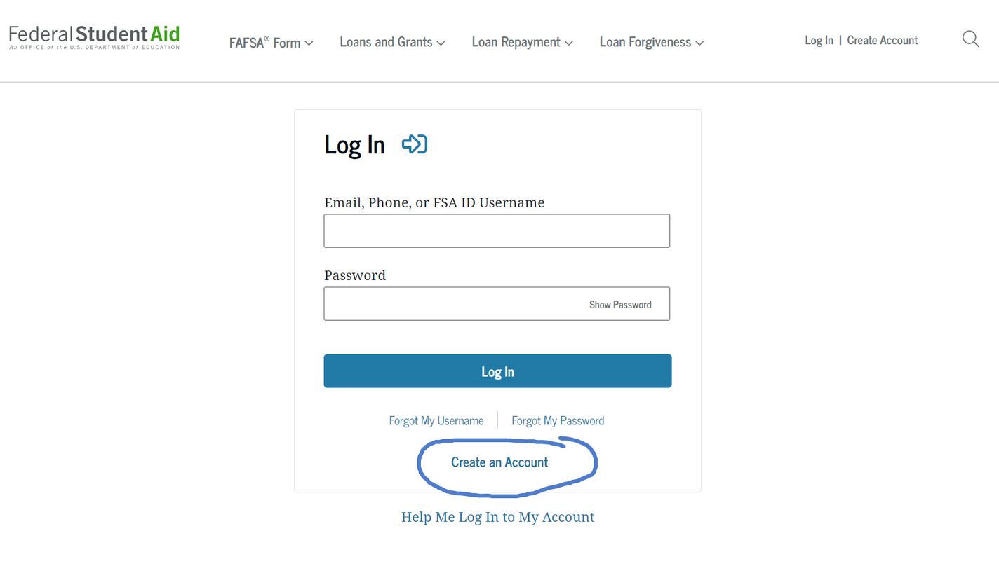

WELCOME TO THE FAFSA FORM

Slide 7

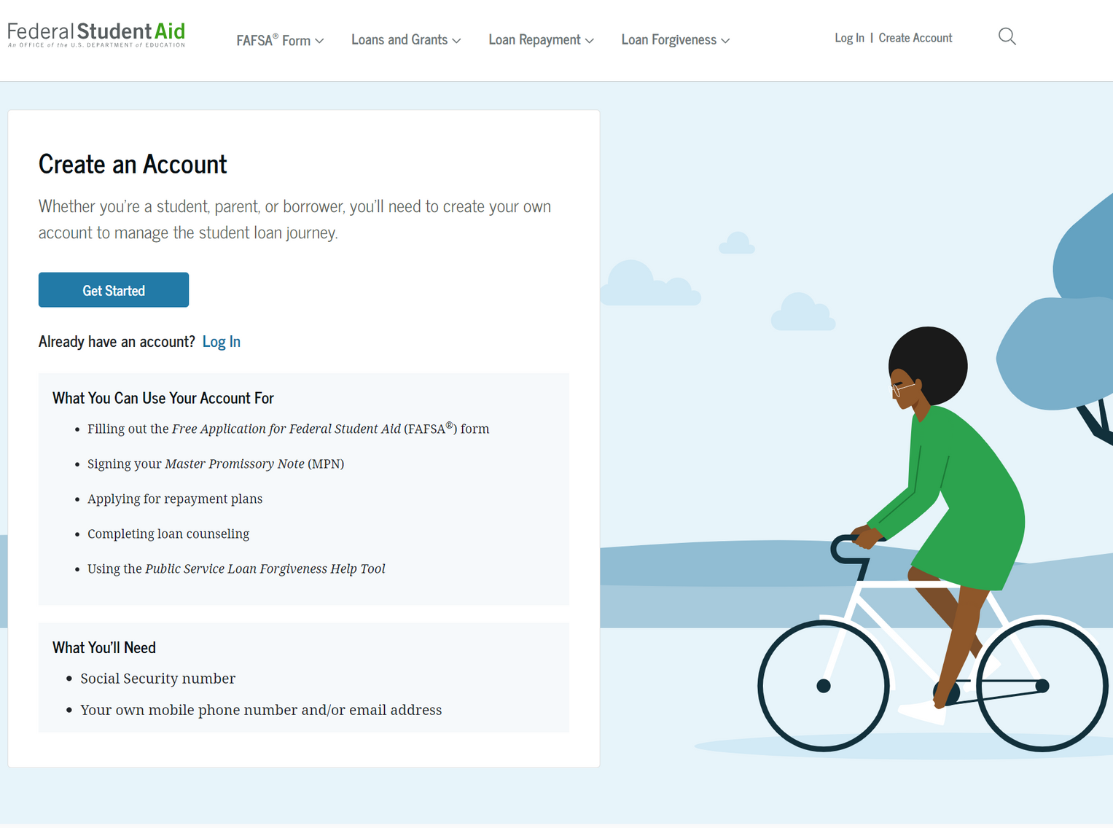
CREATE THE FSA ID

Slide 8
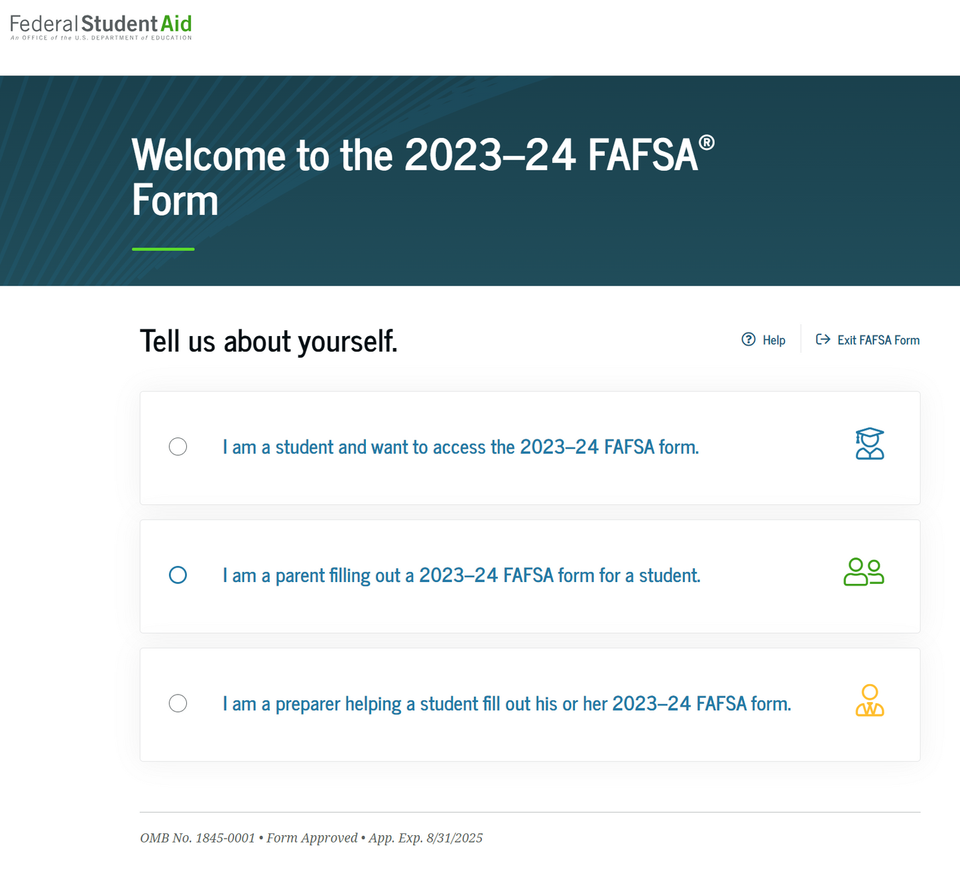
COMPLETING THE FAFSA

Slide 9
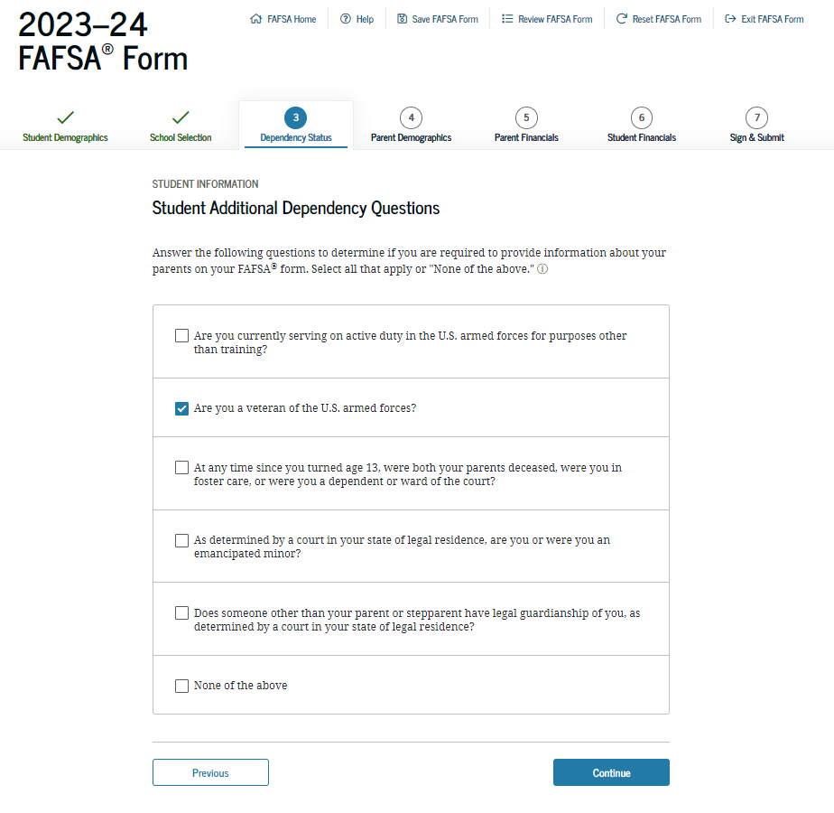
DEPENDENCY STATUS

Slide 10

FAFSA Q45
Are you currently serving on Active Duty in the U.S. Armed Forces for purposes other than training?
  Army, Navy, Air Force, Marines or Coast Guard
  National Guard or Reserves who is on active duty for other than state or training purposes.
  On active duty during the award year.
  Can submit military orders to show active duty status

Slide 11
FAFSA Q46
Are you a Veteran of the U.S. Armed Forces?
  Have engaged in active duty (including basic training in the U.S. Armed Forces
  National Guard or Reserves enlistee who was called to active duty for other than state or training purposes
  Cadet or Midshipman at one of the service academies
  Must be released under a condition other than dishonorable

Slide 12
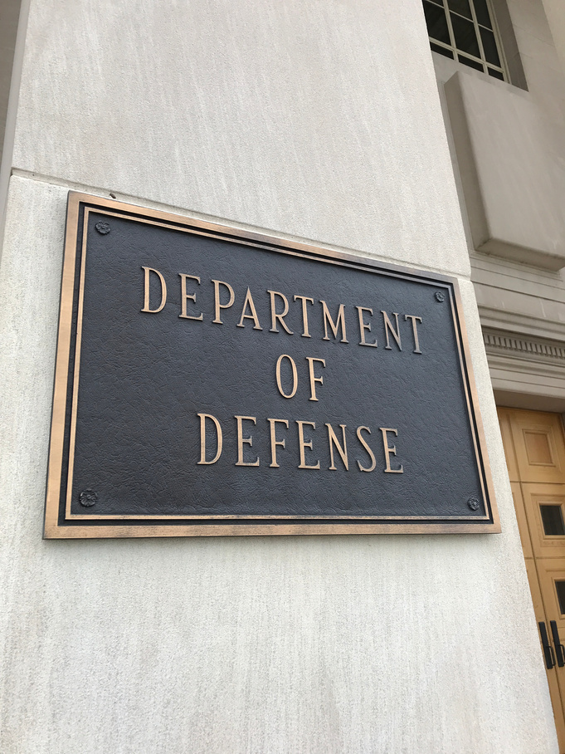

Department of Defense
The military Veteran definition as outlined in 38 U.S Code - 101 is a person who has served in the naval, air, or space military service and was released or discharged honorably.
Department of Education
  Active service
  Released under a condition other than dishonorable.
  No minimum amount of time
  National Guard/Reserves only if called up to active federal duty by Presidential Order other than training.
DEFINE VETERAN

Slide 13
SERVICE ACADEMIES
  U.S. Military Academy (West Point)
  U.S. Naval Academy (Annapolis)
  U.S. Air Force Academy
  U.S. Coast Guard Academy
  U.S. Merchant Marine Academy
  U.S. Military Academy Preparatory School
  Naval Academy Preparatory School
  U.S. Air Force Academy Preparatory School

Slide 14
10 USC 12302
10 U.S.C §12302. Ready Reserve
(a) In time of national emergency declared by the President after January 1, 1953, or when otherwise authorized by law, an authority designated by the Secretary concerned may, without the consent of the persons concerned, order any unit, and any member not assigned to a unit organized to serve as a unit, in the Ready Reserve under the jurisdiction of that Secretary to active duty for not more than 24 consecutive months.

Slide 15
VERIFICATION
  CPS will perform a data match with VA records to confirm the Veteran's status.
  If the VA confirms that the student is a Veteran, no further action is required.
  If the VA database indicates he/she is not a Veteran then the student is required to provide a DD214, Member 4.

Slide 16
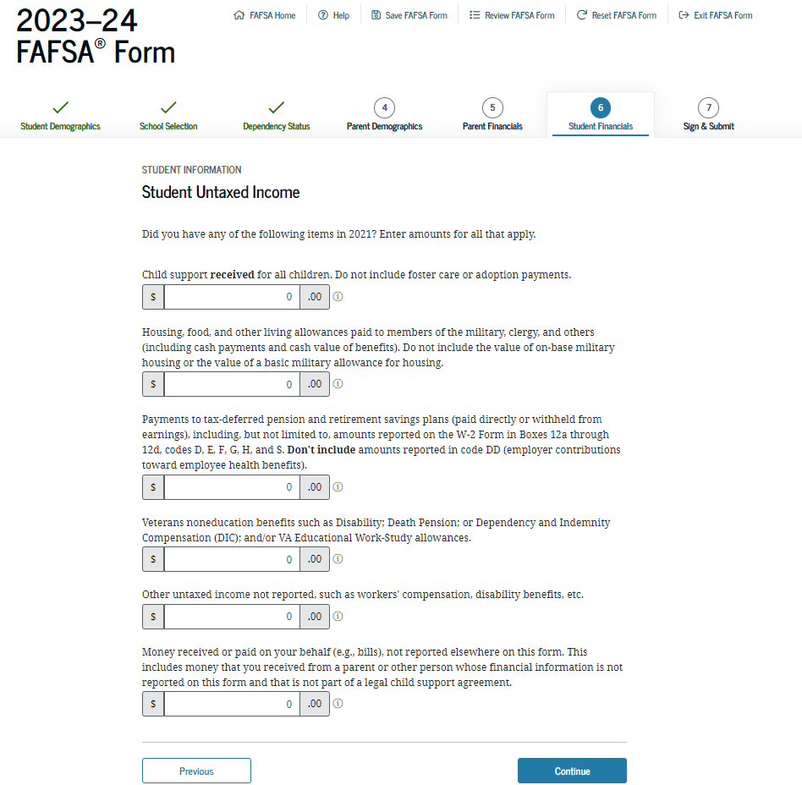
UNTAXED INCOME

Slide 17
THANK YOU
Now let’s talk questions?

