Slide 1
Education Service
School Certifying Official Training
Work Study Allowance Program
Notes:
Instructor Notes:
Here are a some general notes about the presentation as well as some best practice facilitation tips:
Review what is on each slide in your own words; refrain from reading the slides word for word.
On any slide, feel free to accentuate points using examples or scenarios from the field or elicit feedback from the participants.
The notes in the “Instructor Notes” section may not always reflect what is on the slide. The text in “italics” is meant to give direction or suggestions around content delivery. The information in regular font may be pertinent background information or examples that could be mentioned in addition to what is being spoken about on the slide.
There will be pacing guidelines on the topic slides with the number of slides in each section and the suggested time it should take to help keep you on track. This presentation is slated for 40 min. The pacing guidelines will read, “By the end of this section, you will be at # min of #min”.
Pacing:
The introduction section contains four slides
should take approximately 10 min (By the end of this section, you will be at 10min of 40min)
“Welcome to Education Service School Certifying Official Training. I am your instructor [Name] and in this portion of the training, we will be discussing Work Study Allowance Program. This training is slated to take about [## min].
As you know, The Work-Study Allowance Program offers an additional non-taxable allowance to students in return for performing VA-related activities.
As a SCO, your primary responsibility is the accurate and timely certification of GI Bill® Beneficiaries’ enrollments to VA. In order to perform your duties efficiently, as it pertains to Work Study programs, you’ll need to have an in-depth understanding of the program’s policies and qualifications which is what we’ll be covering today.

Slide 2

Learning Objectives
Upon completion of this module, you should be able to:
Describe the benefits of the Work Study program
Identify the criteria used to select students
Describe the duties of a site supervisor
Understand Work Study contracts
Identify the requirements for payments
Understand the impact of Public Law (PL) 116-140
Know how to contact Work Study
Notes:
Instructor Notes:
[Slide Title – Learning Objectives]
[Upon completion of this training you should be able to…
Read learning objectives. ]

Slide 3
Topics
Overview of the VA Work Study Program
Student and Facility Qualifications
Work Study Policies
Impact of Public Law 116-140
Notes:
Instructor Notes:
[Slide Title – Topics.]
[In order to cover the objectives of the presentation, here are the topics we will discuss in today’s session.]

Slide 4
Overview of the VA Work Study Program
Notes:
Instructor Notes:
Pacing:
This section contains 2 slides
should take approximately 5 min (By the end of this section, you will be at 15min of 40min)
Let’s start off by getting an overview of the program.

Slide 5

What is the Work Study Program?
Work Study is:
A Veterans Administration (VA) tax exempt education benefit
Paid to students for performing VA-related activities
Not income
Notes:
Instructor Notes:
[Slide Title – What is the Work-Study Program.]
[Instruction or Discussion –
Explain that The Work-Study Allowance Program offers an additional non-taxable allowance to students in return for performing VA-related activities.
Remember, the earnings the student receives under this program is not considered as income, and should not be mentioned as such. This is a form of supplemental payments to the VA Education Benefits

Slide 6

Benefits to the Institution
No cost to the school
Students help with VA-related activities
Students assist Veteran and dependent students with benefits and services
Notes:
Instructor Notes:
[Slide Title – Benefits to the Institution]
[Instruction or Discussion –
Explain the benefits of the work study program such as the cost, as well as giving examples of possible VA activities and services they help other Veteran students with. More examples will be provided further in the lesson.
Any questions? If not, let’s quickly get into the qualifications for the program.

Slide 7
Student and Facility Qualifications
Notes:
Instructor Notes:
Pacing:
This section contains 11 slides
should take approximately 10 min (By the end of this section, you will be at 25min of 40min)
In this section we’ll discuss program eligibility.

Slide 8

Student Qualifications (1 of 2)
Students must receive benefits through Title 38 or Title 10 under one of the following programs:
Ch30: Montgomery GI Bill® (MGIB)
Ch31: Vocational Rehabilitation
Ch32: Veterans Educational Assistance Program (VEAP)
Ch33: Post-9/11 GI Bill, including Transfer of Entitlement (TOE) and Fry Scholarship
Ch35: Dependents Educational Assistance (DEA)
Ch1606: MGIB – Selected Reserve (SR)
Notes:
Instructor Notes:
[Slide Title – Student Qualifications (1 of 2).]
[Instruction or Discussion –
Explain the programs that apply.

Slide 9
Student Qualifications (2 of 2)
Students must also:
Be enrolled in an approved degree, vocational or
professional program
Be at a rate of ¾ time or higher; or, 75% ROP for Ch33 participants
Work at a VA approved work site
Notes:
Instructor Notes:
[Slide Title – Student Qualifications (2 of 2).]
[Instruction or Discussion –
Explain the conditions that apply. Also let them know that neither federal employees nor students receiving VA education benefits, while participating in an internship program at a VA Facility, are eligible to participate in the Work-Study Allowance Program simultaneously at a VA facility.
Students who have exhausted their education benefits and have a remaining education debt, may qualify for work-study.

Slide 10

Student Selection
The following factors need to be carefully evaluated:
Service-connected disabilities have priority (30% or more)
Financial need
Availability of transportation
Motivation
Work assignments don’t conflict with disability
Notes:
Instructor Notes:
[Slide Title – Student Selection]
[Instruction or Discussion –
Explain the conditions for student selection and if the student has a disability to ensure that the work assignment is compatible with the disability. If the disability is discovered after placing the student, try to accommodate the individual as you would a regular employee. You may consult your local HR or contact VA Work-Study Dept. if you have questions.
Any questions so far? If not, let’s continue. We’ve talked about students and their responsibility so let us talk about the facility and responsibility of site supervisor]

Slide 11

Facility Qualifications
Work Study sites include, but are not limited to:
Department of Defense (DOD) Facilities
VA Regional Offices, Medical Centers and other VA facilities
Educational Institutions
National/State Veteran Cemeteries
Domiciliary Care Facilities
Other non-VA Facilities
State Approving Agencies
Vet Success Centers
Notes:
Instructor Notes:
[Slide Title – Facility Qualifications]
[Instruction or Discussion –
Use this slide to give an examples (like the one below) of facilities.
Services performed under a VA work-study program must be related to VA work. Other example facilities include: Coast Guard or National Guard, Non-VA Facilities such as Veterans of Foreign Wars-VFW, Disabled American Veteran-DAV, Military Order of Purple Heart-MOPH, etc.
]

Slide 12

Duty Qualifications
Work Study job duties must:
Perform the work specifically listed in the site’s job description
Be 100% VA-related activities performance tasks
Work solely at the specific work site listed on the time record
Only VA facilities are permitted to allow Work Study students to provide transportation or operate a motorized vehicle
Notes:
Instructor Notes:
[Slide Title – Duty Qualifications]
[Instruction or Discussion –
Explain the conditions for duties.
VA Facilities: There is no limitation as to the VA-related duties
Department of Defense (DOD), Coast Guard or National Guard Facilities: Only those students receiving Chapter’s 1606 and 1607 benefits performing activities related to administering 1606 & 1607
Other Non-VA facilities: only use students for disseminating information (outreach) on VA benefits and services
Under no circumstances should students do homework or study during their assigned Work-Study time. Work-Study students are assigned to a specific work site and cannot perform work at any other location. Assigning Work-Study students to other locations is cause for withdrawal of the work site.

Slide 13

Duty Qualifications at Education Facilities
Educational facilities are limited to the type of work/duties their students can perform. These include:
Dissemination of information regarding benefits and/or services
Preparation, processing, maintaining and organizing veteran-related files
VA outreach in effort with a VA employee controlling the work activities
Notes:
Instructor Notes:
[Slide Title – Duty Qualifications at Education Facilities]
[Instruction or Discussion –
Explain the conditions for duties.
Specifically at Educational institutions per M22-4, Part1 Chapter 9: 9.11d(1), activities can include assisting with dissemination of general information regarding veteran benefits and/or services, providing assistance to veteran students with general inquiries about veteran benefits via phone, email, or in person, maintaining and organizing veteran-related files. Mentoring and/or tutoring are NOT allowable duties at this type of worksite.
Questions so far?

Slide 14

Site Supervisor Responsibilities
Provide direct supervision
Provide appropriate training
Ensure only approved tasks are performed
Ensure only approved hours are worked
Maintain records for a minimum of 3 years
Read the Work Study Site Supervisor Handbook
Notes:
Instructor Notes:
[Slide Title – Site Supervisor Responsibilities]
[Instruction or Discussion –
Remind audience of the duties as an approved Work-Study Site Supervisor.
Any questions? Ok, let’s review.]

Slide 15
Section Review
Students must receive benefits through Title 38 or Title 10 in order to qualify for Work Study.
True
False
Notes:
Instructor Notes:
[Slide Title – Section Review]
[Instruction or Discussion –]

Slide 16
Section Review
Students must receive benefits through Title 38 or Title 10 in order to qualify for Work Study.
True
False
Notes:
Instructor Notes:
[Slide Title – Section Review]
[Instruction or Discussion – True]

Slide 17
Section Review
Which statements are the most accurate about student selection? (Select all that apply)
A. Service-connected disabilities have priority
B. They do not need to exhibit financial need
C. Must have availability to transportation
D. Work assignments don’t conflict with disability
Notes:
Instructor Notes:
[Slide Title – Section Review]
[Instruction or Discussion –]

Slide 18
Section Review
Which statements are the most accurate about student selection? (Select all that apply)
A. Service-connected disabilities have priority
B. They do not need to exhibit financial need
C. Must have availability to transportation
D. Work assignments don’t conflict with disability
Notes:
Instructor Notes:
[Slide Title – Section Review]
[Instruction or Discussion –A,C, D
So any questions about student or facility qualifications? If not, we will discuss Work-Study Policies.]

Slide 19
Work Study Policies
Notes:
Instructor Notes:
Pacing:
This section contains 12 slides
should take approximately 10 min (By the end of this section, you will be at 35min of 40min)
Students can only begin work after the VA has approved the contract and notified the site supervisor.
We will discuss some of the contract provisions of being in the program in this section.

Slide 20
Contract Agreement and Time Records
Site Supervisors should obtain the student’s signature on the agreement,
VA form 22-8692, and return it to Work Study.
Advance payment and time records cannot be processed until the signed contract is received
Time records may be submitted every 50 hours or 2 weeks, whichever comes first
Time record hours should be kept cumulative, initialed, signed, and filled out before starting a new Time Record
Zero hour time records must continue with cumulative hours from previous time records
The student can expect payment 3-5 business days after the time record has been processed

Slide 21

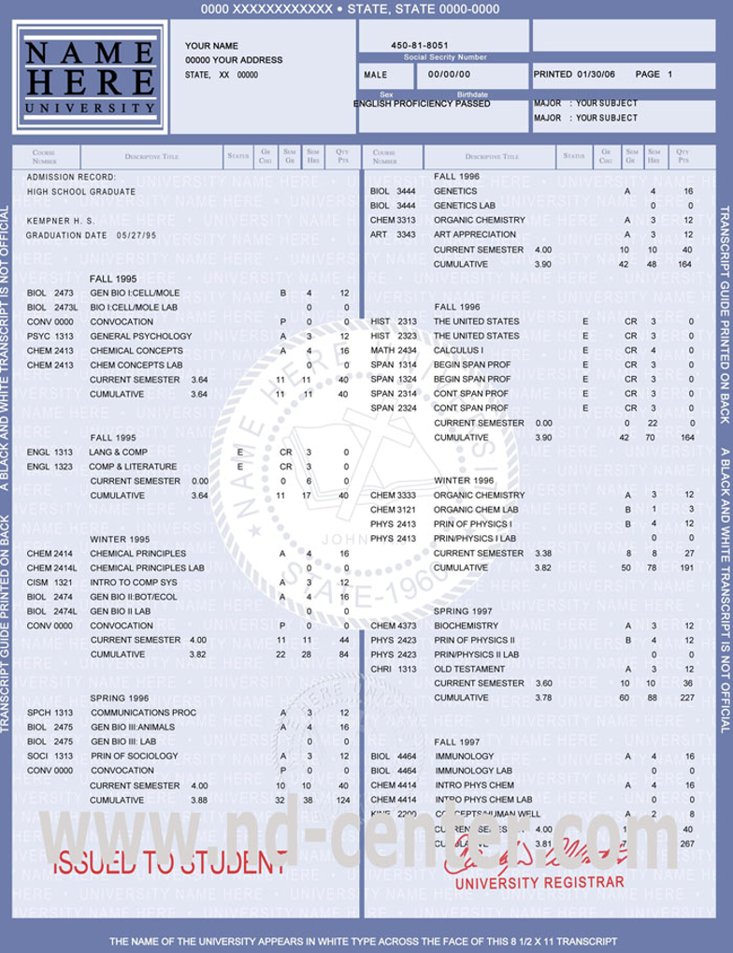
Work Study Contracts
If approved:
  Contract and time record sent to site supervisor
  Time frame and number of approved hours
  Students may not begin working prior to VA approving the contract
If denied:
  Denial letter sent to student
  Courtesy email sent to site supervisor
Notes:
Instructor Notes:
[Slide Title – Work-Study Contracts]
[Instruction or Discussion –
Explain what VA does after receiving your application. Also explain
Remember: Agreements may not begin earlier than 30 days before term, or end more than 30 days after term. Any hours worked prior to approval, after a contract ends, or are in excess of the approved hours CANNOT be paid.
Any questions? With that said, let’s see if you have been following along…]

Slide 22

Hours of Service
Maximum Hours
25 hours per week, prorated for partial weeks
Can be up to one (1) year or a maximum of 1300 hours
Not limited to number a of hours in a day or week
Can only work number of hours approved on contract
Not eligible for overtime pay
Covered under Worker’s Compensation laws
Notes:
Instructor Notes:
[Slide Title – Hours of Service.]
[Instruction or Discussion –
Explain the maximum hours of service.
Contract Dates are determined by qualifying term dates and the date of claim (date submitted by Site Supervisor). The contract may be written for more than one qualifying term, up to one (1) year or a maximum of 1300 hours. Although covered under Worker’s Compensation laws for the duration of their Work-Study contract, they are not considered employees of the Department of Veteran Affairs.

Slide 23


Extensions (1 of 3)
Contract Extension
A continuation of the original agreement
Begins when previous contract ends or 30 days before next term starts
All hours from previous contract not worked by the END DATE are forfeited
Contract extensions requests can be submitted through the GI Bill ® Ask a Question site
Must be approved by VA
Notes:
Instructor Notes:
[Slide Title – Extensions (1 of 3).]
[Instruction or Discussion –
Explain that there are three types of extensions, Contract Extension, the Before-Zero Hour Extension and the After-Zero Hour Extension. When explaining contract extension, provide an example similar to the one below.
Contract extensions can be extended multiple times. At no time may the student be allotted more hours to work during a contract.
For Example: Contract has been approved for the term 01/29/2019 through 05/15/2019 and has allotted the student 382 hours to work by 05/15/2019. The student has worked all 382 hours by 04/30/2019. There will not be any new hours allotted until after the contact ends on 05/15/2019. Depending on the student eligibility. ]

Slide 24
Extensions (2 of 3)
Working 30 days prior to begin date
May start up to 30 days before the term with no extra hours
Automatically given when processed before term starts
Allows a larger timeframe to work allotted hours
Notes:
Instructor Notes:
[Slide Title – Extensions (2 of 3).]
[Instruction or Discussion –
Explain that there are three types of extensions, Contract Extension, the Before-Zero Hour Extension and the After-Zero Hour Extension. When explaining Before-Zero extension, let them know that the student may start working once the Site Supervisor receives the new Work-Study’s contract packet, NOT BEFORE. There is an example below for clarification.
If the student already has a contract that ends after the request has been submitted and processed, this Extension may start the day following the END DATE of current contract or up to 30 days before the beginning of the next term and will end the last day of the new enrollment, also known as the new END DATE noted on the new timecard and agreement.
For Example: Contract has been approved for the term 01/29/2019 through 05/15/2019 and has allotted the student 382 hours to work by 05/15/2019. The student has worked all 382 hours by 04/30/2019. There will not be any new hours allotted until after the contact ends on 05/15/2019. Depending on the student eligibility. ]

Slide 25
Extensions (3 of 3)
Zero Hour Extension
Used at the end of a contract
Additional timeframe to work hours from previous contract
Does not exceed 30 days from END DATE of previous contract
Not to be used when out of hours on previous contract
Zero hour extension requests can be submitted through the GI Bill ® Ask a Question site
Must be approved by VA
Notes:
Instructor Notes:
[Slide Title – Extensions (3 of 3).]
[Instruction or Discussion –
Explain that there are three types of extensions, Contract Extension, the Before-Zero Hour Extension and the After-Zero Hour Extension. When explaining After-Zero extension, let them know that the student may start working once the Site Supervisor receives the new Work-Study’s contract packet, NOT BEFORE. Provide an example.
The student will be required to continue keeping cumulative hours from previous Time Record as they fill out the After-Zero Hour Extension Time Record. PLEASE DO NOT ALLOW STUDENT TO WORK BEFORE YOU RECEIVE THE AFTER ZERO TIME RECORD!! ]
Questions on how extensions work? If not let’s talk about how work-study payments are made.

Slide 26


Work Study Payments
Paid in 50 hour increments or two weeks, whichever comes first
Paid the higher of either the state or federal minimum wage
Once a new rate has taken effect by the Department of Labor, any hours worked on or after the effective date will be paid at the higher rate
Time Records processed in order of receipt
VA will not process and pay out “Future Dates”
VA will not make time record corrections
Students will not be paid prior to the date VA approved
Notes:
Instructor Notes:
[Slide Title – Work-Study Payments.]
[Instruction or Discussion –
Explain how payments are processed. Give an example about 50 hours similar to below.
For example: The Site Supervisor will submit the time record at the end of the student’s first 50 hours worked, then at the end of 100 hours, 150 hours, and so on. The final time record may be for less than 50 hours if less than 50 hours remain to complete the contract, or if the Work-Study contract is terminated before completion of all hours.]

Slide 27


Advanced Pay
Students may elect (from the application) to be paid in advance for 50 hours in their Work Study agreement
The advance payment is recouped from the first regular payment
Students must fulfill their requirement within 60 days of starting their contract
Notes:
Instructor Notes:
[Slide Title – Advanced Pay.]
[Instruction or Discussion –
Explain the Advance Pay policy.
It’s important to know that if your student requested Advanced Payment the student must sign the contract as soon as possible so that the advancement can be released. The site supervisor is responsible for returning a copy of the signed contract to VA. This advance payment will not be processed until the VA Work-Study Department has received the signed contract.
]

Slide 28
Student Reduction or Terminations
If enrollment status changes, report it to Work Study Department immediately.
Reduction
In most instances, VA allows the student to continue/finish
If the pattern continues, VA will notify site and student
Termination
Contract stopped at the end of the month of the withdrawal
If advancement received, the student is allowed to work until it’s paid
Notes:
Instructor Notes:
[Slide Title – Reduction or Terminations.]
[Instruction or Discussion –
Explain student enrollment reductions and withdrawals.
So any questions about what it takes to be stay qualified in the work-study program? Let’s review…]

Slide 29
Section Review
Which statements are the most accurate about hours of service? (Select all that apply)
A. 25 hours per week, prorated for partial weeks
B. Can be up to one (1) year or a maximum of 1300 hours
C. Limited to a number of hours in a day or week
D. Can only work number of hours approved on contract
E. Is eligible for overtime pay
Notes:
Instructor Notes:
[Slide Title – Section Review]
[Instruction or Discussion –]

Slide 30
Section Review
Which statements are the most accurate about hours of service? (Select all that apply)
A. 25 hours per week, prorated for partial weeks
B. Can be up to one (1) year or a maximum of 1300 hours
C. Limited to a number of hours in a day or week
D. Can only work number of hours approved on contract
E. Is eligible for overtime pay
Notes:
Instructor Notes:
[Slide Title – Section Review]
[Instruction or Discussion –A,B,D]

Slide 31
Section Review
The VA will process and pay out “Future Dates” for payments.
True
False
Notes:
Instructor Notes:
[Slide Title – Section Review.]
[Instruction or Discussion –]

Slide 32
Section Review
The VA will process and pay out “Future Dates” for payments.
True
False
Notes:
Instructor Notes:
[Slide Title – Section Review.]
[Instruction or Discussion – False]

Slide 33
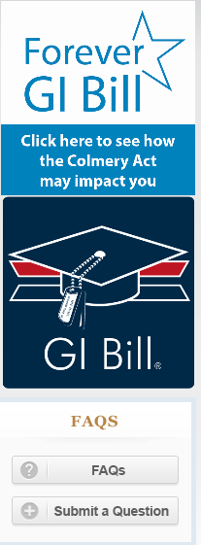
Submitting VA Work Study Documents
All Work Study documents should be submitted through the GI Bill “Ask a Question” website.
Select “Work Study” from the category drop down menu along with the appropriate subcategory (Application, Inquiry, Time Card, Signed Contract, Position Description)
Do not include personal identifiable information in the subject line of your request
Enter the student’s file number or agreement control number in the body of the message
A field toward the bottom of the page will allow you to attach documents
Create a new incident for each document submission or inquiry
Do not submit multiple students on one entry
You’ll receive a response once the request is processed, or if Work Study needs more/corrected/denial information

Slide 34
Impact of Public Law 116-140
Notes:
Instructor Notes:
Pacing:
This section contains 12 slides
should take approximately 10 min (By the end of this section, you will be at 35min of 40min)
Students can only begin work after the VA has approved the contract and notified the site supervisor.
We will discuss some of the contract provisions of being in the program in this section.

Slide 35
Public Law 116-140 Highlights
On April 28, 2020, the Student Veteran Coronavirus Response Act of 2020 was signed into law. Public Law (PL) 116-140 provided additional assistance to Veterans regarding the Novel Coronavirus (COVID-19) and its impact on VA Education benefits
Authorizes Work Study payments to continue in the case of an individual who had an active contract and was in receipt of Work Study payments but is unable to continue to perform the qualifying activities or had a reduction in hours due to COVID-19
Authorizes Work Study to extend the Work study agreement for any subsequent periods of enrollment for those individuals who had an active contract and were in receipt of Work Study payments but are unable to continue to perform the qualifying activities or had a reduction in hours due to COVID-19
The period covered is March 1, 2020 to December 21, 2020
Notes:
H.R. 6322, “Student Veteran Coronavirus Response Act of 2020”, 116th Congress, 2nd Session…by reason of such emergency situation…regardless of the inability of the individual to perform the work-study activities due to the emergency situation.
The law authorizes VA to pay otherwise eligible Work Study students 25 hours per week only for COVID related reasons through December 21, 2020. The COVID related concern can be school specific or based on the student’s personal circumstances

Slide 36
Qualifications
The Work Study student must be in receipt of the Work Study allowance with an active contract that was interrupted due to COVID-19
The student’s work had to be affected by COVID-19, by either having their hours reduced or having no work at all
The student will be paid 25 hours per week, every two weeks, until the restrictions surrounding the qualifying work are lifted, the student’s contract ends, the total approved contract hours are reached, or December 21, 2020, whichever occurs first
The student must still meet Work Study eligibility requirements and be performing approved duties
Work Study students who elect not to work when a work site is operational, shall not be paid these continuation of Work Study payments
Students who continue to perform the qualifying work per their contract are not affected by this law. Site Supervisors will continue to verify hours worked as before. Students will be paid as hours are submitted and verified
Notes:
2nd - For example, students who were not in receipt of Work Study payment on March 1, 2020 because they left the work site shall not receive this continuation of payment.
3rd - E.G. the site is closed, work was limited to interaction with others, etc.

Slide 37
Procedures for Reporting
Students with reduced hours or experiencing the inability to work due to COVID-19 can be paid retroactively beginning March 1, 2020, or the date in which they were affected by COVID-19, whichever is later
The Site Supervisor must report the student has a reduction in hours or is unable to work due to reasons associated with COVID-19
On the student’s time record the Site Supervisor must report the date when the student was no longer able to work or had their work hours reduced
When filling out the time record, the Site Supervisor must write “COVID”, next to the initials for the periods in which they’re requesting payment
Work Study will pay 25 hours per week for a student that has been unable to work or had their hours reduced due to COVID-19
Notes:
1st - Site Supervisors will continue to verify hours worked as before. Students will be paid as hours are submitted and verified.
4th - You must continue to add subsequent dates to the time record (using the COVID remark) as needed until normal work resumes or the student’s contract ends.

Slide 38
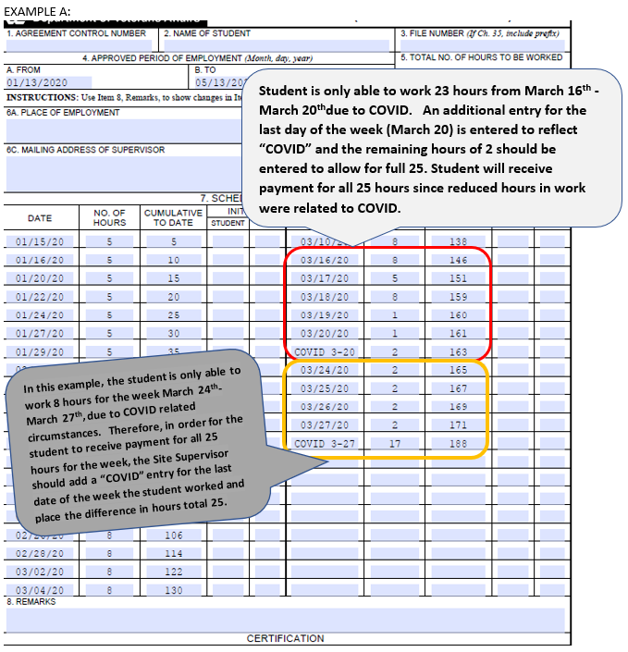
Time Record Example A
Notes:
2nd - Those offices make the final determination on all unemployment benefits.
4th – E.G. the student sent their supervisor an email when logging in and out; the Site Supervisor verifies the completed work submitted that the student did complete the tasks within the timeframe indicated on the timecard; the site has a virtual tracking system of when the student is actively logged into a computer system and working, etc.).

Slide 39
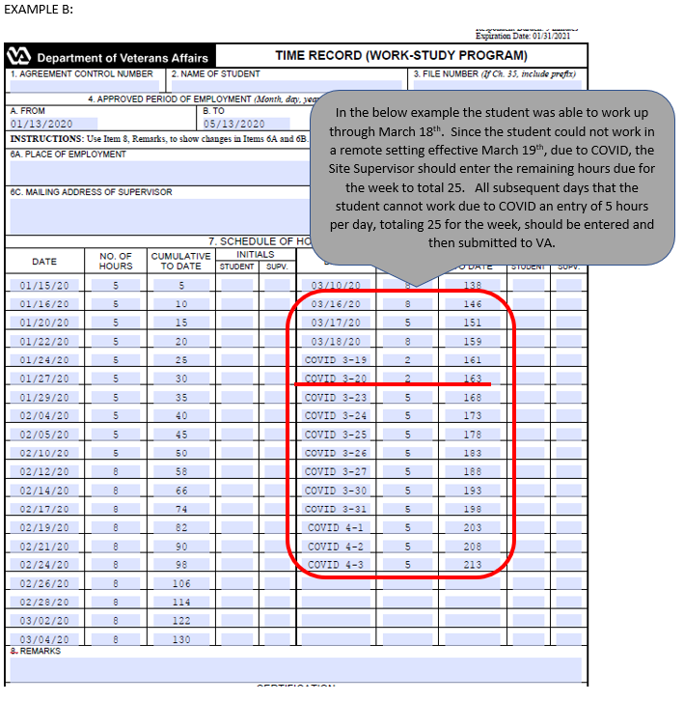
Time Record Example B
Notes:
2nd - Those offices make the final determination on all unemployment benefits.
4th – E.G. the student sent their supervisor an email when logging in and out; the Site Supervisor verifies the completed work submitted that the student did complete the tasks within the timeframe indicated on the timecard; the site has a virtual tracking system of when the student is actively logged into a computer system and working, etc.).

Slide 40
Procedures for Reporting Continued
Work Study is unable to pay future dates
For payments over $1,500.00, there’s a system pay limit of $1,500.00 that requires multiple payments processed daily until complete
Students can continue to receive the payment for 25 hours through December 21, 2020 if the emergency situation continues
Work Study will write new contracts for the student based on enrollment. These should be requested by Site Supervisors as they normally would

Slide 41
Other Considerations
Students that did not have a contract and were in receipt of Work Study payments that was affected by COVID-19, can receive new Work Study contracts but would not be eligible to receive the 25 hours per week payment
Work Study is a VA Education benefit; therefore, unemployment may not be approved. However, if the student has any unemployment benefit questions, they should contact their state or local unemployment office
If a student or Site Supervisor’s signature/initials are unable to be obtained due to COVID-19, the Site Supervisor must include this information in the body of the “Ask a Question” submission
The Site Supervisor may submit the Student Work Study Agreement (VA Form 8692) stating the student read and understands the contract; however, the student could not sign the form due to COVID-19 circumstances
The Site Supervisor remains responsible for making sure the student is working on approved tasks and maintaining records of how hours worked were verified
Notes:
2nd - Those offices make the final determination on all unemployment benefits.
3rd - We will not assume the timecard was not signed due to circumstances caused by COVID-19.
5th - E.G. the student sent their supervisor an email when logging in and out; the Site Supervisor verifies the completed work submitted that the student did complete the tasks within the timeframe indicated on the timecard; the site has a virtual tracking system of when the student is actively logged into a computer system and working, etc.).

Slide 42
Resources
GI Bill ® Ask a Question Website
Online SCO Handbook – Work Study
Frequently Asked Questions (FAQs) for Work Study Site Supervisors Regarding PL 116-140 (Work Study)
Sample Time Record for PL 116-140 (Work Study
GI Bill Ask a Question Site Supervisor number 1-855-225-1159, option 2
Work Study students may call 1-888-442-4551

Slide 43

You should be able to:
Describe the benefits of the Work Study program
Identify the criteria used to select students
Describe the duties of a site supervisor
Understand Work Study contracts
Identify the requirements for payments
Understand the impact of PL 116-140
Know how to contact Work Study
Notes:
Instructor Notes:
[Slide Title – Summary.]
Pacing:
This section contains three slides
should take approximately 5 min (By the end of this section, you will be at 40min of 40min)
Review summary.
[Instruction or Discussion –]

Slide 44

Q & A
Notes:
Instructor Notes:
[Slide Title – Q&A.]
Pacing:
Open the floor for any final questions. If you are available after the presentation, let participants know you are around to speak with them.
[Instruction or Discussion – Thank you for being with me to learn about Work-Study Allowance Programs. Enjoy the rest of the conference.]

Slide 45
Thank you for your time today!

