Slide 1
Compliance Survey

Slide 2
Approved SCO Training
This is approved SCO Annual Training!
Participants will earn credit toward their annual training requirement if they…
Log onto the SCO Training Portal
Self-certify they completed the conference training
Print the certificate and keep for their records
Notes:
Instructor Notes:
[Slide Title – Learning Objectives]
[Upon completion of this training you should be able to…
Read learning objectives. ]

Slide 3
Learning Objectives
Upon completion of this module, you should be able to:
Define a Compliance Survey
State the purpose of a Compliance Survey
Identify how to prepare for a Compliance Survey
Describe what to expect during a Compliance Survey
Notes:
Instructor Notes:
[Slide Title – Learning Objectives]
[Upon completion of this training you should be able to…
Read learning objectives. ]

Slide 4
Topics
Purpose & Authority
Compliance Survey Scheduling
Facility Notification
Briefing School Officials
Areas of Review
General
All Except Training Establishments
All Except Flight Schools and Training Establishments
Nonaccredited Courses Only
Additional Areas of Review
Exit Briefing
Referrals
Notification Letter to Facility
Notes:
Instructor Notes:
[Slide Title – Topics.]
[In order to cover the objectives of the presentation, here are the topics we will discuss in today’s session.]

Slide 5
Purpose & Authority

Slide 6
Purpose of Compliance
The purpose of a compliance survey is to prevent deficiencies and violations, as well as to identify and correct them when they are found.
Ensure facilities and their approved programs comply with the law
Cooperate with the State Approving Agency
Verify prompt and accurate payments are made
Identify training issues and provide needed assistance
Correct discrepancies
Bottom line: ensure that VA students are receiving all the benefits to which they are entitled and to ensure the taxpayers are receiving their money’s worth for the benefits being paid
Notes:
Compliance surveys are conducted in order to ensure that schools and training establishments, and their approved courses, are in compliance with all applicable provisions of the laws administered by VA. Compliance surveys are, however, not the only means to this end. They should be regarded as part of a spectrum of VA activities which includes review of approval information and liaison with schools, training establishments, and SAAs. The purpose of all these activities is to prevent deficiencies and violations, as well as to identify and correct them when they are found.
Maintain the integrity of G.I. Bill benefits.

Slide 7
Authority
Schools and training establishments must make records of progress and training, tuition and charges, and other records available upon request by a duly authorized representative of the Government. (38 U.S.C. 3690(c))
The records of both VA beneficiaries and non-VA students must be reviewed when comparing tuition charges, determining the 85-15 percent ratio, etc. The Buckley amendment (Public Law 93-380) requires that institutions receiving Federal funds administered by the Department of Education must obtain the student's consent to release information from school records. One exception to the law, however, is that information sought in connection with a student's application for receipt of financial aid is exempt. It has been determined that school records relating to VA benefits fall into the "financial aid" category and are therefore exempt from the provisions of the Buckley amendment. Therefore, the VA (and SAA) shall have access to the records of VA beneficiaries as well as non-VA students without the written consent of the student in order to monitor the school's compliance with the law.

Slide 8
Authority
Additional Reasonable Criteria
Title 38 CFR §21.4253(d) & §21.4254(d)(14)
The State Approving Agency may set any additional reasonable criteria for approval of programs for veterans and other persons eligible for VA education benefits.

Slide 9
FERPA
As of January 3, 2012, the U.S. Department of Education's FERPA regulations expand the circumstances under which education records and personally identifiable information (PII) contained in such records - including Social Security Number, grades, or other private information - may be accessed without the student’s consent.
FERPA allows the institution the right to disclose student records or identifiable information without the student's consent under the following circumstances:
To authorized representatives for audit of Federal or State supported programs
Veteran's Administration officials

Slide 10
Compliance Survey Scheduling

Slide 11
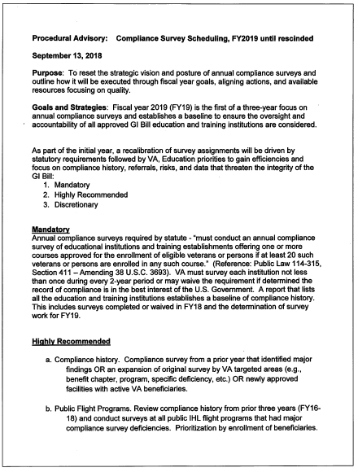
Compliance Survey Scheduling Procedural Advisory FY Compliance Survey Scheduling
A schedule for each Fiscal Year (FY) will be projected and prepared before the start of the FY. This forecast schedule must meet the minimum requirements established by VA.
Goals, strategies and priorities for the Fiscal Year are set by Education Service and communicated to the C&L Divisions at the beginning of each fiscal year in the form of a Procedural Advisory. This advisory is written in accordance with VA statute and outlines priority compliance surveys for that fiscal year. It will include (but is not limited to) the goals for the fiscal year, strategies, compliance survey requirements, remote compliance surveys, centralized surveys, schedule of compliance surveys, sample size, equal opportunity reviews, SAA compliance survey assistance, and reporting requirements.

Slide 12
Compliance Survey Scheduling Procedural Advisory FY Compliance Survey Scheduling
Survey Schedule: The compliance survey schedule is developed based on the “Active Facilities” report. If the facility is not currently active, it will be surveyed based on the schedule that was developed, if there has been activity since the last survey.
Sample Size. The sample size will be developed in accordance with the following table:

Slide 13
Proportional Breakdown of Students to be Surveyed Procedural Advisory FY Compliance Survey Scheduling

Slide 14
Facility Notification

Slide 15
Facility Notification
VA and SAA will notify schools in advance of an anticipated compliance survey
Email or phone call to inform you of our visit
Survey confirmation letter will subsequently be emailed or mailed
Confirm date and time of appointment
Provide school official with names of student files required and items/types of records to be reviewed
Schedule face-to-face interviews with students, if applicable
Notes:
Advance notice is generally around two (2) weeks before the survey.

Slide 16
Example of Scheduled Survey Email
Good morning, A routine compliance survey has been scheduled at your facility on [date] at approximately x:xx AM. Routine compliance surveys are conducted at educational/training facilities by the VA to verify enrollment data certified by the educational/training facility, identify and correct erroneous payments, and provide training to the school certifying officials as needed or requested. I will provide you with a listing of veteran names, additional information concerning the scheduled compliance survey and the documents that will be required for the compliance visit prior to the scheduled visit. In addition to the listed documents a work area needs to be made available during the compliance audit along with Wi-Fi access. If you have any questions prior to the survey, please feel free to contact me either by phone at (xxx) xxx-xxx extension xxxx or email.

Slide 17
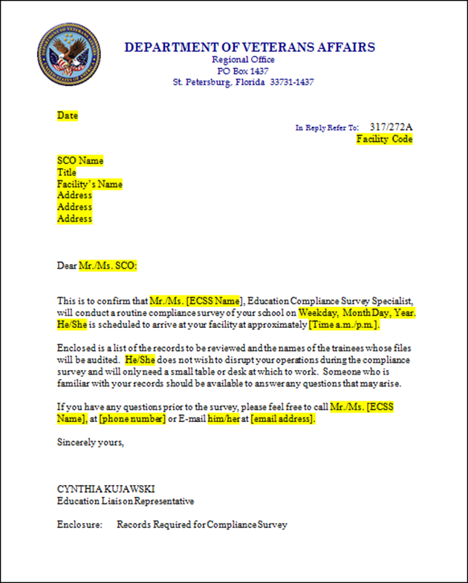
Appointment Letter

Slide 18
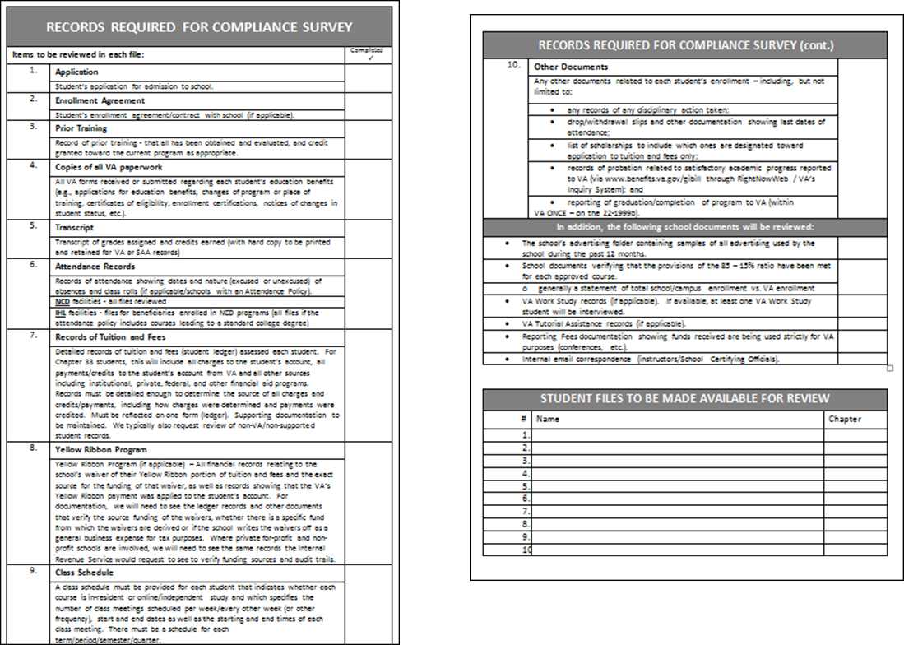
Records Required for Compliance Survey
Notes:
A list of the records required for the compliance survey will be attached.
As you gather the files/documentation requested, you are encouraged to contact the person who will be conducing the survey if you have any questions.
Also, as you gather the files/documentation requested and if you notice changes are required, you are encouraged to make them prior to our visit.
If we find anything that affects payment during visit, we must either submit to the appropriate Regional Processing Office for corrective action, or, in some cases we will request that the school submit the appropriate corrections in VAONCE.

Slide 19
Example of face-to-face email
Effective January 2011, VA will be conducting face-to-face interviews with Veteran students at proprietary institutions as part of our compliance visit protocol. Please provide a private office to use for these meetings. In order to ensure an opportunity for all veteran students to meet with a VA representative, I am asking that you send the following email to all the active veteran students in advance of my visit.
The Veteran representative will be available on DATE from TIME FRAME to conduct individual interviews. These interviews will focus on your experience at our school, not on individual benefit issues. I encourage you to participate. Please remember for benefit issues please call 1-888-GIBILL-1. Participation is strictly voluntary.
We appreciate your cooperation on this matter.
Notes:
In preparation for surveys at private institutions, we may also send an email regarding face-to-face interviews.
As a component of Compliance Surveys, we conduct face-to-face meetings with student Veterans about their experience at school.

Slide 20
Briefing School Officials

Slide 21
Entrance Interview
VA or SAA surveyor will provide an entrance briefing before conducting the survey
Typically with certifying official
Others included as school / facility or auditor sees fit
The institution’s principal official should be informed of the compliance survey. The surveyor will be available to meet with him or her at any time during the on-site survey.
Notes:
Upon arrival at the school or training establishment, the surveyor will provide an entrance briefing before conducting the survey
Introductions
Purpose of compliance survey explained in detail
There are two main purposes of compliance surveys:
To assist school or training establishment officials in understanding the provisions and requirement of the law, and
To verify and ensure the correctness of VA educational benefit payments to eligible claimants.
Other institution officials may be present
Advise of need for EXIT interview upon completion of review of records

Slide 22
Areas of Review General

Slide 23
Referrals
Payment Issues
Corrective award action will be referred to the RPO
Initiated by Surveyor or School Certifying Official
Approval Issues
State Approving Agency jurisdiction
SAA will take action involving approval issues
Other Issues
ELR has jurisdiction of issues involving 85/15%
If WEAMS needs to be updated, the issue will be referred to ELR
Notes:
I want to go over this key because we are going to be seeing these symbols used throughout this presentation.
I want to highlight three primary types of referrals that we encounter on a routine basis. As we’re going through the slides, you’ll see reference to payment issues, approval issues, and other issues. You’ll see the associated symbols to signify the type of referral that is commonly associated with each area of review.
We will be circling back to referrals later.

Slide 24
RECORDS
The facility provided the records and accounts of VA beneficiaries and other students for examination (38 CFR 21.4209, 21.7307, 21.9770)
The facility must be able to provide all of the records necessary for the Department of Veterans Affairs to ascertain institutional compliance with the requirements of GI Bill® benefit programs.
Notes:
The facility provided the records and accounts of VA beneficiaries and other students for examination (38 CFR 21.4209, 21.7307, 21.9770)
Records can be maintained electronically or hardcopy paper files. Frequently, schools will maintain files electronically and print the records for a compliance survey.
Responsibilities for maintaining records of VA students and making the records available for inspection:
- Retain file of VA papers submitted & records of academic progress, program pursuit, etc.
- Maintain records for at least three years following the student’s last date of attendance
- Ensure that records are kept in a safe place and that the privacy of VA students is protected
- Make available all school records to representatives of the SAA and VA.
Typically, we don’t see this issue very frequently at IHLs or NCDs. This item is sometimes an issue at OJT/APP facilities.

Slide 25
The facility provided the records and accounts of VA beneficiaries and other students for examination (38 CFR 21.4209, 21.7307, 21.9770)
RECORDS
During the visit, the following documents will be reviewed:
Copies of all VA paperwork
School’s transcript
Grade reports
Drop slips (for those courses dropped during drop/add)
Registration slips
Tuition and fee ledgers
Transcripts from previous schools with evaluations of same
Student’s school application
Records of disciplinary action
program outline, curriculum guide, or graduation evaluation form
Any other pertinent forms
Notes:
The surveyor will list the records required for the survey on the appointment letter. I’m not going to go too in depth during this slide because this area of review has overlap with “Accurate, Current, and Complete Records of Enrollment” as well as “accurate, current and complete records of progress or grades”. We’ll be covering both of those areas of review in greater detail.

Slide 26
The facility provided the records and accounts of VA beneficiaries and other students for examination (38 CFR 21.4209, 21.7307, 21.9770)
RECORDS
Additional records required of a Yellow Ribbon school:
Track the number of students enrolled under Yellow Ribbon
Track the annual Amount of Tuition and Fees
Develop and document a process for the first come-first serve enrollment of students into the Yellow Ribbon Program
Notes:
If you are a Yellow Ribbon school, you will need to maintain these additional records:
Track the number of students enrolled under Yellow Ribbon
Track the annual amount of tuition and fees
Develop and document a process for the first come-first served enrollment of students into the Yellow Ribbon Program
Additional information in case of questions:
Yellow Ribbon Program (if applicable) – All financial records relating to the school’s waiver of their Yellow Ribbon portion of tuition and fees and the exact source for the funding of that waiver, as well as records showing that the VA’s Yellow Ribbon payment was applied to the student’s account.
For documentation, we will need to see the ledger records and other documents that verify the source funding of the waivers, whether there is a specific fund from which the waivers are derived or if the school writes the waivers off as a general business expense for tax purposes. Where private for-profit and non-profit schools are involved, we will need to see the same records the Internal Revenue Service would request to see to verify funding sources and audit trails.

Slide 27
RECORDS
The facility provided the records and accounts of VA beneficiaries and other students for examination (38 CFR 21.4209, 21.7307, 21.9770)
Examination of Records
Notwithstanding any other provision of law, student records must be made available for review (38 USC 3690 (c)). Refusal to make records available for review could lead to withdrawal of approval (38 CFR 21.4209).
Notes:
Failure to provide the records could lead to withdrawal of approval.

Slide 28
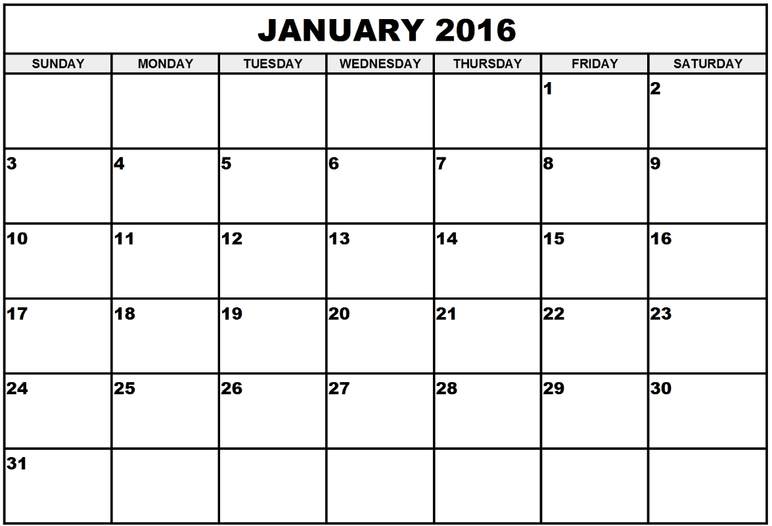
Commencement of Courses
VA beneficiaries commenced the course on the date certified. (38 CFR 21.4131, 21.4203, 21.5810, 21.5831, 21.7131, 21.7152, 21.7631, 21.7652, 21.9720)
Commencing/Beginning Dates
Question: What Beginning Date Must A School Report To VA?
Answer: Schools should report the first scheduled date of classes for any standard term, quarter, or semester in which the student is enrolled.
Exception : Course begins
after seven calendar days -
report actual date.
Notes:
VA beneficiaries commenced the course on the date certified. (38 CFR 21.4131, 21.4203, 21.5810, 21.5831, 21.7131, 21.7152, 21.7631, 21.7652, 21.9720)
SCO Handbook was updated on 02/15/2017 regarding this issue due to the
Advisory: Clarification of the term “Calendar Week” for the Commencement of Award Payments - April 25, 2016
Section 309 of the Colmery Act is one of the 34 provisions that we are already doing. Section 309 pertains to the first day of term within 7 days.
Background: When a student enrolls in a course for which the first class meeting occurs after the first day of the school’s term, quarter, or semester, the beginning date of the award of educational assistance for that course may hinge on the concept of a “calendar week.” There has been confusion over the meaning of this term and, as a consequence, has been applied inconsistently.
Definition: The term “calendar week” will be understood to mean “seven calendar days.”
If a student enrolls in a course and the actual first day that the student attends class is no later than the seventh calendar day of the term, then the beginning date of the award (or increased award) will be the first day of the term, quarter, or semester in which the student is enrolled.
GUIDANCE
IHLs & NCDs operating on a term basis: First day of classes for the semester or quarter
NCDs not operating on a term basis: First day the student is actually physically in class
Flight: Date of first flight or ground school lesson

Slide 29
VA beneficiaries commenced the course on the date certified. (38 CFR 21.4131, 21.4203, 21.5810, 21.5831, 21.7131, 21.7152, 21.7631, 21.7652, 21.9720)
Commencement of Courses
For example: If term starts on Friday, January 1st, then the first day of attendance must be between January 1st and January 7th (i.e. from the first through the seventh calendar day of the term).
If a student enrolls in a course and the actual first day that the student is scheduled to attend class is after the seventh calendar day of the term, then the beginning date of the award (or increased award) will be the actual date of the first class scheduled for that particular course.
Notes:
Advisory: Clarification of the term “Calendar Week” for the Commencement of Award Payments
For example: If term starts on Friday, January 1st, then the first day of attendance must be between January 1st and January 7th (i.e., from the first through the seventh calendar day of the term).
If a student enrolls in a course and the actual first day that the student attends class is after the seventh calendar day of the term, then the beginning date of the award (or increased award) will be the actual date of the first class scheduled for that particular course.

Slide 30
Commencement of Courses
VA beneficiaries commenced the course on the date certified. (38 CFR 21.4131, 21.4203, 21.5810, 21.5831, 21.7131, 21.7152, 21.7631, 21.7652, 21.9720)
Corrective Award Action
This type of discrepancy will frequently affect the award. Payment related discrepancies will be referred to the Regional Processing Office for corrective award action.

Slide 31
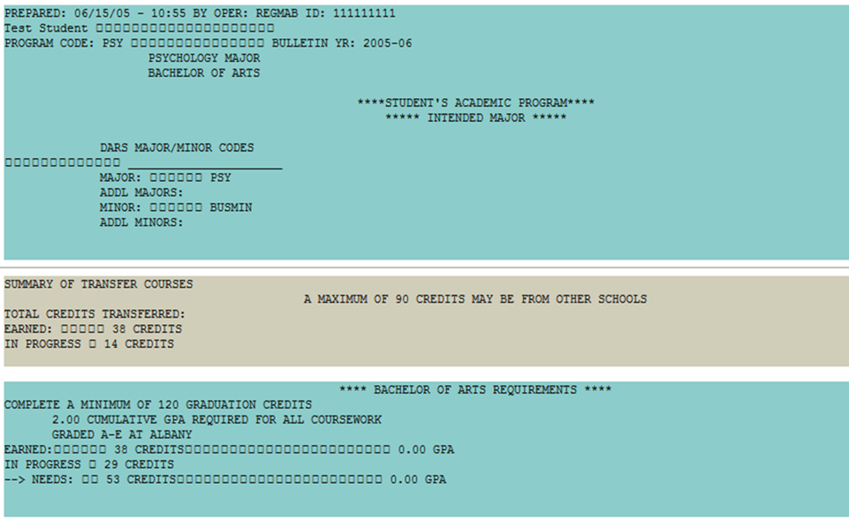
PURSUING PROGRAM AS APPROVED
VA beneficiaries are enrolled in and pursuing the approved program as certified (38 CFR 21.3030, 21.5131, 21.7130, 21.7630, 21.9710)
Course Applicability
Only courses that satisfy requirements outlined by:
curriculum guide
or
graduation evaluation
can be certified to VA
Notes:
VA beneficiaries are enrolled in and pursuing the approved program as certified (38 CFR 21.3030, 21.5131, 21.7130, 21.7630, 21.9710)
Course Applicability
During the “Certification Process” presentation, the importance of course applicability was emphasized. I think the most ELRs would agree that this is one of our most frequently asked questions.
To recap, only courses that satisfy requirements outlined by the curriculum guide or graduation evaluation form can be certified for VA purposes. A curriculum guide or graduation evaluation form should be kept in the student’s file and courses certified should be checked. If a student takes a course that does not fulfill a program requirement, it cannot be certified for VA purposes. Excessive free electives, for example, cannot be certified.

Slide 32
VA beneficiaries are enrolled in and pursuing the approved program as certified (38 CFR 21.3030, 21.5131, 21.7130, 21.7630, 21.9710)
PURSUING PROGRAM AS APPROVED
Pursuing the program as approved includes issues such as:
Course Applicability
Audited Courses
Repeating Courses
Courses Required for Admission to the Next Level of Training
Remedial and Deficiency Courses
Undeclared Major
Non-matriculated Students
Guest Student
Practical Training
Rounding Out
Course Substitutions
Courses pursued for sole purpose of raising the student’s CGPA
NOTE: The list is not all inclusive
Notes:
The following topics were covered more in-depth during the “Certification Process” presentation.
To recap, pursuing the program as approved includes Issues such as:
Course Applicability
Only courses that satisfy requirements outlined by the curriculum guide or graduation evaluation form can be certified for VA purposes.
Audited Courses
Audited courses cannot be certified.
Repeating Courses
Classes that are successfully completed may not be certified again for VA purposes if they are repeated.
Courses Required for Admission to the Next Level of Training
Courses required for admission to the next level of training may be approved in certain situations.
Remedial and Deficiency Courses
These courses can be certified as part of an approved program, but only for students for whom a verifiable need has been established.
Undeclared Major
Some schools don’t require a student who is pursuing a bachelor’s degree to declare a major before their junior year.
Non-matriculated Students
VA educational benefits cannot be paid to non-matriculated college or university students unless they are pending admission to your school.
Guest Student
A student may take courses at more than one school that apply to his or her degree.
Practical Training
Courses approved as practical training are considered resident training. A student teaching course is considered resident training.
Rounding Out
A VA student can round out a schedule with non-required courses to bring his/her course load up to a full-time schedule in his/her last term only.
Course Substitutions
VA will allow course substitutions if the school approves them and they are documented in the student's file.

Slide 33
VA beneficiaries are enrolled in and pursuing the approved program as certified (38 CFR 21.3030, 21.5131, 21.7130, 21.7630, 21.9710)
PURSUING PROGRAM AS APPROVED
Corrective Award Action
This type of discrepancy will frequently affect the award. Payment related discrepancies will be referred to the Regional Processing Office for corrective award action.

Slide 34
PRIOR CREDIT
The facility maintains a record of previous education and training of VA beneficiaries, has granted appropriate credit and has reported the grant to the beneficiaries (38 CFR 21.4253, 21.4254, 21.4263)
Prior Credit
One of the criteria for approval of any school for Veterans' training is that it review prior credit and grant credit as appropriate to a VA student's current program. This is found in Title 38, Code of Federal Regulations, Sections 21.4253(d)(3) and 21.4254(C)(4). In essence, this requires every approved school to have and enforce a policy with regard to transfer courses, credits, and previous experience.
Schools no longer have to report prior credit to VA, Schools must:
Evaluate prior credit,
Grant credit as appropriate,
Notify the student of the evaluation, and
Shorten the program certified accordingly
Notes:
The facility maintains a record of previous education and training of VA beneficiaries, has granted appropriate credit and has reported the grant to the beneficiaries (38 CFR 21.4253, 21.4254, 21.4263)
Schools must:
Evaluate prior credit,
Grant credit as appropriate,
Notify the student of the evaluation and
Shorten the program certified accordingly

Slide 35
PRIOR CREDIT
The facility maintains a record of previous education and training of VA beneficiaries, has granted appropriate credit and has reported the grant to the beneficiaries (38 CFR 21.4253, 21.4254, 21.4263)
Whenever a student initially enrolls in your school or changes programs at your school a credit evaluation must be completed. VA will review credit evaluations during compliance surveys and credit evaluation records must be kept and made available to VA upon request.
Schools should make every effort to obtain transcripts to comply with the requirement to evaluate and grant credit where appropriate. However, if a transcript cannot be obtained, you may continue to certify enrollment as long as the student has matriculated. Reviews of prior credit policies will be conducted during compliance surveys and treated as approval issues if the school is not complying.
Notes:
In all cases, the CFR requires institutions to obtain and evaluate such prior credit regardless of a veteran’s desire that such credit not be transferred or evaluated.

Slide 36
PRIOR CREDIT
The facility maintains a record of previous education and training of VA beneficiaries, has granted appropriate credit and has reported the grant to the beneficiaries (38 CFR 21.4253, 21.4254, 21.4263)
Military Education and Training Resources
Military education and training should be evaluated for prior credit. Information needed to evaluate military education and training is available online.
The ACE Military Guide
Find information about the American Council on Education (ACE) Military Guide (Guide to Evaluation of Educational Experiences in the Armed Services) at their website.
Military Transcripts
Find information about the Military Joint Services Transcripts and how transcripts may be requested by current and former members of the Army, Coast Guard, Marine Corps, and Navy at their webpage.
Notes:
Evaluating prior credit includes military education and training. The SCO Handbook provides several links and information about military transcripts.

Slide 37
PRIOR CREDIT
The facility maintains a record of previous education and training of VA beneficiaries, has granted appropriate credit and has reported the grant to the beneficiaries (38 CFR 21.4253, 21.4254, 21.4263)
Violation of Approval Criteria
Failure to maintain adequate records of prior education or training or to give appropriate credit.
If an approval related discrepancy is identified, the issue may also be referred to the State Approving Agency (approving authority).
Notes:
If the SAA has already presented on this topic, reference their presentation. Evaluation of prior credit is an approval related issue and the SAA has jurisdiction because they are the approving authority.
Failure to maintain adequate records of prior education or training or to give appropriate credit is an approval related discrepancy.
There are a number of specific types of discrepancies that require referral to the SAA.
If VA conducts the survey and identifies this issue, the surveyor will refer this issue to the SAA.

Slide 38
ACCURATE, CURRENT, AND COMPLETE RECORDS
The facility maintains accurate, current and complete records of enrollment, correspondence lessons serviced, flight training hours or APP/OJT hours (38 CFR 21.4253, 21.4254)
The facility must maintain accurate, current and complete records of enrollment.
For example, when reviewing class schedules or tuition and fees ledgers, the records must contain the following elements:
Class Schedules | Detailed Records of Tuition and Fees
Must: Be provided for each term/semester/quarter; include begin and end dates of course(s), days per week course(s) are scheduled to meet, hours per day, and location each class is scheduled to meet; Be sufficient for VA or SAA to verify whether any particular class meets the regulatory requirements to be considered resident or online; and Be coded to differentiate between resident and online/independent study classes and campuses (and should also be made clear in the catalog, handbooks, etc.) | Will be assessed for each student Chapter 33 students – this will include all charges to the student’s account, all payments/credits to the student’s account from VA and all other sources including institutional, private, federal and other financial aid program (scholarship payment requirements) Must be detailed enough to determine the source of all charges and credits/payments, including how charges were determined and payments were credited The term in which any charges/payments/credits occur should be clearly identified and linked to the appropriate dollar amount VA payments and refunds should be clearly labeled as such Do not lump other campus payments (with a separate facility code) within the payments for your campus
Each type of record must contain sufficient detail in order to determine whether the facility is meeting the compliance requirements of GI Bill® benefit programs.
Notes:
The facility maintains accurate, current and complete records of enrollment, correspondence lessons serviced, flight training hours or APP/OJT hours (38 CFR 21.4253, 21.4254)
We’ve circled back to records. Once we have each type of record, we look to see if each type contains sufficient detail. I want to highlight 2 types of records of enrollment that we sometimes encounter issues with:
Class Schedules must:
be provided for each term/semester/quarter;
include begin and end dates of course(s), days per week course(s) are scheduled to meet, hours per day, and location each class is scheduled to meet;
be sufficient for SAA or VA to verify whether any particular class meets the regulatory requirements to be considered resident or online; and
be coded to differentiate between resident and online/independent study classes and campuses (and should also be made clear in the catalog, handbooks, etc.)
Some software does not allow SCOs to view schedules for prior terms – it only allows them to view the schedule for the current term. If this is the case, capture the schedule during the term and maintain in the file.
Detailed Records of Tuition and Fees
Will be assessed for each student
Chapter 33 students – this will include all charges to the student’s account, all payments/credits to the student’s account from VA and all other sources including institutional, private, federal and other financial aid program (scholarship payment requirements)
Must be detailed enough to determine the source of all charges and credits/payments, including how charges were determined and payments were credited
The term in which any charges/payments/credits occur should be clearly identified and linked to the appropriate dollar amount
VA payments and refunds should be clearly labeled as such
Do not lump other campus payments (with a separate facility code) within the payments for your campus
An invoice and payment voucher is not sufficient.
In addition to sufficient enrollment records, we also see issues with insufficient progress records. We’ll be touching on attendance records when we discuss progress records.

Slide 39
ACCURATE, CURRENT, AND COMPLETE RECORDS
The facility maintains accurate, current and complete records of enrollment, correspondence lessons serviced, flight training hours or APP/OJT hours (38 CFR 21.4253, 21.4254)
Examination of Records
Type of records. Each educational institution must upon request of duly authorized representatives of the Government make available for examination all appropriate records and accounts (38 CFR 21.4209).
Notes:
Failure to maintain adequate records is a SAA referral.
Procedures for handling inadequate records, if a facility’s records don’t contain sufficient detail for VA purposes, obtain copies of the insufficient records (source documents), cite the discrepancy (line item #5), and refer the issue to the State Approving Agency without taking any further action with regard to those records, i.e., do not require the school to attempt to provide further documentation at the time of the survey. Adequate records should show enough detail for the surveyor to ascertain compliance with VA benefit programs. The surveyor should not request/dissect other various records to reconstruct the necessary elements of the particular type of record.

Slide 40
ACCURATE & PROMPT REPORTING
The facility accurately and promptly reported enrollment, tuition and fees, lessons serviced, flight training hours or APP/OJT hours (38 CFR 21.4203(e)(f)(g), 21.4204, 21.7156, 21.9735)
This is one of the most common findings – it is very broad and encompasses numerous discrepancies.
In addition to the facility promptly reporting the enrollment information, reporting accurate enrollment involves issues such as (this list is not all inclusive):
Reporting the correct enrollment periods
Term basis in credit hours
Operate on block/unit/modular/lock-step basis in clock hours
Do NOT operate on block/unit/modular/lock-step basis in clock hours
Reporting the correct number and type of hours
Residence
Distance
Remedial/Deficiency
Clock
Chapter 33 Tuition and Fees
Tuition
Fees
Scholarships and other aid
Notes:
The facility accurately and promptly reported enrollment, tuition and fees, lessons serviced, flight training hours or APP/OJT hours (38 CFR 21.4203(e)(f)(g), 21.4204, 21.7156, 21.9735)
Read slide
GUIDANCE
Timeliness
Certifications may be submitted in advance, but must be submitted within 30 days from the date of event. Typically the start of the term is the event. If drop/add is applicable, it would be 30 days from the end of drop/add. If the schools requires VA students to submit a request for certification, it would be 30 days from the date of the request.

Slide 41
ACCURATE & PROMPT REPORTING
The facility accurately and promptly reported enrollment, tuition and fees, lessons serviced, flight training hours or APP/OJT hours (38 CFR 21.4203(e)(f)(g), 21.4204, 21.7156, 21.9735)
Corrective Award Action
This type of discrepancy will frequently affect the award. Payment related discrepancies will be referred to the Regional Processing Office for corrective award action.

Slide 42
NOTIFY VA WHEN BENEFICIARIES TERMINATE TRAINING
The facility promptly notified VA when beneficiaries terminated or interrupted training (38 CFR 21.4203, 21.7156, 21.9735)
Non-punitive grades. Benefits are not payable for any courses in which a non-punitive grade, for example a “W” for withdrawal, is assigned when the effective date of withdrawal (last date of course pursuit) is after the official drop period and mitigating circumstances do not exist. The last date of course pursuit varies as follows:
Residence Courses—Last date of attendance. This may include regularly scheduled exam days
Independent Study Courses—Official date of change in status under the practices of the institution. This usually is the last date the student accessed the online system or was in contact or met with the instructor/professor
Cooperative Training—Date of last training
Notes:
The facility promptly notified VA when beneficiaries terminated or interrupted training (38 CFR 21.4203, 21.7156, 21.9735)
Terminations or interruptions in training must be promptly reported to VA
GUIDANCE
Have a system or mechanism (internal audit, report) in place to identify when students withdraw/terminate or interrupt training
An automatic notice to the SCO through your computer system of any changes to a file marked VA, veteran, etc., is most helpful
Last dates of attendance must be able to be identified during compliance survey visit and notification must be made to VA within 30 days of the student’s last date of attendance
Maintain drop and withdrawal slips in file

Slide 43
The facility promptly notified VA when beneficiaries terminated or interrupted training (38 CFR 21.4203, 21.7156, 21.9735)
NOTIFY VA WHEN
BENEFICIARIES
TERMINATE TRAINING
NCD schools must report the first date from which no credit accrued, if:
The instruction is organized on a block or unit basis; and
The block or unit must be repeated in its entirety (no credit for work completed)
This is in addition to the effective date of change, last date of attendance for reduction in clock/credit hours of attendance, or termination of attendance. SCOs should not submit adjustments for absences that are allowed within the schools approved attendance policy. Additionally, they may not extend enrollment for students who need additional hours simply because of absences. However, if a student failed a portion of the course and has to repeat it, that portion may be re-certified as long as the student continues to meet the Standards of Progress for the school.
Notes:
Determine if the Last Date Credit Accrued was Reported Correctly.
To recap for those of you who attended the NCD breakout, there is an additional field in VA-ONCE for the last date credit accrued. The last date of attendance and the last date credit accrued are not always the same date.

Slide 44
NOTIFY VA WHEN BENEFICIARIES
TERMINATE TRAINING
The facility promptly notified VA when beneficiaries terminated or interrupted training (38 CFR 21.4203, 21.7156, 21.9735)
Corrective Award Action
This type of discrepancy will frequently affect the award. Payment related discrepancies will be referred to the Regional Processing Office for corrective award action.

Slide 45
PROGRESS RECORDS
The facility maintains accurate, current and complete records of progress or grades for VA beneficiaries (38 CFR 21.4253, 21.4254, 21.4262, 21.4263)
Progress Records. Adequate records must be kept by the school to show progress or grades. Standards relating to progress, grades, and conduct must be enforced.
For non-accredited courses, attendance records must be kept and an attendance standard must be enforced
For IHL courses, the school’s progress standard is usually based on minimum grades or grade point average
For NCD courses, the school’s progress standard may be based on the following:
Minimum grades or grade point average
Minimum attendance requirements
A combination of the above
NOTE: IHLs that have an attendance policy must maintain attendance and enforce those standards
Notes:
The facility maintains accurate, current and complete records of progress or grades for VA beneficiaries (38 CFR 21.4253, 21.4254, 21.4262, 21.4263)
We’ve circled back to records again. This time, we’re focusing on progress records.
We’re looking at each type of progress record to see if each type contains sufficient detail. I want to highlight attendance records because that is the most common type of progress record that we see that not sufficient for VA purposes.
Attendance Records (if applicable for schools with programs that have an attendance policy)
Records must be maintained, monitored and policies enforced
Records should be based on daily attendance (positive attendance as opposed to negative attendance records)
Files must contain documentation of excused absences (if policy allows for excused absences)
Once it is determined a student failed to meet attendance standards, you MUST terminate the student’s enrollment certification. You may have an attendance policy that is more strict for the receipt of VA benefits than for other students.
Monitor attendance to ensure compliance with reporting within 30 days

Slide 46
PROGRESS RECORDS
The facility maintains accurate, current and complete records of progress or grades for VA beneficiaries (38 CFR 21.4253, 21.4254, 21.4262, 21.4263)
Violation of Approval Criteria
Failure to maintain adequate records showing progress.
If an approval related discrepancy is identified, the issue may also be referred to the State Approving Agency (approving authority).
Notes:
Failure to maintain adequate records showing progress is an approval related discrepancy.
There are a number of specific types of discrepancies that require referral to the SAA.
If VA conducts the survey and identifies this issue, the surveyor will refer this issue to the SAA.

Slide 47
NOTIFY VA WHEN BENEFICIARIES ARE NOT PROGRESSING SATISFACTORILY
The facility promptly notified VA when beneficiaries did not progress satisfactorily according to approved standards and practices of the facility (38 CFR 21.4203(d), 21.4277)
Determine if Termination of Attendance was Promptly Reported.
Termination of attendance must also have been reported to VA timely.
Verify the last date of attendance by cross-checking the date reported with the instructor's or school's daily attendance record, if one is kept
If the course is organized on a unit or block basis and no credit accrued for the work completed, verify that the school also properly reported the first date from which no credit accrued
Notes:
The facility promptly notified VA when beneficiaries did not progress satisfactorily according to approved standards and practices of the facility (38 CFR 21.4203(d), 21.4277)
Compliance Survey Standards
Did you promptly notify VA when satisfactory progress was not made?
GUIDANCE
Unofficial transcripts should be monitored to ensure students are meeting satisfactory academic progress
Maintain documentation in files (e.g., letters of probationary status, suspension)
SAP must be monitored and your approved policy enforced (i.e., students must be suspended/dismissed in strict adherence with your approved policy – that policy may be more strict for the receipt of VA benefits than for other non-VA students)
Report probation to VA via RightNowWeb (mandatory as of August 1, 2011-VA will offer counseling to beneficiary)

Slide 48
NOTIFY VA WHEN BENEFICIARIES ARE NOT PROGRESSING SATISFACTORILY
The facility promptly notified VA when beneficiaries did not progress satisfactorily according to approved standards and practices of the facility (38 CFR 21.4203(d), 21.4277)
Violation of Approval Criteria
Failure to enforce the approved policy relating to attendance, conduct, or progress.
If an approval related discrepancy is identified, the issue may also be referred to the State Approving Agency (approving authority).
Notes:
Failure to enforce the approved policy relating to attendance, conduct, or progress is an approval related discrepancy.
There are a number of specific types of discrepancies that require referral to the SAA.
If VA conducts the survey and identifies this issue, the surveyor will refer this issue to the SAA.

Slide 49
Areas of Review All Except Training Establishments

Slide 50
CHARGES TO VA BENEFICIARIES FOR TUITION AND FEES WERE THE SAME OR LESS THAN THE CHARGES TO OTHER SIMILARLY CIRCUMSTANCED STUDENTS (38 CFR 21.4210(d), 21.9600, 38 U.S.C. 3690(a))
The school may not charge or receive from any Veteran or eligible person any amount in excess of the established charges for tuition and fees which the school requires from similarly circumstanced students who are not VA beneficiaries and are enrolled in the same course. School policy for the payment or refund of tuition and fees which differs for students who are not VA beneficiaries and Veterans or eligible persons may not have the effect of increasing charges to those students receiving VA benefits.
Notes:
CHARGES TO VA BENEFICIARIES FOR TUITION AND FEES WERE THE SAME OR LESS THAN THE CHARGES TO OTHER SIMILARLY CIRCUMSTANCED STUDENTS (38 CFR 21.4210(d), 21.9600, 38 U.S.C. 3690(a))
Compliance Survey Standards
How do tuition and fees compare to other students’ charges?
Tuition and fees charged to VA beneficiaries must be the same or
less than charges to other similarly circumstanced students
(38 CFR §21.4210(d), §21.9600, 38 U.S.C. 3690(a))
GUIDANCE
Monitor programs and charges for non-VA students
Some non-VA files may be randomly selected for this purpose
Charging VA students more than similarly circumstanced non-VA students is grounds for immediate withdrawal of approval.

Slide 51
CHARGES TO VA BENEFICIARIES FOR TUITION AND FEES WERE THE SAME OR LESS THAN THE CHARGES TO OTHER SIMILARLY CIRCUMSTANCED STUDENTS (38 CFR 21.4210(d), 21.9600, 38 U.S.C. 3690(a))
Actions Affecting Groups
§21.4210 Suspension and discontinuance of educational assistance payments, and of enrollments or reenrollments for pursuit of approved courses.
Overcharges by educational institutions may result in the disapproval of enrollments.
Notes:
Charging VA students more than similarly circumstanced non-VA students is grounds for immediate withdrawal of approval.

Slide 52
CERTIFICATION OF THE 85 PERCENT ENROLLMENT LIMITATION WAS VERIFIED (38 CFR 21.4201)
PERCENTAGE OF VETERANS AND ELIGIBLE PERSONS ENROLLED.
By law VA cannot approve enrollment in any course for a person who is not already registered if 85 percent of the students enrolled in a course have all or part of their tuition, fees, or other charges paid by the educational institution or by VA. This is known as the 85 percent enrollment limitation.
Notes:
CERTIFICATION OF THE 85 PERCENT ENROLLMENT LIMITATION WAS VERIFIED (38 CFR 21.4201)
Compliance Survey Standards
Are you monitoring enrollment numbers?
Verification of the 85 percent enrollment limitation must be performed
Schools to provide documents verifying that the provisions of the
85-15 % ratio have been met for each approved course (generally, a
statement of total school/campus enrollment v. VA student enrollment)
(38 CFR §21.4201)
History
The Servicemen’s Readjustment Act of 1944
This program ended July 25, 1956
In 1952, 85/15% ratio resulted from congressional hearing
The two year rule also resulted
Purpose of 85/15% and two year rule was to weed out expensive courses of poor quality

Slide 53
Statement of Assurance of Compliance With 85 Percent Enrollment Ratios
Program Name | Number of VA Students FTE | Number of Non VA Students | Total Enrollment | VA Student Percentage | Date of Calculation
Totals
I certify that this information is true and correct as of the date submitted.
___________________________________
Name of Facility
___________________________________
Facility Code
___________________________________
School Official’s Printed Name
____________________________________ _______________________
School Official’s Signature Date Signed
Notes:
I’m not going to dive into too much detail with 85/15% since there is a separate session specifically on 85/15%.
Due to the % of violations with 85/15, verifying compliance with this requirement has evolved over the past few years and will continue to evolve.
Verifying compliance with 85/15 is an element of review that is verified during compliance surveys.

Slide 54
CERTIFICATION OF THE 85 PERCENT ENROLLMENT LIMITATION WAS VERIFIED (38 CFR 21.4201)
Ratio Exceeds 85 Percent
The ELR must suspend enrollments and reenrollments effective the date that the ratio exceeds 85 percent VA students when notified by the school.
Notes:
If a problem with the percentage of VA/supported students is identified during the survey, the issue should be referred to the ELR. If the SAA conducts the survey and finds an issue with the ratio, the SAA refers the issue to the ELR.

Slide 55
Areas of Review All Except Flight Schools and Training Establishments

Slide 56
THE FACILITY PROMPTLY NOTIFIED VA OF ANY CHANGES IN CREDIT OR CLOCK HOURS, OR TUITION & FEES, THAT WOULD AFFECT THE AMOUNT OF PAYMENT TO BENEFICIARIES (38 CFR 21.4203, 21.7156(b), 21.9735)
Schools should report changes in enrollment
within 30 days of the change
Notes:
Was VA Promptly Notified of any Changes in Credit or Clock Hours that would Affect the Amount of Payment to the Beneficiary?
Compliance Survey Standards
Did you submit changes to VA in a timely fashion?
Changes in clock or credit hours, tuition or fees must be promptly reported to VA (within 30 days)
Changes in clock or credit hours, tuition or fees must also be accurately reported to VA (38 CFR §21.4203, §21.7156(b), §21.9735)
Ensure the amount of tuition and fees is reduced appropriately (must be equal to what the student should have been charged had s/he only been in those hours to begin with)

Slide 57
Policy Advisory on F Grades
November 15, 2013
Advisory: Questions and Answers on School Reporting Requirements for Changes in Attendance
SCHOOLS WITH NO ATTENDANCE POLICY
If the student completes a period of enrollment with a failing punitive grade (i.e., an F) assigned, does the school need to report the last date of attendance during that enrollment period?
No. The last date of attendance during a period of enrollment does not need to be reported if a student completes the enrollment period with a punitive grade and does not violate the school’s standards of conduct, progress, or attendance during that term.
SCHOOLS WITH AN ATTENDANCE POLICY MUST ENFORCE THAT POLICY
Notes:
As it applies to the areas we review during compliance surveys, the Policy Advisory on F Grades is applicable with reductions and also has some overlap with notification of terminations.
This slide is based off the November 15, 2013, Policy Advisory. The key to this advisory is whether or not your school has an attendance policy.
Only schools that have an attendance policy are required to report the last date of attendance for an F grade.
This includes reporting a Last Date of Attendance for students who received a punitive grade of “F” when they did not complete the course (i.e., unearned or walkaway F – did not take the final exam).
EXEMPT: IHLs without an attendance policy (38 CFR §21.4253)
Advisory: Questions and Answers on School Reporting Requirements for Changes in Attendance.
November 15, 2013
I. Background: VA’s regulations covering school reporting requirements are contained in section 21.4203 of title 38, Code of Federal Regulations. Subsection (d), in particular, states that “When a veteran or eligible person interrupts or terminates his or her training for any reason, including unsatisfactory conduct or progress, or when he or she changes the number of hours of credit or attendance, this fact must be reported to VA by the school in a form specified by the Secretary [emphasis added].” However, section 21.4253 of the same part only requires accredited schools to maintain attendance records if the school has an established attendance policy.
II. Issue: Regional Processing Office (RPO) personnel that conduct compliance surveys are unclear as to whether the regulations require all schools to report all changes in attendance, or only schools that have an attendance policy. The RPOs have asked a number of questions regarding attendance reporting requirements. The questions and answers are shown below.
III. Questions & Answers
Note: The questions and answers below deal with requirements for schools to report any/all changes in attendance. Reporting requirements for non-attendance due to an interruption (e.g. a leave of absence), changes in enrollment (e.g. voluntary or involuntary reductions or terminations), violations of established policies for attendance or conduct, or for corrections to information previously certified in error are separate issues and remain unchanged.
Question 1: Do the regulations require all schools, including those that are accredited and don’t have an attendance policy, to report changes in attendance?
Answer 1: No. Only schools that have an attendance policy are required to report pertinent changes in attendance.
Question 2: Are schools required to report any changes in attendance, or only those that violate the schools attendance policy?
Answer 2: Schools with an established attendance policy must monitor compliance with that policy, enforce the policy, and report terminations due to violations of the policy to VA without delay. However, absences that do not violate the established attendance policy don’t need to be reported. Schools that don’t have an established attendance policy are not required to report changes in attendance.
Question 3: If a student completes a period of enrollment with a failing punitive grade (i.e. an F) assigned, does the school need to report the last date of attendance during that enrollment period?
Answer 3: No. The last date of attendance during a period of enrollment does not need to be reported if a student completes the enrollment period with a punitive grade and does not violate the school’s standards of conduct, progress, or attendance during that term.
IV. Additional Questions. If you have any questions regarding this advisory, please direct them to the Policy & Regulations Development team via email at VAVBAWAS/CO/225C.
/s/ Robert M. Worley II Director, Education Service
Additional clarification
As long as the school takes attendance for all students (we do not and cannot require accredited IHLs to do so), and if the student receives a grade of F specifically because that student did not finish attending for that term, then it’s a walk away F and the school must report it as a withdrawal after drop period, punitive grade assigned, and give the student’s LDA for that course(s). It doesn’t matter whether or not the student violated any attendance policy the school may have, if the reason for the F grade was because the student stopped attending and the school takes attendance, then it’s reported as a walk away F.
Simplified clarification
IHL does not have a school-wide attendance policy:
• LDA only has to be reported for withdrawals and terminations
IHL does have a school-wide attendance policy:
• LDA reported for withdrawals and terminations as above
• If student receives an F grade for poor or non-attendance, school must report LDA
o Does not matter if F awarded at end of term, if it was awarded for non-attendance they must report actual LDA
In other words:
The issue is, if a school does not have a school-wide attendance policy, then if an F is issued and that’s all that shows on the transcript, then even if it was for poor attendance, the school does not report a LDA other than the end of the term. On the other hand, if the school in this instance has a grade awarded specifically for poor attendance, such as FA (failed because of poor attendance or stopped attending), then the school must report the LDA and not just the end of the term.
The difference between school-wide and not school-wide policies is this:
• A school wide policy specifies what the attendance policy is for all courses school wide, e.g., the enrollment of any student missing more than three classes is terminated.
• A non-school-wide policy leaves it to each instructor/faculty member to formulate and enforce their own attendance policy, i.e., there is no school policy that applies across the board, but rather, each faculty member formulates and enforces her/his own policy.
Clarification to SCO Handbook for IHLs that do not have a school-wide attendance policy:
Florida SCO Handbook 2011-2012 (pp 90-91):
Last Date of Attendance
VA will accept as satisfactory the last date of pursuit reported by an accredited institution which has filed a statement of the institution's policy on determination of academic progress toward graduation, and a statement that the institution has informed students they are required to report to the institution immediately upon withdrawal or dropping from courses. These steps enable institutions to establish the official withdrawal or drop date required to be reported to VA and provide a good faith basis for establishing a definite date of last attendance. This will not relieve an institution of its responsibility to report the changes promptly, if a student fails to withdraw officially and continues to receive benefits following termination of pursuit.
The certifying official may determine the last date of pursuit in a number of ways. For institutions that do not take attendance or for programs of education leading to a standard college degree, the certifying official may use any of the following methods of determining the last date of pursuit:
* The last activity date reflected in the instructor's record;
* The last date papers were submitted;
* The last date an examination was completed;
* The date shown on the student's "drop form"; or
* The student's reasonable statement of last date of attendance.
VA personnel will be checking whatever institution records are available to determine last date of pursuit at the time a VA compliance survey is conducted.
The SCO Handbook (p. 75) became confusing when the verbiage was changed to state:
Last Date of Attendance/Effective Date
VA-ONCE asks for the “LDA/EFF Date” (Last Date of Attendance/Effective Date).
• If a student officially withdraws, the date the student withdrew is the effective date.
• If a student is administratively withdrawn or stops attending without officially withdrawing, the actual last date of attendance must be determined and reported.
• If a student completes the term with all “F” and/or non-punitive grades, then determine and report the actual last date of attendance for each course and, if required, terminate the student for unsatisfactory progress.
Use one of the following methods to determine the last actual date of attendance: (1) attendance records, (2) grading reports, (3) last date on which examination or other papers filed, or (4) last day of activity in the instructor's records.
Note: A signed statement from the student as to the last day of his or her attendance may not be used as the sole means of verifying attendance.

Slide 58
Areas of Review Nonaccredited Courses Only

Slide 59
STUDENTS WERE FURNISHED A COPY OF THE COURSE OUTLINE, SCHEDULE OF TUITION AND FEES AND OTHER CHARGES, AND REGULATIONS PERTAINING TO ATTENDANCE, GRADING POLICY, CONDUCT AND RULES OF OPERATION (38 CFR 21.4254(c))
Students must be furnished a catalog or bulletin containing official policies with regard to tuition, fees, and other charges, refunds, grading system, course description, etc.
Notes:
Was the Beneficiary furnished a Copy of the Course Outline, Schedule of Tuition, Fees and Other Charges, and Regulations pertaining to Attendance, Grading Policy, Conduct and Rules of Operation?
Compliance Survey Standards
Did you provide the student with all appropriate copies?
A copy of the course outline, schedule of tuition and fees and other charges, as well as regulations pertaining to attendance, grading policy and conduct of rules of operation must be furnished to students
(38 CFR §21.4254(c))
GUIDANCE
Create an acknowledgment form listing all items
Have the student initial next to each item indicating s/he has received the above, then sign and date
Unless part of the approval criteria for an accredited course

Slide 60
ENROLLMENTS WERE WITHIN THE LIMITATION ESTABLISHED BY THE STATE APPROVING AGENCY (38 CFR 21.4254(c))
Enrollment must be within the limitations approved by the SAA. Enrollment limitations may be based on a maximum number of students for the institution and/or on student teacher ratios.
Notes:
Was the Beneficiary’s Enrollment within the Limitation established by the State Approving Agency?
Compliance Survey Standards
Are you within the limits?
Enrollments must be within the limitation established by the
State Approving Agency
(38 CFR §21.4254(c))
GUIDANCE
Enrollment limitations (typically based on number of students per instructor or classroom space), if applicable, will be specified on the WEAMS report
* Unless part of the approval criteria for an accredited course

Slide 61
THE SCHOOL'S REFUND POLICY MEETS THE REQUIREMENTS OF VA REGULATIONS (38 CFR 21.4254(c), 21.4255, 21.4256)
For students who terminate the course, a pro rata refund of tuition, fees and other charges is required in proportion to the amount of the course completed before withdrawal or discontinuance. The refund must be made promptly, i.e., within 40 days of the notice of termination.
Notes:
If Interrupted, did the Beneficiary receive a Refund that meets the Requirements of VA Regulations?
Compliance Survey Standards
Do you have and enforce a Pro Rata refund policy?
Refund policies must meet the requirements of VA regulations
(38 CFR §21.4254(c), §21.4255, §21.4256)
GUIDANCE
The refund policy must be pro rata or more advantageous to VA students than pro rata
Must be pro rata to the very end
Example: Student drops out after completing 75% of the course; the school must refund 25% of the tuition to the student
An accredited school could have a nonaccredited program to which the pro rata refund rule would apply

Slide 62
Nonaccredited Courses Only
Violation of Approval Criteria
Failure to furnish a copy of the course outline, school policies, and similar material.
Failure to adhere to enrollment limitations.
Failure to make required refunds of tuition and fees, or charging tuition and fees in excess of those approved.
Notes:
Failure to furnish a copy of the course outline, school policies, and similar material.
Failure to adhere to enrollment limitations.
Failure to make required refunds of tuition and fees, or charging tuition and fees in excess of those approved.
Are all specific types of discrepancies that require referral to the SAA.
If VA conducts the survey and identifies this issue, the surveyor will refer this issue to the SAA.

Slide 63
Additional Areas of Review

Slide 64
THE FACILITY HAS CORRECTED AND NOT REPEATED ANY DISCREPANCY FOUND ON THE PRIOR SURVEY, OTHER THAN AN OCCASIONAL CLERICAL ERROR (38 CFR 21.4210(d))
Are there repeat
discrepancies?
Notes:
Compliance Survey Standards
Déjà Vu?
We will review to ensure you corrected and did not repeat any discrepancy found during the prior survey – other than an occasional clerical error
(38 CFR §21.4210(d))
GUIDANCE
Implement procedures or mechanisms after a survey to ensure you do not repeat any discrepancies

Slide 65
THE FACILITY HAS CORRECTED AND NOT REPEATED ANY DISCREPANCY FOUND ON THE PRIOR SURVEY, OTHER THAN AN OCCASIONAL CLERICAL ERROR (38 CFR 21.4210(d))
Actions Affecting Groups
§21.4210 Suspension and discontinuance of educational assistance payments, and of enrollments or reenrollments for pursuit of approved courses.
Submission of improper or incorrect reports in such number, manner, or period of time as to indicate negligence on its part, including failure to maintain an adequate reporting or recordkeeping system.
Notes:
§21.4210 (d) (C)
Submission of improper or incorrect reports in such number, manner, or period of time as to indicate negligence on its part, including failure to maintain an adequate reporting or recordkeeping system.

Slide 66
ADVERTISING, SALES OR ENROLLMENT PRACTICES OF ANY TYPE (38 CFR 21.4252(b)(h), 21.4254(c))
Advertising
Sales or Enrollment
Advertising, Sales, or Enrollment by Omission
Notes:
Advertising
Advertising must not leave a false, misleading, or exaggerated impressions
Example #1
Regarding occupational opportunities for its graduates, an example would be testimonials from graduates that convey the impression that typical students obtain jobs or high earnings, but the testimonials are fictitious or represent only a small percentage of students.
Sales or Enrollment
Sales or enrollment practices can be more subtly deceptive or misleading, mainly because statements may not be documented, and cannot be as easily reviewed as advertisements.
Example #2
Once example that we see is when advertising indicates that VA has approved the training/facility.
Question: Who is the approving authority?
Answer: State Approving Agency
Advertising, Sales, or Enrollment by Omission
Advertisements, sales or enrollment practices can be erroneous, deceptive or misleading by omission as well as by actual statement or intimation. Such omissions include the failure to disclose any material fact concerning the school or its instruction which may reasonably affect the student's decision to enroll.
Example #3
An example would be if a school indicates that its courses are creditable toward a degree, when, in fact, the transfer of credit is severely limited.

Slide 67
ADVERTISING, SALES OR ENROLLMENT PRACTICES OF ANY TYPE (38 CFR 21.4252(b)(h), 21.4254(c))
Violation of Approval Criteria
Evidence that the school is not financially sound or that it is using false or misleading advertising.
If an approval related discrepancy is identified, the issue may also be referred to the State Approving Agency (approving authority).

Slide 68
INDEPENDENT STUDY (38 CFR 21.4267)
Independent Study Education that is tailored to fit the interests of a specific student, which occurs outside the traditional “classroom/laboratory setting”, and is carried out under the direct supervision of a trainer. Independent Study can be offered via in-residence or distance learning.
Notes:
Compliance Survey Standards
Are your programs approved for independent study? (38 CFR §21.4267)
The definitions for distance learning and independent study have been redefined. Previously, the terms were interchangeable. That is no longer the case.
Difference between Independent Study and Distance Learning
Independent Study – education that is tailored to fit the interests of a specific student, which occurs outside the traditional “classroom/laboratory setting”, and is carried out under the direct supervision of a trainer. Independent Study can be offered via in-residence or distance learning.
Distance Learning – training which uses one or more technologies to deliver instruction to students who are separated from the instructor and to support regular and substantive interaction between the students and the instructor, synchronously or asynchronously.
For the purpose of distance learning, technologies include:
o Web-based training
o One-way and two-way transmissions through open broadcast, closed circuit, cable, microwave, broadband lines, fiber optics, satellite, or wireless communications devices;
o Audio conferencing
NOTE: If a course only utilizes training through the technologies outlined above, the course must be certified as distance training.
“For VA, closed circuit courses (which includes internet-based broadcast that are only viewable at the training location – so it does not necessarily have to be “television” – but it does not include streaming classes that can be viewed anywhere) is considered in-residence. This is a carve out of the generalized definition of “distance learning”. In other words, VA regulations regarding closed-circuit supersedes the Department of Education generalize definition of distance learning and includes an exception of training through closed-circuit broadcast.”

Slide 69
INDEPENDENT STUDY (38 CFR 21.4267)
Approval of Independent Study
Referral to SAA-
Nonaccredited NCD courses offered by independent study programs.
Notes:
§21.4267 Approval of independent study.
(f) Course approval. A State approving agency may approve a course offered by independent study or a combination of independent study and resident training only if the course—
Referral to SAA-
Nonaccredited NCD courses offered by independent study programs.

Slide 70
OTHER (Specify)
Annual Reporting Fee
Example:
Proper Use of Reporting Fees
Notes:
Compliance Survey Standards
Are the reporting fees being appropriately maintained/spent?
Since August 1, 2011, VA has required all reporting fees to be used exclusively in support of school efforts to certify the enrollment of their VA students. The restriction allowed those funds to also be used for school certifying officials to attend VA and other VA specific training conferences.
Section 304 specified additional requirements if the school has over 100+ Veteran Students.
Confirmation that the Annual Reporting Fee was not merged with any other funds at the school.
The ways the school specifically used the funds.

Slide 71
OTHER (Specify)
Example:
Priority Enrollment
Notes:
Another Example – priority enrollment.
Section 303 of the Colmery Act requires VA to publicly report whether or not a school offers priority enrollment to Veteran and servicemember students.
“Priority enrollment” for the purposes of fulfilling this provision is a policy allowing a Veteran or servicemember student to register for classes earlier than other students. It does not mean Veterans or servicemembers need to be allowed to register before all other students.
Priority enrollment will be verified via Compliance Survey.

Slide 72
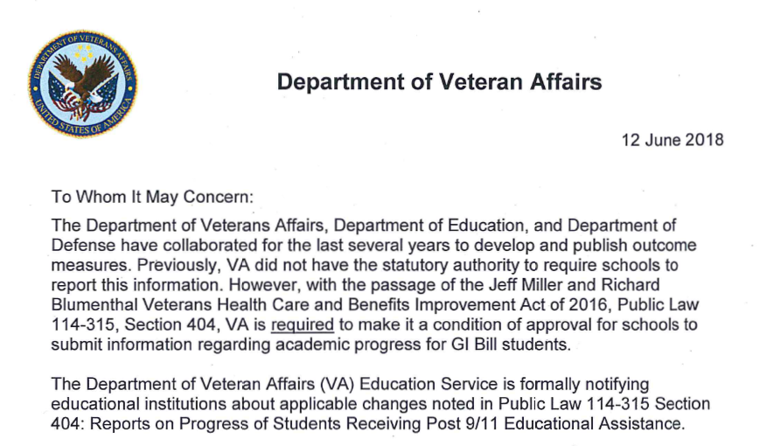
OTHER (Specify)
Example:
Reporting graduation or program completion information
Notes:
Reporting graduation/program completion information
VA letter dated 06/12/2018

Slide 73
OTHER (Specify)
Trademark Terms of Use – Authorized Use:
The term “GI Bill®” is a federally registered trademark owned by VA. Authorized third-parties users of the trademark are:
Educational institutions approved for GI Bill® benefits
State Approving Agencies
Recognized Veterans Service Organizations
GI Bill® is a registered trademark of the U.S. Department of Veterans Affairs (VA).
Notes:
GI BILL ® TRADEMARK
Authorized users may use the registered trademark ‘‘GI Bill’’ in print, electronic, radio, digital, or other media as established by the terms of use. The trademark symbol ‘‘®’’ should be placed at the upper right corner of the trademarked phrase in the most prominent place at first usage; such as the title of a brochure, form, or the very top of a Web page and the following trademark attribution notice must be prominently visible: ‘‘GI Bill® is a registered trademark of the U.S. Department of Veterans Affairs (VA).

Slide 74
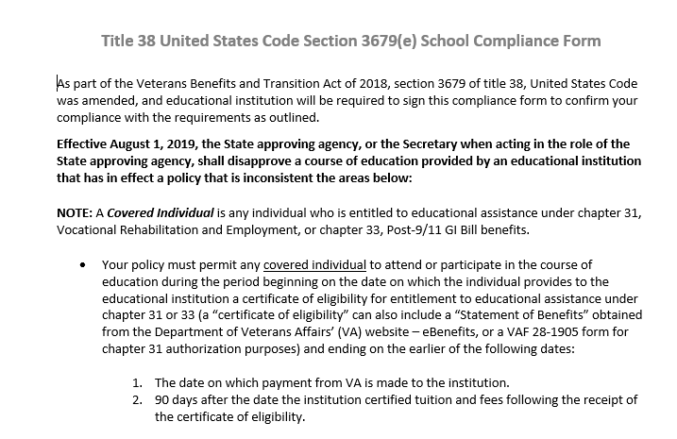
OTHER (Specify)
Verify compliance with PL 115-407 Sections 103 and 104
Effective August 1, 2019
Allow Individuals to Stay Enrolled in Courses of
Education Pending Receipt of Educational Assistance from VA
74
Notes:
Effective August 1, 2019, the State approving agency shall disapprove a course of education provided by an educational institution that has in effect a policy that is inconsistent with Sections 103 and 104:
Your policy must permit any covered individual to attend or participate in the course of education for a period of time without imposing a penalty.
The period of time begins on the date the individual provides the school a certificate of eligibility (or alternative eligibility documentation) and ends on the earlier of the following dates:
1. The date on which payment from VA is made to the institution.
2. 90 days after the date the institution certified tuition and fees following the receipt of the certificate of eligibility.

Slide 75
Exit Briefing

Slide 76
Exit Briefing
EXIT INTERVIEW
Conducted with Certifying Official and others as school or auditor sees fit
Results of the survey are discussed
Discuss discrepancies
Payment related discrepancies
Approval criteria discrepancies
Discrepancies that restrict enrollment
Provide general training and assistance
Corrective action will be discussed
VA will initiate
SCO will initiate
Notes:
Exit Briefing
Upon completion of the on-site survey, the surveyor will conduct an exit briefing with the Certifying Official. As a SCO, the exit interview can be a used as a helpful tool for you. Frequently, exit interviews will include other school officials.
Results of the survey are discussed:
Payment Issues
Corrective award action will be referred to the RPO
Initiated by Surveyor or School Certifying Official
Approval Issues
State Approving Agency jurisdiction
SAA will take action involving approval issues
If VA conducts the survey, approval related issues will be referred to the SAA. If SAA conducts the survey, they will take action and/or provide information as deemed appropriate.
Other Issues
ELR has jurisdiction of issues involving 85/15%
If WEAMS needs to be updated, the issue will be referred to ELR
General training and assistance will be provided

Slide 77
Common Errors
Common Errors
Type of Hours not Properly Certified (hybrid)
Inaccurate Term Dates
Inaccurate Tuition and Fees
Scholarships/Discounts
Enrollment Changes
Inappropriate Courses

Slide 78
Referrals

Slide 79
Referrals
Payment Issues
Corrective award action will be referred to the RPO
Initiated by Surveyor or School Certifying Official
Approval Issues
State Approving Agency jurisdiction
SAA will take action involving approval issues
Other Issues
ELR has jurisdiction of issues involving 85/15%
If WEAMS needs to be updated, the issue will be referred to ELR

Slide 80
Corrective Award Action
- VA/SAA Initiated - SCO Initiated
Corrections to education records for errors found during Compliance Surveys are accomplished through the use of either VA-ONCE or a referral memo that is prepared by the surveyor.
Notes:
Corrections to education records for errors found during Compliance Surveys are accomplished through the use of either VA-ONCE or a referral memo that is prepared by the surveyor.
Schools Using VA ONCE
The preferred method of submitting Compliance Survey Referrals for facilities using VA-ONCE is to request the school submit the correction through VA-ONCE. In some situations, the issues found during the survey may be of such a detailed or complex matter, the surveyor will need to submit the referral using a compliance survey referral template.
Schools That Do Not Use VA ONCE:
In instances where schools/institutions do not use VA-ONCE, or if the referral involves a complex issue, the surveyor should use the Compliance Survey Referral template.

Slide 81
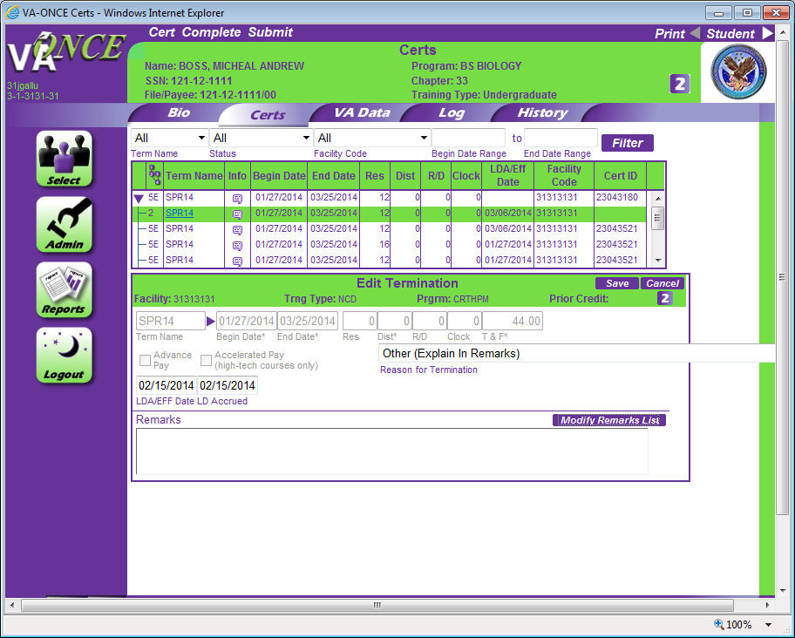
Corrective Award Action
- SCO Initiated
The surveyor will instruct and actively assist the SCO in submitting the appropriate corrections (e.g. amendment, adjustment, or termination) through VA-ONCE at the time of the compliance survey.

Slide 82
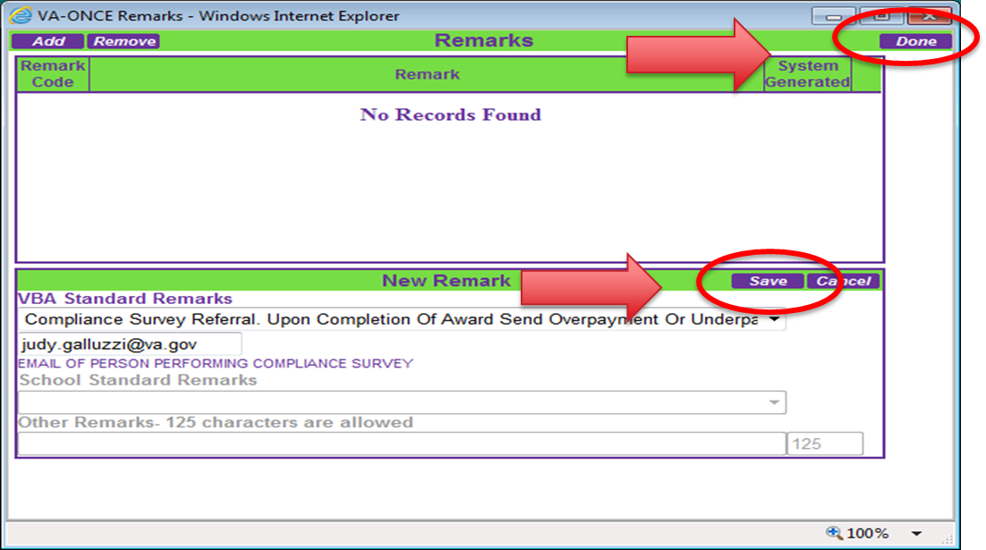
Corrective Award Action
- SCO Initiated
The VA-ONCE standard remark for these submissions reads:
“Compliance Survey Referral. Upon completion of award send overpayment or underpayment amounts to...” prompting the entry of contact information for the surveyor. This email address must be for the person controlling the response for the survey.

Slide 83
Corrective Award Action
- SCO Initiated
Submitting corrections in this manner does not eliminate the requirement to identify the error in the compliance survey narrative.
A copy of the referral submitted through VA-ONCE should be retained by the surveyor.

Slide 84
SAA Referrals (Sample Letter)
If discrepancies are found that involve approval criteria, the approval discrepancies will be referred to the SAA.
Notes:
All discrepancies involving approval criteria, must be reported to the State Approving Agency.
Refer the following specific types of discrepancies to the SAA (this list is not all inclusive):
Failure to maintain adequate records of prior education or training or to give appropriate credit.
Failure to maintain adequate records showing progress.
Evidence that the school is not financially sound or that it is using false or misleading advertising.
Indication that the quality of instruction is not adequate or up to standards of other similar schools.
Failure to enforce the approved policy relating to attendance, conduct, or progress.
Failure to follow the approved school calendar or approved attendance schedules.
Failure to make required refunds of tuition and fees, or charging tuition and fees in excess of those approved.
Failure to furnish a copy of the course outline, school policies, and similar material.
Failure to give certificates indicating satisfactory completion of a course.
Failure to adhere to enrollment limitations.

Slide 85
Correspondence to Facility

Slide 86
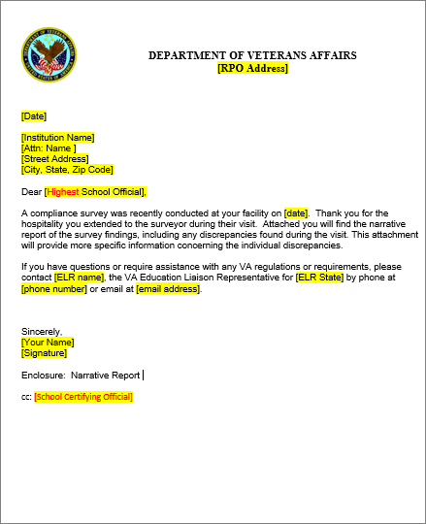
Correspondence to Facility
Findings Letter Identify student records reviewed Detail any discrepancies/findings Specify corrective actions (if any) required by the school or facility
Notes:
CORRESPONDENCE TO THE FACILITY. Correspondence to the school or training facility is always required to provide feedback as to the outcome of the Compliance Survey and confirm the discrepancies identified and any corrective action as necessary. The letter will typically be addressed to the school leadership with a courtesy copy to the School Certifying Official.
Many certifying officials find these letters to be a very helpful tool. For example, if the probable cause of the discrepancy was outside the Certifying Official’s control, the surveyor can provide the details in the letter.

Slide 87
You should be able to:
Define a Compliance Survey
State the purpose of a Compliance Survey
Identify how to prepare for a Compliance Survey
Describe what to expect during a Compliance Survey
Notes:
Instructor Notes:
[Slide Title – Summary.]
Pacing:
This section contains three slides
should take approximately 5 min (By the end of this section, you will be at 60min of 60min)
Review summary.
[Instruction or Discussion –]

Slide 88
Q & A
Notes:
Instructor Notes:
[Slide Title – Q&A.]
Pacing:
Open the floor for any final questions. If you are available after the presentation, let participants know you are around to speak with them.
[Instruction or Discussion – Thank you for being with me to learn about Compliance Surveys. Enjoy the rest of the conference.]

Slide 89
CONFERENCE/VIRTUAL TRAINING CREDIT PROCESS
ONE
TWO
THREE
FOUR
FIVE
1. ATTEND
2. RECORD
3. CERTIFY
4. PRINT
5. PROFILE
Attend a National, Regional, Local Conference or Workshop offering eligible SCO Annual Training. Training must be taught or co-taught with an ELR or VA staff member.
Record your attendance using the tracking method designated by presenter.
Go on the SCO Training Portal and certify each conference session you attended. By completing this form you are certifying that you attended this training in-person and documented your attendance at the conference training session.
Print your certificate and keep for your records.
Check your profile to make sure all of your online and conference credit is properly counted.

Slide 90
FY’22 Qualifying Training Topics – Existing SCOs
 | Existing SCO - Training Topics
1 | New School Certifying Official Training
2 | Advanced School Certifying Official Training
3 | Compliance Surveys
4 | Flight School Program at IHLs
5 | Certification Process for Non-College Degree (ND) Programs
6 | Education Programs and Benefits
7 | Program Approval and the State Approving Agency
8 | Yellow Ribbon
9 | Work-Study
10 | School Liability
11 | Debt Management Center
12 | 85/15 Rule
13 | VA-ONCE for Institutions of Higher Learning (IHLs)
14 | VA-ONCE for Non-College Degree (NCDs)

Slide 91
SCO Annual Training Requirement by Facility Type
New SCO Annual Training Requirements
Facility Type | Number of Training Modules Required
Institutions of Higher Learning (IHL) | 10
Non-College Degree (NCD) Programs | 10
High Schools and Residency Programs | 1
OJT/Apprenticeship Programs | 1
Vocational Flight | 1
Existing SCO Annual Training Requirements
Facility Type | Number of Training Modules Required
Institutions of Higher Learning (IHL) | 4
Institutions of Higher Learning (IHL) with Flight Courses | 4
Institutions of Higher Learning (IHL) with NCDs | 4
Non-College Degree (NCD) Programs | 4
Vocational Flight | 4
High Schools and Residency Programs | 1
OJT/Apprenticeship Programs | 1

Slide 92
FY22 SCO Annual Training Requirements
Please remember, if you don’t complete your annual training requirements, VA has the authority to remove your access from VA-ONCE and the SAA has the authority to disapprove your school’s programs
October 1, 2021
Annual Training Window Opened. Updated training requirements for all new SCOs and continuing education requirements for existing SCOs are effective
August 31, 2022
Annual Training Window Closes! Continuing education requirements for existing SCOs completed
September 1-30, 2022
Existing SCOs - No training in progress
June 1, 2022
July 1, 2022
August 1, 2022
August 15, 2022
60-Day Training Alert! Notifications and reminders of the approaching August 31st continuing education deadline will be posted on the GI Bill® website and sent to SCOs via Gov Delivery notice
90-Day Training Alert! 90-Day Notifications and reminders of the approaching August 31st continuing education deadline will be posted on the GI Bill® website and sent to SCOs via Gov Delivery notice
30-Day Training Alert! Notifications and reminders of the approaching August 31st continuing education deadline will be posted on the GI Bill® website and sent to SCOs via Gov Delivery notice
15-Day Training Alert! Notifications and reminders of the approaching August 31st continuing education deadline will be posted on the GI Bill® website and sent to SCOs via Gov Delivery notice
.
New SCOs – Training is continuous throughout the year

Slide 93
Thank you for your time today!

